Slide 1


Quarterly SUD Provider Meeting
Welcome!
We’ll get started at 12:05.
The meeting will be recorded and posted to the MSHN website afterwards.

Slide 2
Quarterly SUD Provider Meeting
March 20, 2025

Slide 3
Plenary Agenda
Joe Sedlock: Welcome & Regional Update
Access Updates
FY25 MSHN Regional Opioid Settlement Funds Update
Health Equity Work in the Current anti-DEI
Ecosystem

Slide 4
Welcome
&
MSHN General Remarks
Joe Sedlock
Chief Executive Officer

Slide 5
General Remarks
Regional Financial Position
MSHN continues to experience revenue shortfalls and to regionally operate in a significant deficit.
MSHN and its regional partners are taking all available actions to improve its financial positions.
There are no current plans that would impact our SUD prevention, treatment, and/or recovery providers or the SUD service array. MSHN has already announced, and plans to continue, a moratorium on new or expanded projects (except health homes and those that are already in progress).

Slide 6
General Remarks
PIHP Procurement
MDHHS publicly announced that all 10 PIHPs would be competitively procured prior to 10/01/26.
MDHHS has not released any related details, including future bidder eligibility or any other parameters.
MSHN is exploring all available avenues to participate successfully in the procurement process.
As factual, pertinent details are learned, these will be made available to our region.

Slide 7
General Remarks
PIHP Procurement
Given the uncertainty about what the procurement will entail, whether MSHN will be permitted to be a bidder, and if so, whether MSHN can be a successful bidder, and the myriad of other considerations, the MSHN Leadership Team must ensure best use of resources, which includes the time and talent of our provider partners, workforce members and very limited financial resources.
    MSHN is evaluating its ongoing operations, projects and initiatives using criteria its leadership has developed for continuation, suspension, modification, or termination.

Slide 8
General Remarks
PIHP Procurement (Continued)
Performance Matters! MSHN has a long history of achieving high levels of performance against established standards and benchmarks, of leading a variety of initiatives in our region and across the state and achieving positive outcomes in our operations and for beneficiaries and communities in our 21-county region.
  Our leadership team will encourage continued strong performance in all areas of operations and will continue to strive for excellence in all that the organization does, especially focusing on positive beneficiary and community impacts. The MSHN organization will continue to focus on its mission, vision, performance, quality, and compliance.
Relationships Matter! MSHN has a long history of effective collaboration and engagement with our MDHHS colleagues, with our CMHSP Participants, with our Provider Network, with other stakeholders, and with the communities within which we operate.
  Our leadership team will encourage continued effective collaboration and engagement across all areas of operations and will continue to create, develop, and maintain effective relationships with all stakeholders.

Slide 9
Access Implementation Update
Rusmira Betkas
Access Administrator

Slide 10
Access Implementation Update
Phone System
We are still in the process of identifying the right phone company to meet our organizational needs.
Due to the current phone system, there is inadequate data on call volume.
As a result, we are holding off on hiring decisions until more accurate data is available.

Slide 11
Access Implementation Update
Recovery Housing is now being managed strictly through REMI messages to streamline the process and improve communication.
Recovery Housing Referrals
As of 11/1/2024, the screening for recovery housing services was to be moved to MSHN Access. In order to assist people in a more efficient manner, MSHN is asking recovery housing providers to continue screening people seeking that service as they have done previously. Providers should send a REMI Message to Access that includes the following:
  Person's name
  Date of Birth
  Any recent treatment reported by the person
  Typical use pattern
  Last date of use
  Proposed admission date (we cannot complete the referral without this information)

Slide 12
Access Implementation Update continued...
MSHN staff will review and create a treatment episode with authorization for the date the person is expected to be admitted. REMI messages are secure and protected, so health information can be sent.
Click the envelope next to the 'Home' button in REMI which will open a new window. Select 'Compose a New Message' which will open another new window. Select the icon of 2 people, and it will open a drop-down menu for distribution lists. Select Access and send the requested information. MSHN will respond and notify the provider when/if a treatment episode and authorization are created.

Slide 13
Access Implementation Update
New After-Hours Service- Protocall
Protocall has been implemented as our new after-hours service provider.
This change will enhance after-hours access for our clients and ensure consistent service delivery.
We encountered some small challenges with Protocall, but these have been addressed and corrected.
All after-hours requests are thoroughly reviewed.
If follow-up is needed, requests are logged into Remi for proper tracking and response.

Slide 14
Access Implementation Update
Questions and Feedback
Questions?
Feedback:
  If you have any questions or require additional information in the meantime, please do not hesitate to reach out to us at access@midstahealthnetwork.org
  We encourage you to continue reviewing our Access page for the latest information. You can find the link here: MSHN Access

Slide 15
FY25 MSHN Region
Opioid Settlement Fund Update
Dr. Trisha Thrush, PhD., LMSW
Director of SUD Services & Operations

Slide 16
FY25 MSHN Region OSF Update
Listening sessions (virtual) held January 8th & 9th
  About 100 individuals attended and provided feedback!
OSF Proposal Request - Update
  MSHN received 25 proposals from providers in 17 of 21 counties across the region
    Proposal Requests Totaled: $1,185,016.28
    MDHHS Review of Allowable: $525,065
      Several proposals were referred to other MDHHS departments for inquiries for funding. MSHN has provided this information to providers in the OSF email communications provided.
  SUD Clinical has made contract recommendations to the March BOD for review and determination.
    Contracts would be for 4-1-2025 thru 9-30-2025. (Note: No carry forward requests will be approved. Funds must be spent before the end of the fiscal year.)
    The SUD Clinical team will provide an email with information of what was determined allowable/not allowable and the approved amount of funding, along with finance information related to FSR or invoicing.

Slide 17
Health Equity Work in the Current anti-DEI
Ecosystem
Dr. Dani Meier, PhD, MSW
Chief Clinical Officer

Slide 18

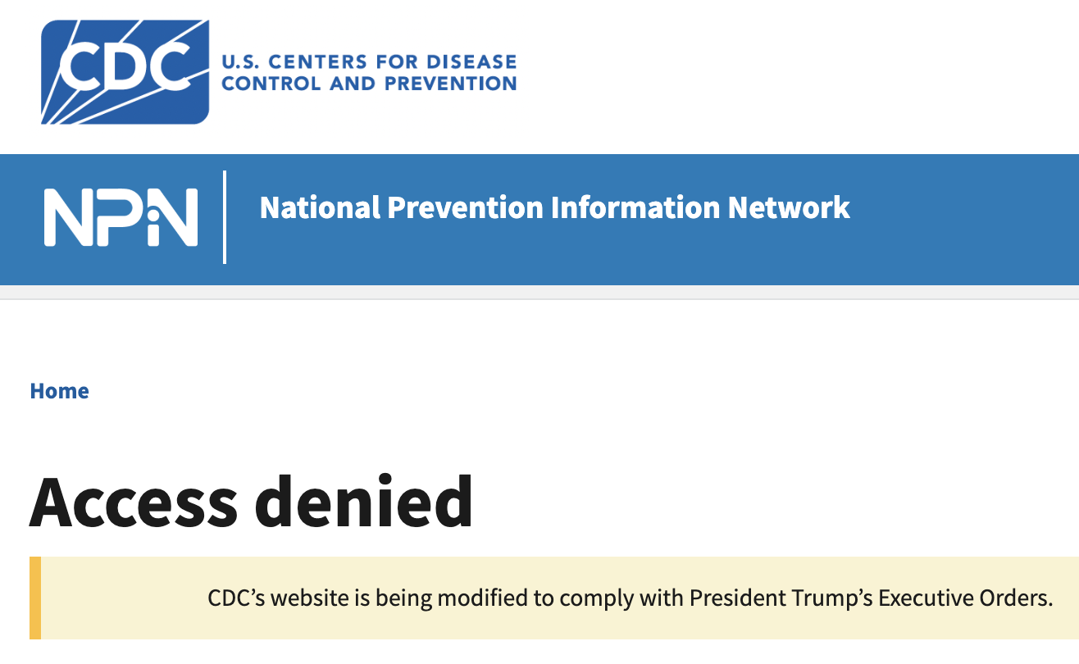
#1: Focus on the data
Click on images for links to data sources

Slide 19
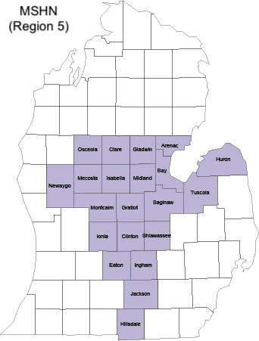
Use Michigan Data:
Region 5 OD Death Rate Disparities
Native American Region 5 residents have 3.4x the OD death rate among non-Hispanic White Region 5 residents.
Black Region 5 residents have 2.7x the OD death rate among non-Hispanic White Region 5 residents.
Hispanic Region 5 residents have 1.2x the OD death rate among non-Hispanic White Region 5 residents.
MODA Dashboard

Slide 20
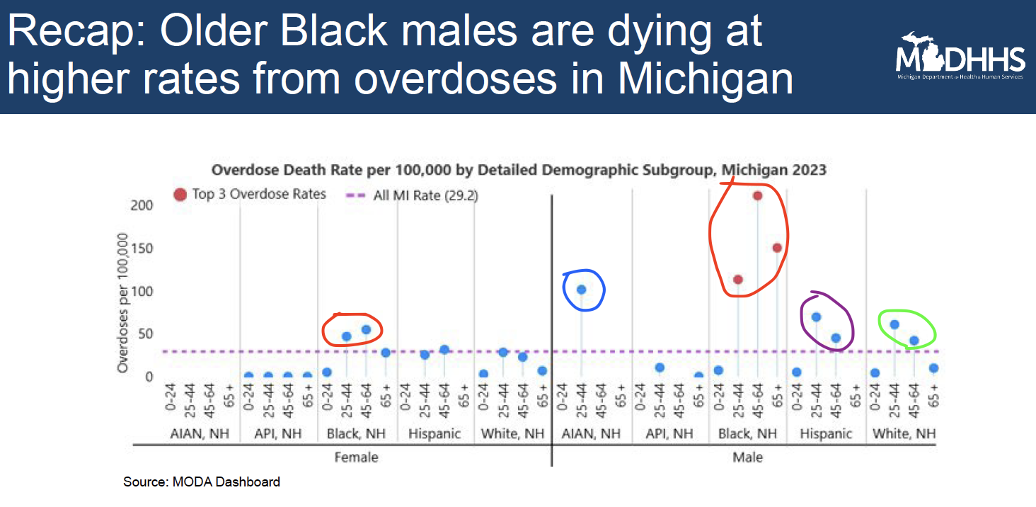
Use Michigan Data:
Region 5 OD Death Rate Disparities

Slide 21
#2. Identify Why Data Matters
“The vision of Mid-State Health Network is to continually improve the health of our communities ... [by tackling] the complex needs of the most vulnerable citizens in our region.”
From our perspective any vision of healthy communities must be inclusive of all residents of Region 5’s 21 counties.

Slide 22

#3: Follow Michigan Law
“The availability of federal funding has no bearing on Michiganders’ right to seek and receive healthcare services ... [and] does not relieve Michigan healthcare facilities and providers of the obligation to comply with Michigan laws, including those that prohibit discrimination against individuals based on their membership in a protected class, such as religion, race, color, national origin, age, sex, sexual orientation, gender identity or expression, or marital status.”
Click on image for links to source

Slide 23


#4: Be Aware & Respond:
Reframe Equity Activities
“Terminate ... all DEI, DEIA, and “environmental justice” offices and positions, all “equity action plans,” “equity” actions, initiatives, or programs, “equity-related” grants or contracts; and all DEI or DEIA performance requirements for employees, contractors, or grantees.
Click on image for link to data sources

Slide 24
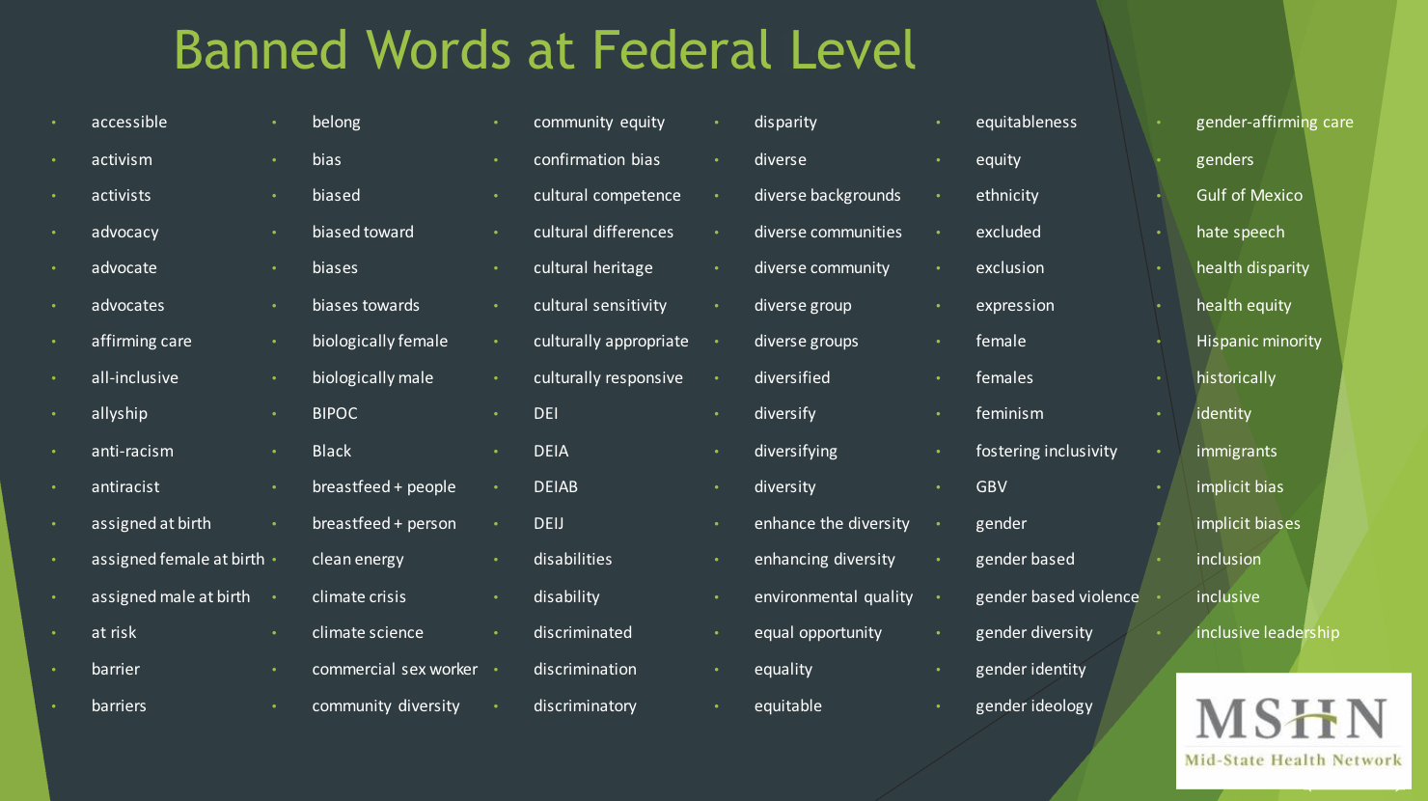

Slide 25
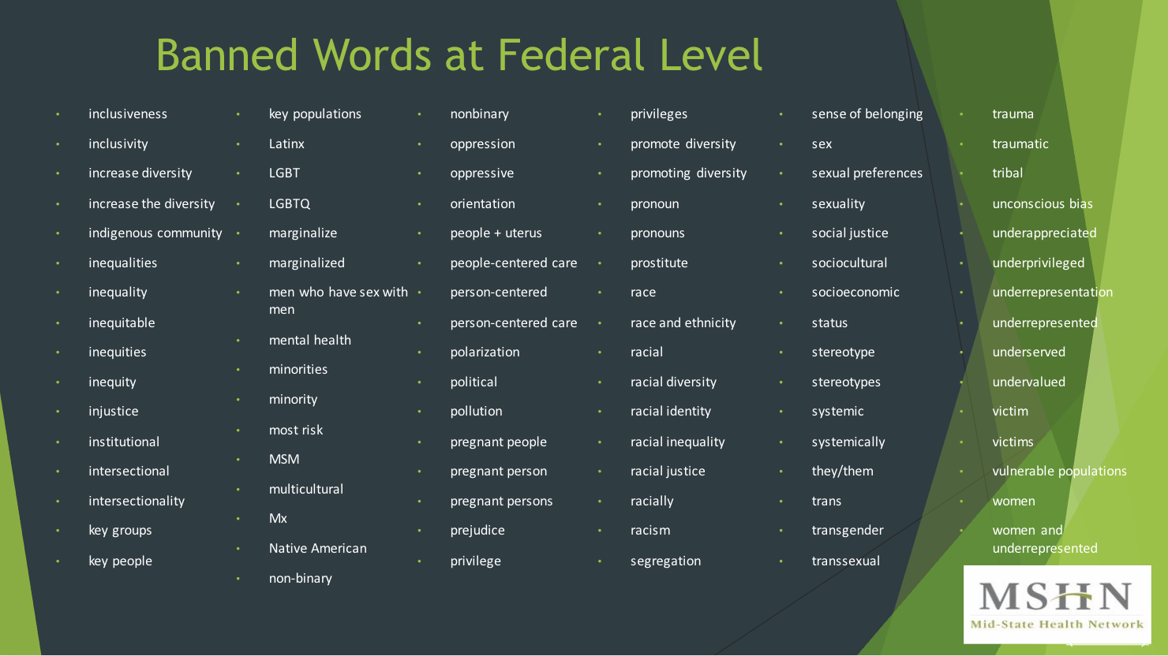

Slide 26
So, Moving Forward...
DATA is the foundation of our work. Use quantitative and qualitative (story-telling) data.
BE MISSION-DRIVEN: Is your mission to serve all members of your community? Focus on that.
STATE GUIDANCE: Follow the AG, MDHHS, etc.
REFRAME: Labels like DEI may put a target on your back.
REACH OUT: Don’t do it alone. Seek Allies among community members & stakeholders esp. those with lived experience.

Slide 27

Questions?
Lunch & Learn (3.6.2025)

Slide 28
Treatment Breakout

Slide 29
Treatment Breakout Agenda
MSHN SUD Data Updates
Community Health Worker Overview
Residential Core Hours
MDHHS Update to Treatment Policy #4
FY26 Annual Treatment & Recovery Planning Process Overview
FY25 Lunch & Learn Series
MSHN Hosted ASAM Criteria 4th Edition Trainings
Notes:
AMANDA
These are arranged by strengths and weaknesses (internal-looking), threats and opportunities (external-looking).

Slide 30
MSHN SUD Data Updates
Joseph Wager, MSW
Information Technology Project Manager

Slide 31
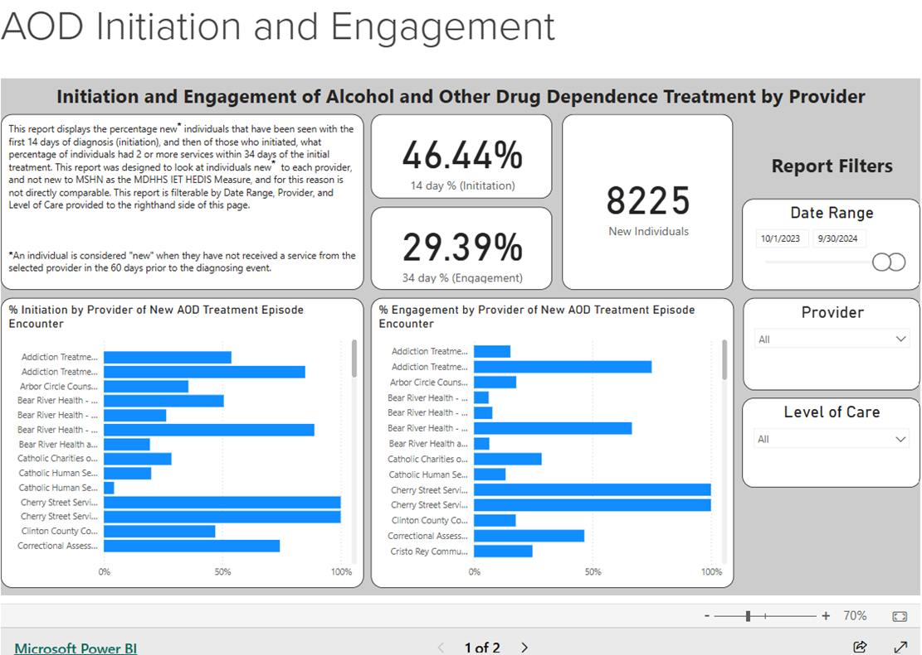
AOD Initiation and Engagement
MDHHS/HEDIS: Initiation and Engagement of Alcohol and Other Drug Abuse or Dependence Treatment (IET)
33

Slide 32
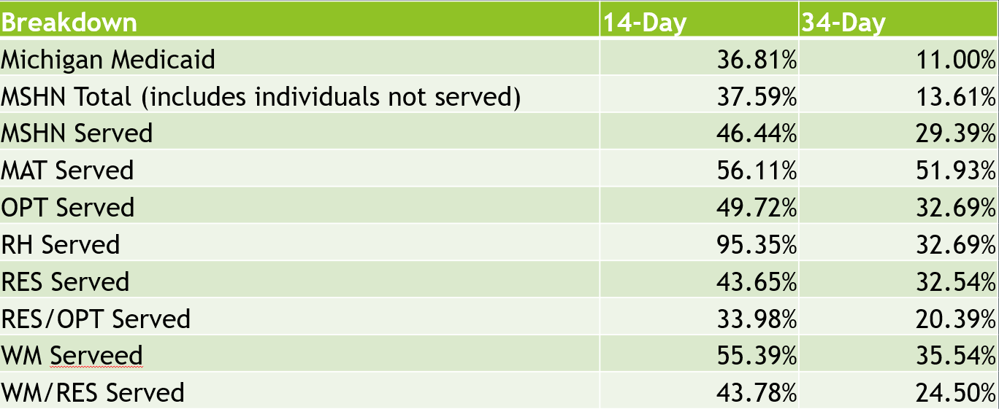
AOD Continued
Date Range: 10/1/2023 – 9/30/2024

Slide 33
Other MSHN SUD Reports:
SUD MMBPIS Indicator 4b
SUD Delegated Managed Care Review
SUD Withdrawal Management Readmission
SUD Residential Readmission and Follow Up
Primary Drug at SUD Admission
35

Slide 34
MSHN SUD Data Update
Questions?
Email further questions:
joseph.wager@midstatehealthnetwork.org

Slide 35
Community Health Worker
Overview
Katy Hammack, M.Ed., QIDP, QMHP
Integrated Healthcare Coordinator

Slide 36
Definition: Community Health Worker (CHW)
“A frontline public health worker who is a trusted member of and/or has an unusually close understanding of the community served. This trusting relationship enables the CHW to serve as a liaison/link/intermediary between health/social services and the community to facilitate access to services and improve the quality and cultural competence of service delivery. A CHW also builds individual and community capacity by increasing health knowledge and self-sufficiency through a range of activities such as outreach, community education, informal counseling, social support and advocacy.”
Source: American Public Health Association’s
Notes:
A community health worker (CHW) is a frontline public health worker who is a trusted member or has a particularly good understanding of the community served. A CHW serves as a liaison between health and social services and the community to facilitate access to services and to improve the quality and cultural competence of service delivery.- CDC
CHWs may be known by many titles in Michigan, which include, but are not limited to:
Certified Peer Support Specialist
Community Health Advocate Community
Outreach Worker
Community Neighborhood Navigator
Family Health Outreach Worker
Outreach and Enrollment Worker Community
Health Representative
Certified Peer Recovery Coach
Community Health Outreach Worker
Community Health Worker Early Intervention Services (EIS) Worker
Maternal Child Health Worker
Promotor
Source: Michigan Community Health Worker Alliance (MiCHWA): About CHWs (michwa.org)

Slide 37
CHW
Community Resources
System Navigation
Health Promotion and Education
Community Engagement
Partnership
Advocate
Notes:
What does a CHW do?
Connect beneficiaries to community resources
Assist with health system navigation
Help beneficiaries follow health recommendations
Provide coaching, social support, and culturally-appropriate health education
Advocate for individuals and communities
Build individual and community capacity
Provide direct service such as basic screening tests and basic services
Perform individual and community assessments
Build community partnerships, trust, and goodwill

Slide 38
Community Health Worker vs.
Peer Recovery Coach
Community Health Worker
Peer Recovery Coach
Work on a wide range of health issues, providing education and linking individuals to appropriate services.
Act as a bridge between the community and healthcare system, navigating individuals through complex healthcare processes
Key Skills: Cultural competency, Advocacy skills, Care coordination and system navigation, and Health education and promotion
Primarily focus on supporting individuals in recovery from SUD/MH by drawing on their own lived experience to provide guidance and mentorship.
Provide ongoing support and encouragement throughout the recovery process.
Key Skills: Relapse prevention strategies, Motivational interviewing, Building recovery support networks, and Sharing personal recovery experiences
Notes:
Community Health Workers (CHWs) and Peer Recovery Coaches (PRCs) are both professionals who support people in Michigan's recovery from substance use and mental health disorders. While CHWs focus on community health and wellness, while PRCs provide support based on their lived experience with addiction.
CHW work to connect individuals within a community to healthcare services and promoting overall health, while PRC specifically supports people in recovery from substance use disorders by drawing on their own lived experience to provide guidance and mentorship, acting as a personal guide through the recovery journey.
Essentially, a CHW is more broadly focused on health access while a Peer Recovery Coach is specifically focused on addiction recovery.
Community Health Worker (CHW)
Connects people with health and social services
Promotes community health and wellness
Provides outreach, social support, and community education
Has skills in advocacy, care coordination, and communication
Peer Recovery Coach (PRC)
Supports people in recovery from substance use and mental health disorders
Provides support based on their personal experience with addiction
Helps people create and maintain networks of support
Helps people reduce barriers and obstacles
Helps people practice harm reduction
Links people to resources in the recovery community

Slide 39
CHW Requirements
Must be 18 years of age
or older
Possess at least a high school diploma or high school equivalency diploma/certification
Must meet the CHW Training Program Pathway or the Work Experience Pathway
Has successfully completed a CHW application with the MDHHS designated contractor and must be listed in good standing on the MI Medicaid CHW Registry
Complete provider enrollment requirements detailed in the Provider Enrollment section of this policy.
Notes:
To qualify to deliver Medicaid reimbursable CHW services, an individual must meet the following criteria
Complete provider enrollment requirements detailed in the Provider Enrollment section of this policy
CHW Training Program Pathway To be recognized as a MI Medicaid certified CHW under the CHW Training Program Pathway, an individual must have completed an MDHHS-approved Community Health Worker training program that aligns with the Community Health Worker Core Consensus Project (C3 Project) core competencies.
Work Experience Pathway During the initial 24 months of the policy implementation (from January 1, 2024, to December 31, 2025), an individual who does not possess the CHW Training Program Pathway qualifications will be permitted to temporarily deliver CHW services and seek reimbursement if the individual meets the following criteria:
Has completed 1,000 hours of experiential learning in the previous three years; and
Has a plan for completing a CHW training program, as described above. A CHW certified through the Work Experience Pathway must complete their MDHHS approved CHW training program by December 31, 2025, to maintain their eligibility to continue delivery of CHW services for Medicaid reimbursement.

Slide 40
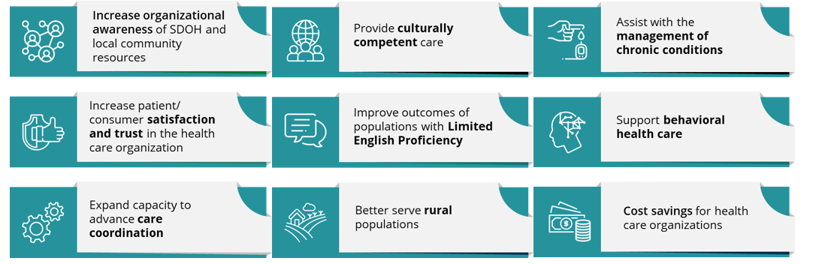
Potential Benefits of CHW Programs
Source: Centers for Medicare & Medicaid Services On the Front Lines of Health Equity: Community Health Workers (cms.gov)
Notes:
Community Health Workers (CHWs) offer numerous benefits, including improved health outcomes, increased access to healthcare, and enhanced community engagement, ultimately leading to a healthier and more equitable society.
Improved Health Outcomes:
Increased access to healthcare:
CHWs bridge the gap between healthcare providers and communities, ensuring that individuals, especially those in underserved areas, receive necessary services.
Improved health outcomes:
Studies have shown that CHWs can improve health outcomes in areas like child mortality, HIV care management, TB control, and more.
Enhanced maternal and child health:
CHWs play a crucial role in improving maternal and child health services, including expanding access to family planning and supporting the prevention and care of noncommunicable diseases.
Increased health screenings:
CHWs can increase community awareness and assist in cancer screening and follow-up, as well as enhancing acceptability.
Improved chronic disease management:
CHWs can support the prevention and care of noncommunicable diseases, such as diabetes and heart disease.
Enhanced Community Engagement:
Cultural competence:
CHWs understand the cultural nuances and challenges faced by their communities, making them ideal facilitators of health education and support.
Building trust:
CHWs serve as trusted figures within their communities, building trust in healthcare systems and promoting health-seeking behaviors.
Advocacy:
CHWs advocate for policies that improve health outcomes and address social determinants of health.
Community engagement:
CHWs actively engage with community members, identifying needs and developing culturally appropriate interventions.
Resource access:
CHWs help individuals access essential resources, such as transportation, medication, and social services.
Patient navigation:
CHWs help patients navigate the healthcare system, ensuring they receive timely and appropriate care.
Other Benefits:
Cost-effectiveness:
CHWs can be a cost-effective way to improve healthcare access and outcomes.
Increased workforce capacity:
CHWs can help address healthcare workforce shortages by providing essential services.
Improved continuity of care:
CHWs can help ensure continuity of care by conducting outreach and home visits, and providing follow-up care.
Family involvement:
CHWs can engage families in the healthcare process, promoting a holistic approach to health.
Reduced health disparities:
CHWs can help reduce health disparities by addressing social determinants of health and ensuring equitable access to care.

Slide 41

Covered Services
Covered Services CHW services must be provided face-to-face. CHW services should be provided in the language of the beneficiary’s choice when possible. CHW services available to beneficiaries include:
Health System Navigation and Resource Coordination
Health Promotion and Education
Notes:
Health System Navigation and Resource Coordination include providing information, training, referrals, or support to encourage beneficiary-led efforts to access covered services, understand, engage, or re-engage in the health care system, or engage in their own care needs. These services also work to connect beneficiaries to relevant community resources necessary to promote health, address health care barriers, or address health-related social needs.
The following are examples of Health System Navigation and Resource Coordination:
Helping to engage, re-engage, or ensure beneficiary-led follow-up in primary care; routine preventive care; adherence to treatment plans; and/or self-management of chronic conditions.
Helping a beneficiary find the appropriate Medicaid provider to receive a recommended covered service.
Helping a beneficiary make and keep an appointment for a Medicaid covered service.
Helping a beneficiary find and access other relevant community resources.
Helping a beneficiary with a telehealth appointment and/or educating a beneficiary on the use of telehealth technology.
Connecting a beneficiary to medical translation/interpretation or transportation services.
Serving as a cultural liaison or assisting a licensed health care provider to create a plan of care, as part of the health care team.
Health Promotion and Education is used to promote the beneficiary’s health or address barriers to physical and mental health care, including providing information, instruction, methods, and measures on health topics that have been proven effective in preventing disease, disability, and other health conditions or their progression; prolonging life; and/or promoting physical and mental health and efficiency. The content of health promotion and education must be consistent with established or recognized health care standards and best practices. Health promotion and education may include coaching and goal-setting to improve a beneficiary’s health or ability to self-manage health conditions.
The following are examples of Health Promotion and Education topics:
Addressing family violence/inter-partner violence
Control of certain health conditions (i.e., heart disease, high blood pressure, dental disease, etc.)
Diabetes prevention and control
Chronic disease self-management
Chronic pain self-management
Sexual and reproductive health
Improvement in safety and the environmental health of housing, (i.e., to mitigate asthma risk, risk of injury from unsafe housing, lead exposure, etc.)
Improvement in nutrition, physical and/or mental health
Promotion of preventative services, such as cancer screenings and immunizations
Reduction in the misuse of alcohol or drugs
Stress management and reduction
Services NOT covered:
Case management
Transportation services
Personal care services/Home help (including shopping and cooking meals)
Companion services
Employment services
Helping a beneficiary enroll in govmt or other assistance programs that aren’t related to improving their health
Delivery of medication, medical equipment, or medical supplies
Services that require a license
Respite care
Discharge planning
Community transitions
Support services covered under BH service programs by Certified Peer Supports or Certified Peer Recovery Coaches

Slide 42
Who Can Recommend CHW Services
As required by federal regulations at CFR 440.130(c), CHW services must be recommended by a licensed healthcare provider. Healthcare providers qualified to recommend CHW services include but are not limited to the following:
  Physician
  Physician Assistant
  Advanced Practice Registered Nurse
  Registered Nurse
  Licensed Master Social Worker
  Dentist
  Psychiatrist or Psychologist
Licensed healthcare providers recommending CHW services are not required to be part of the beneficiary’s healthcare team, but collaboration is highly encouraged.
Notes:
Conditions that may define a beneficiary's need for CHW services must be assessed utilizing an appropriate health risk and/or social determinant of health (SDOH) screening/assessment tool.
The conditions that may support the need for the CHW services include but are not limited to:
Diagnosis of one or more chronic health conditions including behavioral health;
Unmet health-related social need; or
Pregnancy and up to 12 months postpartum.

Slide 43
Reimbursement & Service Limitations
98960 - individual patient
98961 - 2-4 patients
98962 - 5-8 patients.
The group size may not exceed 8 patients.
CHW services are limited to 2 hours (8 units) per day and 16 visits per month, for a maximum of 32 hours (128 units) per month, per beneficiary. This limit may be exceeded based on medical necessity determined in collaboration with the recommended licensed provider and requires prior authorization.
There are no Place of Service restrictions for CHW services.
Code Available 4/1/25
Notes:
Effective on January 1, 2024, Michigan Medicaid began reimbursing for Community Health Worker (CHW) services provided to Medicaid beneficiaries.
Reimbursement Considerations and Billing Guidelines CHW services are to be reported as follows:
These codes are to be reported in 15-minute increments and must be billed with the CG modifier to be considered for payment.
One 15-minute increment equals one unit of service.
Service Limitations CHW services are limited to 2 hours (8 units) per day and 16 visits per month, for a maximum of 32 hours (128 units) per month, per beneficiary. This limit may be exceeded based on medical necessity determined in collaboration with the recommending licensed provider and requires prior authorization. Group services are limited to eight unique beneficiaries at one time. There are no Place of Service restrictions for CHW services.
Scope of Practice Limitation:
Never give medical advice
Never complete or participate in a medical procedure unless specifically trained to complete (i.e. blood pressure, finger stick blood sugar)
Analyze clinical data or making clinical decisions re: plan of care
Performing wound care
Do not provide therapy
Services NOT covered:
Case management
Transportation services
Personal care services/Home help (including shopping and cooking meals)
Companion services
Employment services
Helping a beneficiary enroll in govmt or other assistance programs that aren’t related to improving their health
Delivery of medication, medical equipment, or medical supplies
Services that require a license
Respite care
Discharge planning
Community transitions
Support services covered under BH service programs by Certified Peer Supports or Certified Peer Recovery Coaches

Slide 44
MDHHS CHW Community Feedback Forum (CHW-CFF)
The CHW-CFF brings together community members, as well as state and local community partners to provide input on policy and program recommendations to support the CHW workforce in Michigan.
The next CHW-CFF meeting is scheduled for: May 13, 2025, from 10:00-11:30 AM
If you would like to attend, please register below:
  CHW Community Feedback Forum Meeting #4 Registration
Notes:
To support recommendations under the ‘engagement’ priority, the MDHHS Policy and Planning SDOH team convened a CHW Community Feedback Forum (CHW-CFF) in August 2023.
It will provide relevant and diverse perspectives informing recommendations to support and sustain the CHW workforce in Michigan, while promoting awareness of CHWs and their integral role in improving health and equity.

Slide 45

Questions?
To learn more, visit the Michigan Medicaid CHW Policy website
Also view MDHHS MI Medicaid Policy 23-74 Bulletin

Slide 46
Residential Core Hours:
Peer Coaching Groups
Kate Flavin
Treatment Administrator

Slide 47
Clarification Update
If a peer is providing education on relapse prevention, relapse triggers, and sometimes coping skills, it can be considered part of core service hours as a group function, as it falls under the Interactive Education/Counseling area.
Individual, or one-on-one, meetings with a peer would NOT count toward core hours as it is considered building recovery capital, which is not a covered core service.
  Building recovery capital is considered part of the Milieu/Environment per the Covered Services Grid in Treatment Policy #10.

Slide 48
MDHHS Update to
Treatment Policy #4:
Off-site Dosing & Extranet Use Requirements
Kate Flavin
Treatment Administrator

Slide 49
Treatment Policy #4 Updates:
Effective: February 1, 2025
Updates highlight a shift towards a more personalized and flexible approach to treatment while ensuring safety and compliance with regulations.
  Individualized Considerations for Off-Site Dosing
  Use of Updated Regulatory Language
  Focus on Comprehensive Treatment
  Emergency Considerations
  Policy Compliance and Exception Requests

Slide 50
Treatment Policy #4 Updates:
Dosing Restrictions: do not apply to buprenorphine and buprenorphine products
  During First 14 Days:
    Take home supply limited to 7 days
  After 15 Days:
    Take home supply limited to 14 days
  After 31 Days:
    Take home supply limited to 28 days
The # of take-home doses is within the OTP prescriber’s discretion but must be based on the take-home criteria. The rationale for the decision must be documented in the person's clinical record.

Slide 51
Treatment Policy #4 Updates:
While the language in Treatment Policy #5 states an individual attend dosing daily initially, it also states "off-site dosing must be in compliance with the current Michigan Department of Health & Human Services (MDHHS) Treatment Policy #4."
MDHHS is in the process of updating Treatment Policy #5 so that it will reflect the changes to 42 CFR Part 8. If there are conflicts in language between policy #5 and CFR, CFR is the rule to follow.

Slide 52
FY26 SUD Treatment & Recovery
Annual Planning Process
Kate Flavin
Treatment Administrator

Slide 53
Purpose
Annual plan meetings provide MSHN Treatment Specialists with the opportunity to:
  Discuss your agency’s goals for the upcoming fiscal year
  Provide an opportunity for the provider to share successes or innovative ideas
  Hear about challenges and support needs
  Opportunities for technical assistance
  Support relationship building between the provider and MSHN
Annual Plans are completed during a collaborative meeting between the provider agency and the treatment specialists who support the agency.
Some meetings may also be attended by the MSHN team members from UM, Access, & Integrated Care.

Slide 54
Process
  The agency’s lead treatment specialist will reach out and provide FY26 annual plan documents and information individualized to each agency.
    Information was sent to all providers the week of March 10-14, 2025
  Meetings will be completed virtually using the Zoom platform.
  MSHN is requesting providers review and complete the annual plan document prior to the scheduled meeting date/time.
    Note: There is a NEW tab for Access information this year. This should also be completed prior to the meeting.
  Please review the annual plan documents and be prepared to discuss the items applicable to your agency.
  Please be prepared to share progress on the Trauma Informed Care goals identified during the FY25 annual plan process, as well as what the agency's goals will be for FY26.
  Please ensure agency staff who are knowledgeable about annual plan topics are in attendance for the annual plan meeting.

Slide 55
Annual Plan Content
  Instructions
  Annual Plan Update
  Content Specific Areas:
    Recovery Housing
    Women’s Specialty Services
    Residential and Withdrawal Management
  Access Info

Slide 56
Timeframe
  March
    Provider will receive an email with link to Box with FY26 annual plan documents and request dates and times they are available to meet.
    Treatment Specialist will schedule annual plan meeting and provide a Zoom meeting invite.
  April-May
    Annual Plan meetings will take place. Plan for 2-3 hours for this interaction.
    Annual Plans will be finalized in Box for each provider.
    All Cost Reimbursed providers should have their finance/budget person attend the May 8th 12-1p Lunch & Learn on Budget Preparation. Info available in the Constant Contact weekly.

Slide 57
Timeframe Continued
  June
    Cost Reimbursed budget requests are due by COB 6/2/2025.
    Please email budgets to Trisha Thrush at trisha.thrush@midstatehealthnetwork.org
    Please submit budget(s) early if they are prepared.
    Cost reimbursed budgets will be reviewed.
    Questions regarding the budgets will be shared with the provider.
  July
    Treatment Team makes FY26 contract recommendations.

Slide 58
Timeframe Continued
    August
      FY26 contract recommendations supported by PA2 funding go before Oversight Policy Board (OPB) for review and approval/denial.
      Items approved will move to MSHN Board of Directors (BOD) for final review of approval/denial.
      September
        FY26 contract recommendations go before MSHN Board of Directors (BOD)
        If approved, MSHN Contract Specialist, Kyle Jaskulka, will send contracts to providers.
        If denied, MSHN treatment specialist would be in contact and follow-up.

Slide 59
Questions?

Slide 60
FY25 Lunch & Learn Series
Sherrie Donnelly
Treatment & Recovery Specialist

Slide 61
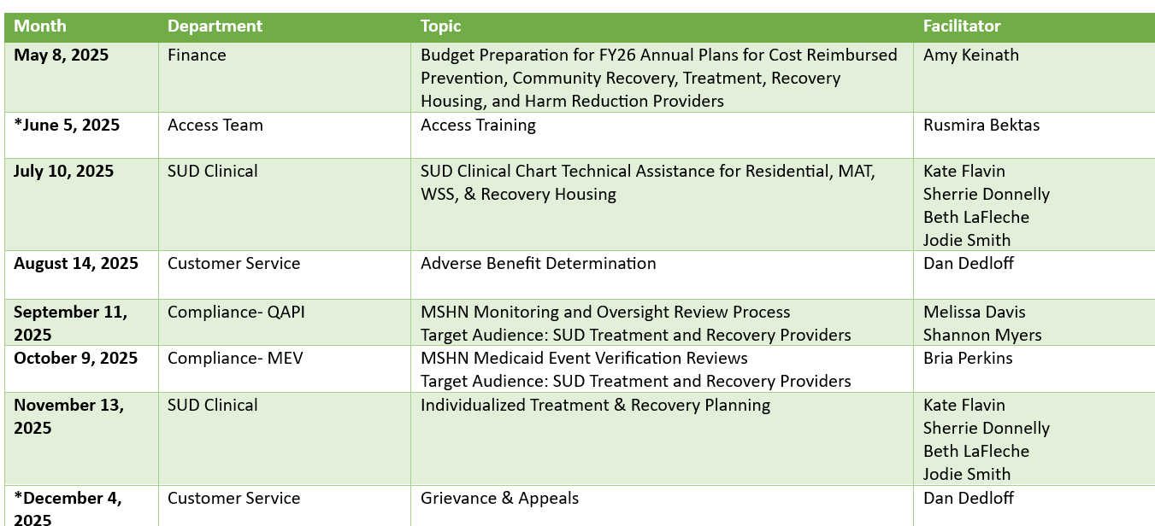
FY25 Lunch & Learn Series: Schedule
All Sessions 12-1pm
Join Zoom Meeting: https://us02web.zoom.us/j/3125295892
Meeting ID: 312 529 5892
Provider Trainings - Lunch and Learn Training Series are available on the MSHN website.

Slide 62
MSHN Hosted ASAM Criteria 4th Edition Trainings for FY25
Kate Flavin
Treatment Administrator

Slide 63
MSHN – ASAM Criteria 4th Edition Trainings
MSHN is providing 10 ASAM Criteria 4th Edition Trainings for contracted SUD Treatment providers.
Coordinated by CMHAM with a $50 registration fee.
Everyone who registers and completes the training will receive an ASAM Criteria 4th edition manual.
CMHAM has opened the registration information for all 10 trainings.
Note: MSHN will be evaluating the need to add additional trainings based on registration for the planned 10. So please have your team members register early.

Slide 64
MSHN – ASAM Criteria 4th Edition Trainings, cont.
MSHN will be giving priority to contracted SUD Providers for registration.
  Please register no later than April 30, 2025.
If there are remaining spots for registration, MSHN will open registration to CMHSPs in our region.
  Note: For CMHSPs with an SUD contract directly with MSHN, you are able to register now.
  **Reach out to your MSHN Treatment Specialist with any questions.

Slide 65
MSHN – ASAM Criteria 4th Edition Trainings
Virtual Training Dates
In-Person Training Dates
May 1-2
May 6-7
June 4-5
June 23-24
July 7-8
July 15-16
August 5-6
June 16-17 – Bay City
July 22-23 - Lansing
August 12-13 – Mt. Pleasant

Slide 66
Questions?

Slide 67
Quarterly SUD Provider Meeting
Prevention Breakout
March 20, 2025
FY26 Annual Plans
MPDS Update
FY25 AHR Reporting
Prevention Conference Update
Notes:
AMANDA
These are arranged by strengths and weaknesses (internal-looking), threats and opportunities (external-looking).
viewed as a highly collaborative in region and with external partners, and a statewide leader in reciprocity. MSHN is known to “listen” to the needs of region and incorporate network feedback into services and operations. MSHN is a trailblazer in new state waiver initiatives, for example: HCBS, Autism, Influence, leading to systems change. MSHN has operationalized innovation when developing programs like the Mobile Care Unit.

Slide 68
FY26 Annual Plans
Plan templates were sent out March 10 with a return date of June 2
The required Direct Service hours will remain the same for FY26
  600 hours per 1 FTE
  20%, or 120 hours, may be included on AHR (480 in MPDS)
Templates are the same as FY25. Please be sure to fill in the yellow highlighted cells, or your plan will be returned
Please use the template we send you and do not make additions or use a previous year template
Please do not convert these to pdf documents when you return them to us
Notes:
AMANDA
These are arranged by strengths and weaknesses (internal-looking), threats and opportunities (external-looking).

Slide 69
FY25 Annual Plans
Budgets may have necessary and appropriate increases related to programming/staffing, but increases are not guaranteed at this point
Budget Preparation for FY26 Annual Plans Lunch and Learn
  May 8, 2025 from 12-1 via Zoom
  Join Zoom Meeting:
  https://us02web.zoom.us/j/3125295892
  Meeting ID: 312 529 5892
Notes:
AMANDA
These are arranged by strengths and weaknesses (internal-looking), threats and opportunities (external-looking).

Slide 70
MPDS Update
Hope to begin training very soon
Looks very much like the previous site, so should be an easy transition
Back-data entry for FY25 will need to be completed by the end of the fiscal year
Notes:
AMANDA
These are arranged by strengths and weaknesses (internal-looking), threats and opportunities (external-looking).

Slide 71
MPDS Update
Q2 data aggregation
  January – March
  Submit reports to your MSHN lead as an excel sheet only
  Ensure that data is entered in the appropriate cell and not shifted a line above or below or a row to the right or left
  Reports are due by the 10th of the month following services
  You can add rows and columns that will help with entering data, but do not omit any from the template

Slide 72
Direct and Indirect Activities
MPDS Direct Service:
Captures direct face-to-face or virtual staff activities to a targeted population.
NOT a Direct Service:
These indirect activities may be captured on the Additional Hours Report.
Botvin, Prime for Life, Anger Mgmt, EBP’s
  Must follow fidelity
Assessments and Screenings for referral
Meetings with stakeholders outside your org
Vendor Ed, Compliance Checks, training DYTURs
Coalition Collaboration/Attendance
Travel:
  MSHN allows for entry of ½ of travel time
Training attendance
Program Evaluations
  Scoring pre/post tests, summarizing findings
Population Based:
  Developing coalition agendas, minutes, materials
  Developing media campaigns
  Filling Harm Reduction distribution boxes

Slide 73
FY24 Additional Hours Report (AHR)
First half of the year is due 4/11/25 to your MSHN Prevention Specialist
The AHR collects indirect hours
  See previous slide
  Details of what can be included are on the second tab- Report Instructions
Notes:
AMANDA
These are arranged by strengths and weaknesses (internal-looking), threats and opportunities (external-looking).

Slide 74
Prevention Conference Update
Get ready for a Prevention Red Carpet May 5-6 in Frankenmuth!
Registration was sent out on March 11
Open to MSHN-region providers and coalition members
Notes:
AMANDA
These are arranged by strengths and weaknesses (internal-looking), threats and opportunities (external-looking).

Slide 75
Questions?
cari.patrick@midstatehealthnetwork.org
sarah.surna@midstatehealthnetwork.org
sarah.andreotti@midstatehealthnetwork.org
Notes:
AMANDA
These are arranged by strengths and weaknesses (internal-looking), threats and opportunities (external-looking).

Slide 76
Upcoming Quarterly SUD Provider Meetings for FY25
June 26, 2025
September 18, 2025
December 18, 2025

