Slide 1
BUPE: An Innovative Tool for Managing Opioid Use Disorders in Emergency Departments
Presentation from the National Rx Summit April 2019
Rebecca Emmenecker
MSHN Treatment Specialist

Slide 2
Why support Buprenorphine in the ED….
ED physicians are in a unique position to interact with people with OUD.
These same people are often seen multiple times in the ED.
Often seen for Naloxone to reverse an OD.
Research indicates positive outcomes with the initiation of medication in the ED for OUD.
A 2015 study (JAMA) found that twice as many patients were in OUD treatment at 30 days when the ED initiated Buprenorphine.
The opioid epidemic is strongly impacting ED’s.
Since 2002, ED physicians can administer buprenorphine in the ED for opioid withdrawal.

Slide 3
BUPE: Buprenorphine Use in the Emergency Department Tool
Developed by two emergency department physicians for physicians use in implementing Buprenorphine with patients in the ED.
Eric Ketcham, MD, MBA, FACEP, FASAM
Shawn Ryan, MD, MBA, ABEM, ABAM
“App” or Application for smartphones from Google Play, Apple, and found on the internet (https://www.acep.org/patient-care/bupe/)

Slide 4
Data to Support Use of BUPE in Emergency Departments
Emergency Department visits related to opioids have been climbing for years and continue to do so.
Only 3 of 10 patients who had an overdose received MAT in the year following the overdose.
Patients who don’t receive MAT have a much higher mortality rate when compared to patients receiving MAT:
Untreated patients with OUD have at Year 1:
Greater than 2.5 times all cause mortality
Greater than 8 times overdose mortality

Slide 5
3 Key Steps for ED’s with OUD
Identify
Screening in the ED should be accurate, reliable, and easy/quick to administer.
Manage
Refer (or Admit)

Slide 6
Objectives of BUPE App
Bring the fundamentals of treating OUD with buprenorphine into the hands of the ED Doc’s at the bedside.
Convenience
Ease of Navigation
Complete Reference
Overcome Resistance
Build Confidence

Slide 7
Objectives of BUPE App – Continued…
Begin Prescribing
Utilize Naloxone
Provide Linkage to Treatment
Educate on Rules & Regulations

Slide 8
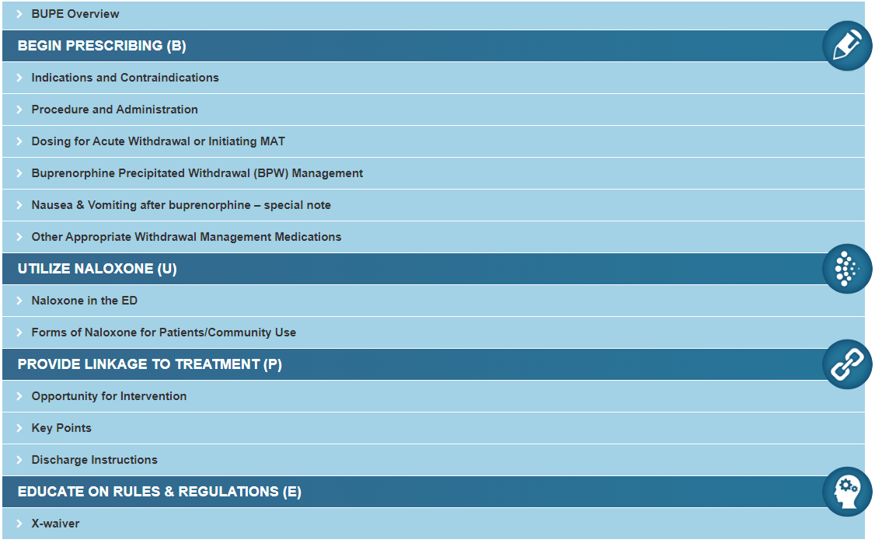

Slide 9
BUPE Overview

Slide 10
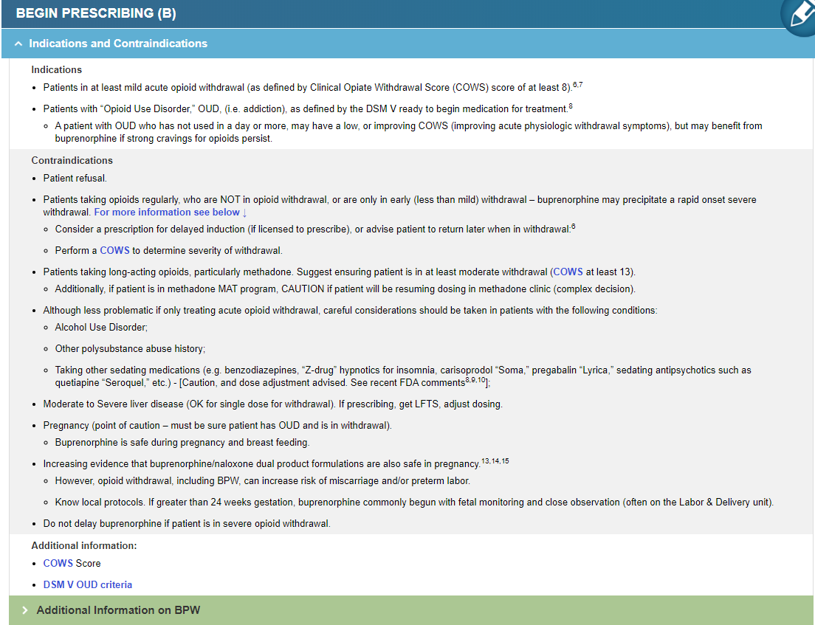

Slide 13
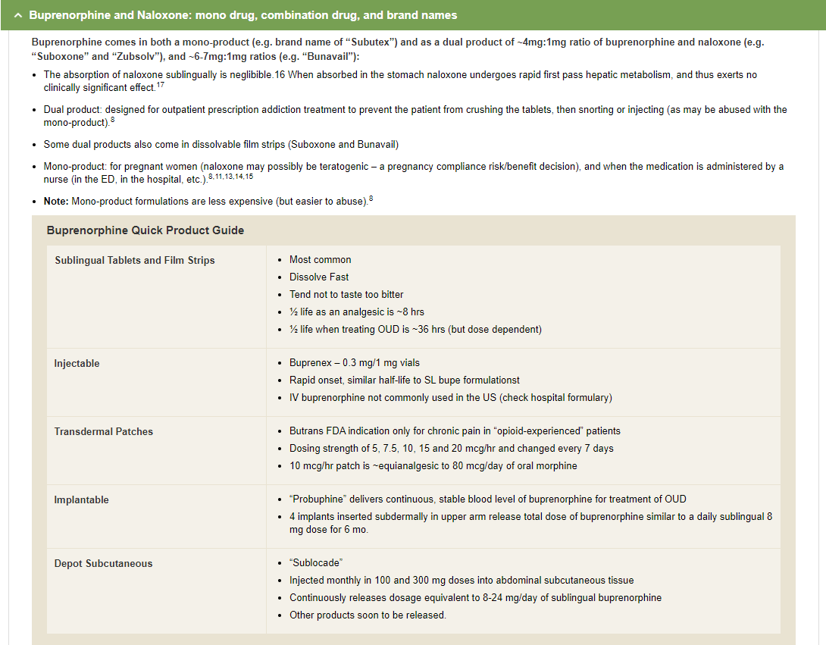

Slide 14
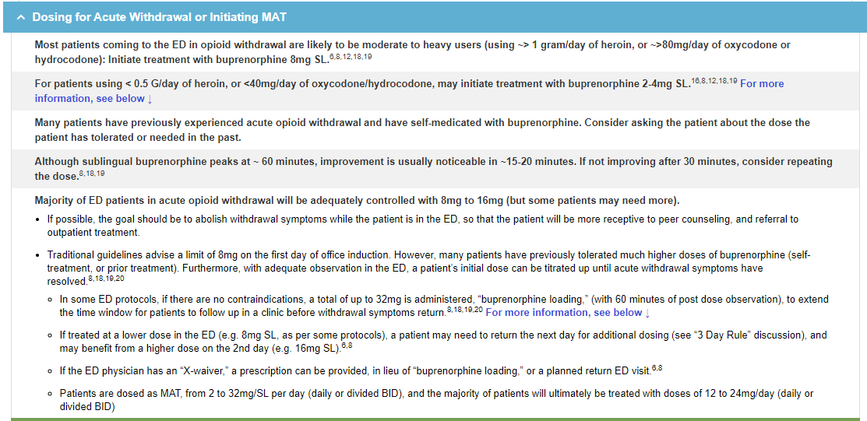

Slide 16
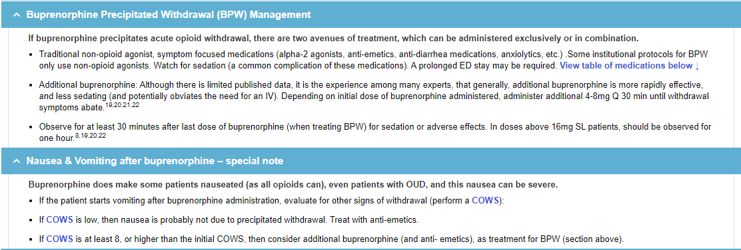

Slide 17
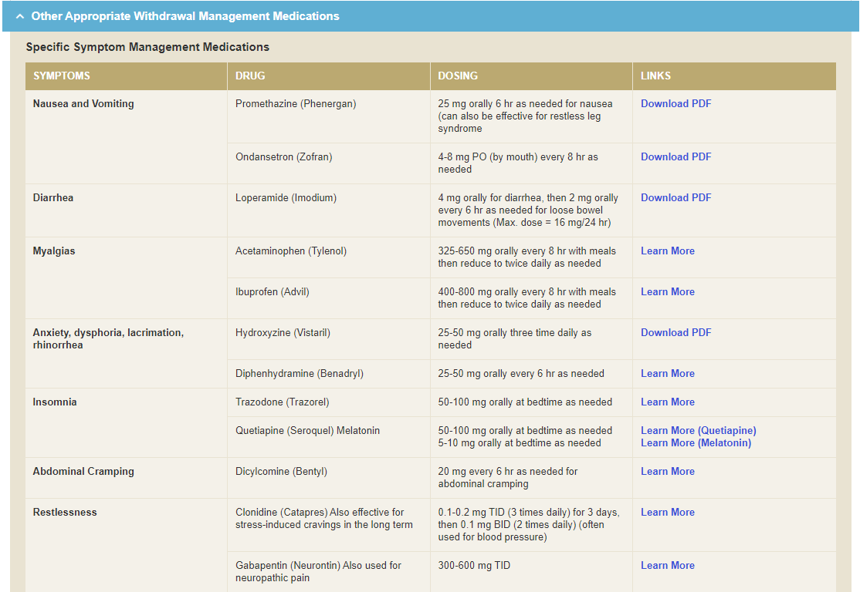

Slide 21
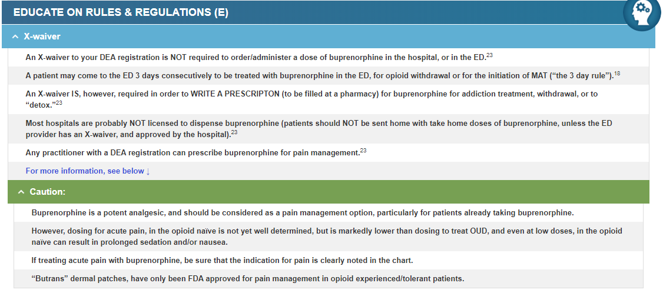

Slide 22
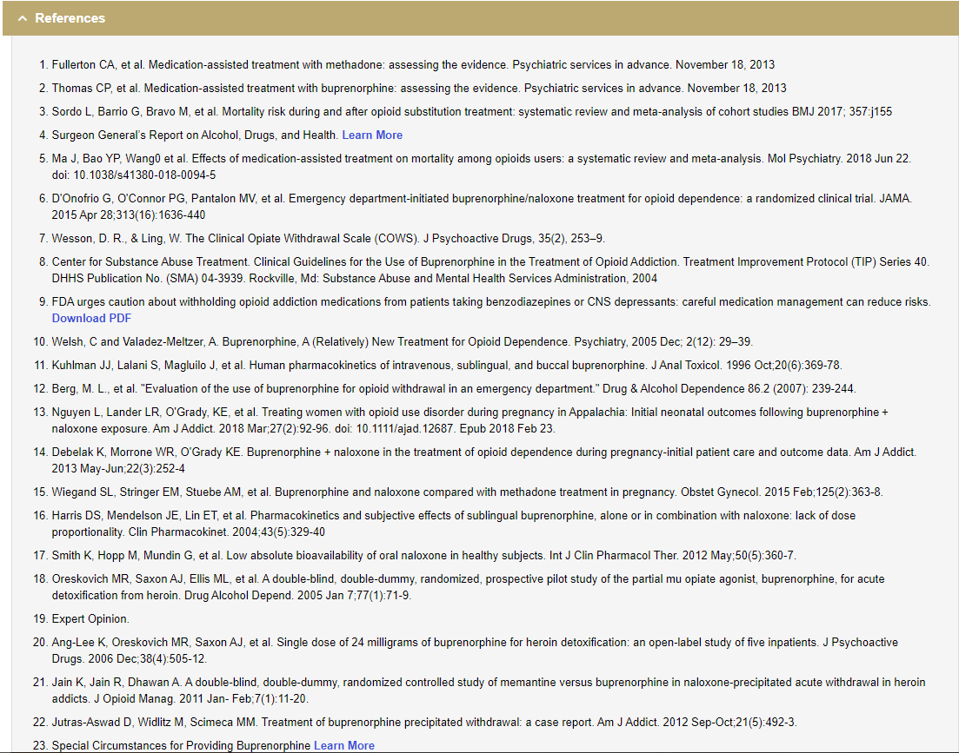

Slide 23
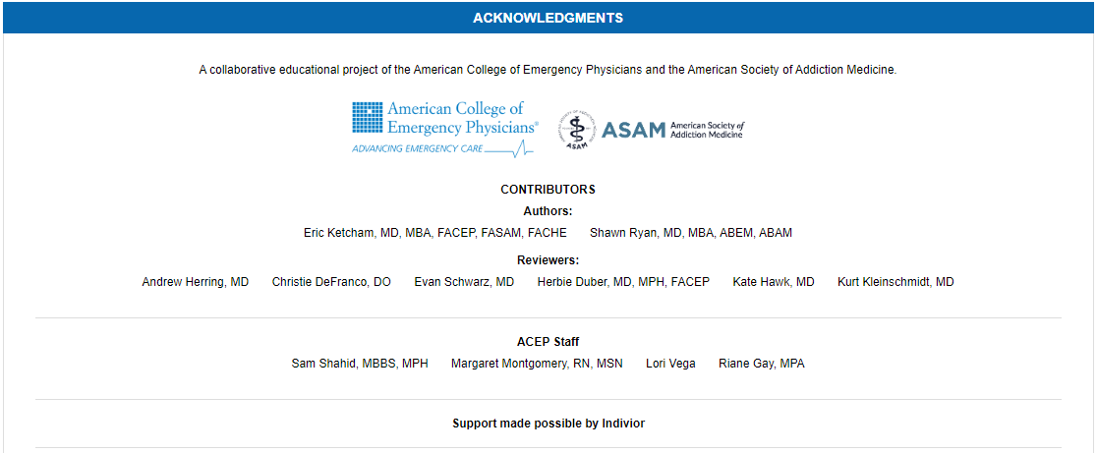

Slide 24
Questions?

