Slide 1

Medication Assisted Treatment for Opioid Use Disorder: Myths and Facts
Audrey Hazelbaker, LMSW

Slide 2



Michigan Opioid Collaborative is funded by:
Michigan Department of Health and Human Services
Substance Abuse and Mental Health Services Administration

Slide 3
Predictable
Chronic
Brain Disease
ADDICTION
NOT a moral
failing
Notes:
The thing that I want you to walk away with from our time today is that addiction is a predictable, chronic brain disease – not a moral failing.

Slide 4
What is Addiction
As defined by the American Society of Addiction Medicine (ASAM),addiction is “a primary, chronic disease of brain reward, motivation, memory, and related circuitry”
It is characterized by inability to consistently abstain, impairment in behavioral control, craving, diminished recognition of significant problems with one’s behaviors and interpersonal relationships, and a dysfunctional emotional response.
Like other chronic diseases, addiction often involves cycles of relapse and remission

Slide 5
DSM-5 diagnosis of opioid use disorder
Use in larger amounts/longer periods than intended
Unsuccessful efforts to cut down
Excessive time spent taking drug
Failure to fulfill major obligations
Continued use despite problems
Important activities given up
Recurrent use in physically hazardous situations
Continued use despite social consequences
Craving
Tolerance*
Withdrawal*
*This is not considered to be met for those taking opioids solely under appropriate medical supervision.
Mild: 2-3
Moderate: 4-5
Severe: 6 or more
Notes:
Symptoms are behaviors
Tolerance- needing larger amounts of drug to get same euphoric effect
Withdrawal- irritability, rhinorrhea, lacrimation, myalgias, arthralgias, N/V/D, abdominal pain, INSOMNIA

Slide 6
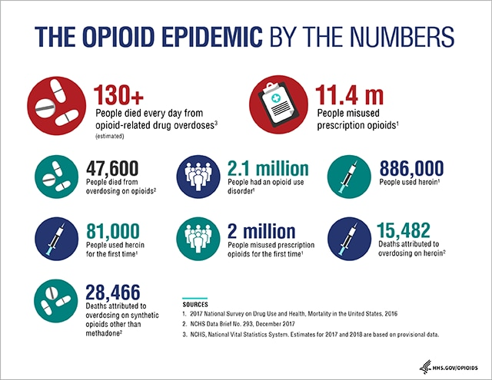
We have an opioid epidemic

Slide 7
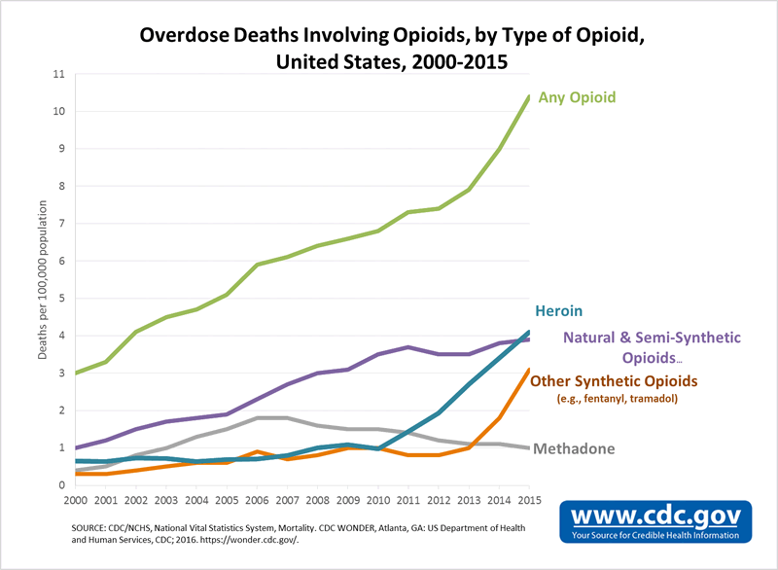

Slide 8
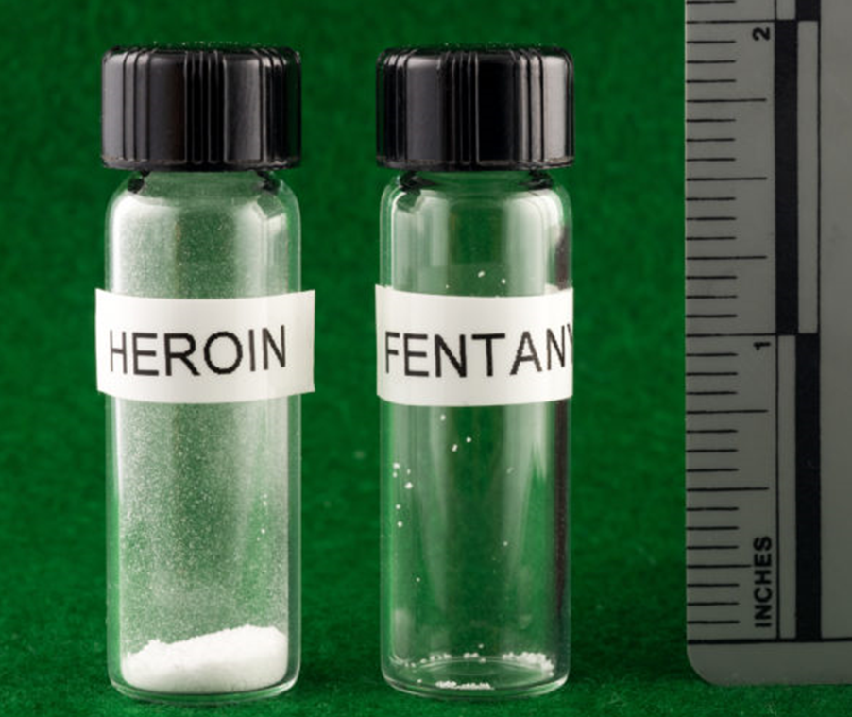

Slide 9
What is Medication Assisted Treatment (MAT)
These medications help reduce cravings and withdrawal symptoms that come from stopping opioid use. The medications approved for MAT are methadone, buprenorphine, and naltrexone
The goal of medication-assisted treatment is to recover from addiction. It does NOT replace one addictive drug with another. It provides a safe, controlled level of medication to overcome the use of a problem opioid
Research shows that when people include a medication prescribed to treat opioid use disorder as part of their recovery plan, their chances of success increase

Slide 10
What are the barriers to treatment?
Lack of providers in many areas
Stigma
Complexities of addiction
(Rosenblatt 2015)
Notes:
Rebecca Haffajee’s current unpublished work updates this for bup, methadone, naltrexone and looks unmet treatment need (counties w/ high overdose but low treatment) and characteristics associaqtedw tih those counties -> many are rural

Slide 11
Stigma
Stigma is defined as a mark of disgrace or infamy, a stain or reproach, as on one's reputation
Substance use disorders are some of the most stigmatized conditions
There is often a perceived fault with substance use disorder as well as perceived control about the condition
This stigma can lead to individuals being less likely to seek help or dropping out of treatment early

Slide 12
Types of stigma
Stigma from within
  Blame self, feel hopeless
Stigma from recovery community
  Medications versus “abstinence”
Stigma from clinicians
  Belief that treatment is ineffective
Stigma from outside
  Choice versus disease (moral failing)

Slide 13
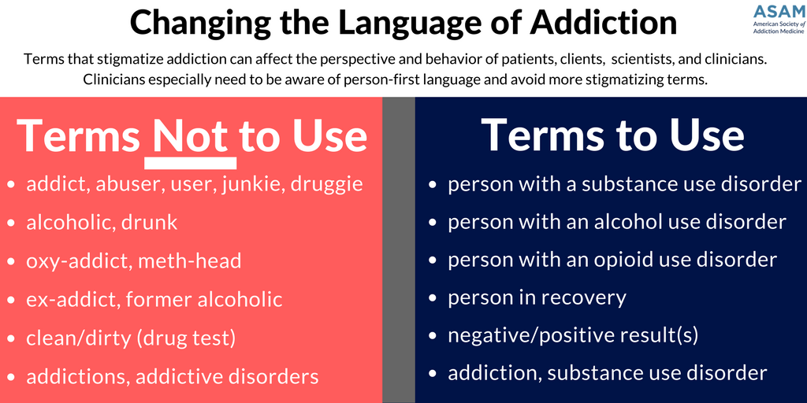
How can we reduce stigma?

Slide 14
Top MYTHS about mat

Slide 15
Myth 1:
MAT JUST TRADES ONE ADDICTION FOR ANOTHER
MAT bridges the biological and behavioral components of addiction. Research indicates that a combination of medication and behavioral therapies can successfully treat SUDs and help sustain recovery.
http://www.integration.samhsa. gov/clinical-practice/mat/mat-overview

Slide 16
Myth 2:
MAT IS ONLY FOR THE SHORT TERM
Research shows that patients on MAT for at least 1-2 years have the greatest rates of long-term success. There is currently no evidence to support benefits from stopping MAT.
http://www.integration.samhsa. gov/clinical-practice/mat/mat-overview

Slide 17
Myth 3:
CONDITION IS NOT SEVERE ENOUGH TO REQUIRE MAT
MAT utilizes a multitude of different medication options (agonists, partial agonists and antagonists) that can be tailored to fit the unique needs of the patient.
https://www.whitehouse.gov/sites/default/ files/ondcp/recovery/medication_assisted_treatment_9-21-20121. pdf

Slide 18
Myth 4:
MAT INCREASES THE RISK FOR OVERDOSE IN PATIENTS
MAT helps to prevent overdoses from occurring. Even a single use of opioids after detoxification can result in a life-threatening or fatal overdose. Following detoxification, tolerance to the euphoria brought on by opioid use remains higher than tolerance to respiratory depression.
“MAT Maintenance Treatment and Superior Outcomes” PowerPoint, Dr. Arthur Williams

Slide 19
Myth 5:
PROVIDING MAT WILL ONLY DISRUPT AND HINDER A PATIENT’S RECOVERY PROCESS
MAT has been shown to assist patients in recovery by improving quality of life, level of functioning and the ability to handle stress. Above all, MAT helps reduce mortality while patients begin recovery.

Slide 20
Myth 6:
THERE ISN’T ANY PROOF THAT MAT IS BETTER THAN ABSTINENCE
MAT is evidence-based and is the recommended course of treatment for opioid addiction. American Academy of Addiction Psychiatry, American Medical Association, The National Institute on Drug Abuse, Substance Abuse and Mental Health Services Administration, National Institute on Alcohol Abuse and Alcoholism, Centers for Disease Control and Prevention, and other agencies emphasize MAT as first line treatment.
http://www.samhsa.gov/medication-assisted-treatment/ training-resources/support-organizations

Slide 21
Medication assisted Treatment (MAT)

Slide 22
Medication Assisted Treatment
Comparison of Medications for Opioid Use Disorder (OUD)
 | Methadone | Naltrexone | Buprenorphine
Mechanism | Agonist | Antagonist | Partial agonist
Clinical uses | Medically supervised withdrawal, maintenance | Prevention of relapse to opioid dependence, following medically supervised withdrawal | Medically supervised withdrawal, maintenance
Administration | Oral | Oral, intramuscular injection | Oral tablet or film, subdermal implant
Prescribing and dispensing | SAMHSA-certified Opioid Treatment Programs (OTPs) dispense methadone for daily administration on site or at home (stable patients). | Any individual licensed to prescribe medicines may prescribe and/or order administration by qualified staff. | Physicians outside OTPs must complete special training and certification to qualify for a federal waiver to prescribe. Any pharmacy can fill the script.
Other considerations | Stigma associated with treatment, potential for misuse/diversion | Lowers opioid tolerance and can increase overdose risk | Potential for misuse/diversion

Slide 23
Differences in how the medications work
(Naltrexone)
Notes:
Opioid effect- respiratory depression NOT euphoria or pain control.

Slide 24
Goals of treatment
HARM REDUCTION
Reducing cravings and strengthening coping capacity
Prevention or reduction of withdrawal symptoms
Increasing periods of abstinence and self-efficacy
Restoration of functioning disrupted by substance use
Notes:
Harm reduction is a set of practical strategies and ideas aimed at reducing negative consequences associated with drug use.
Doesn’t apply with nicotine- due to inflammatory cascade released with smoking, goal is complete cessation.

Slide 25
Stages of Treatment
Induction is the starting phase. Your doctor will keep a close watch to make sure you adjust to the medication safely. This can be done at home and is safe and more patient friendly.
Stabilization begins when you are on the right dose and your body and brain have adjusted to the new medication
Maintenance is the long-term use of medication while remaining drug free and rebuilding a life in recovery
Tapering is medically managed withdrawal from a medication by gradually reduced do

Slide 26
Maintenance treatment versus detox
Detoxification: stopping opioids and symptomatic treatment of withdrawal
  Overall, high relapse rate after detox
  Lose tolerance and does not address underlying chronic illness
Maintenance treatment: continuing regular dose of medications to treat OUD
Notes:
Opioid withdrawal- convention is it is uncomfortable but not life threatening. However, a precipitated withdrawal (for example with narcan/naloxone) can cause catecholamine surge and be fatal.

Slide 27
Assessment & Induction Overview
History and physical which includes past/current use, treatment history, social supports
Check MAPS history
Lab tests including urine toxicology
Discuss treatment options
Make a plan
  Prior Authorization/Script to fill
  Instructions to return with no use for 12-24 hours prior
  POC testing
  COWS
  Induction 2mg and up to 8 on first day (can do this at home with instructions for patients who have used this in the past).
  Follow up via phone and increase to 12-16mg as needed
  Return in 2-3 days or 1 week and weekly until dose is stable then every 2 weeks with UDS and then move to monthly once stable

Slide 28
What it’s like
Mr. S is a 44 year old male with h/o HTN, depression and chronic pain presents to clinic to get help for his “problem with opioids.” Reports he was started on hydrocodone 5 yrs ago after work-related injury. First took it as prescribed, but also noticed it seemed to help with his mood and he started taking more than prescribed. Over time, he was finishing a month’s prescription in a few days and started snorting the opioids to get more potent effects. Has missed a lot of work, grown more depressed and his wife has been very concerned.
He says, “I can’t do this anymore. I feel like I’m going to lose everything, but I’m afraid to stop.”

Slide 29
Plan
Patient would like to try buprenorphine/naloxone.
  Discuss treatment agreement
  Prescribe starting dose
  Observe patient after initial doses for effects
  Titrate dose and prescribe short term prescriptions early on in treatment and assess patient each visit including urine toxicology screen and continue to provide support to encourage ongoing sobriety.
  Continue patient on stabilized dose
Mr.S 4 months into treatment comes to see you for followup. He is stable on dose of 12mg buprenorphine/naloxone. Urine screens are consistently negative for any other opioids. Says he is functioning much better and pain is also better controlled.
Notes:
Addiction disease. Relapses common.
Stable pt- explore mood do and factors which led to addiction in first place.

Slide 30
OUD treatment effectiveness
Reductions in overdose and overall death rates
Reductions in opioid use and other substance use/misuse
Improved HIV and Hep C outcomes
Increased likelihood that a person will remain in treatment
Reduced criminal justice involvement
Increased likelihood of employment
Recent evidence suggesting cost effective and improved quality of life
Medications are the most effective treatment for OUD. Without medication treatment, patients have higher rates of substance use and overdose rates.
(Norton et al 2017, Altice et al 1999, Kenworthy et al., 2017; Nosyk et al., 2015
Schwartz et al 2013, Sordo et al 2017)
Notes:
Evidence-based treatment

Slide 31
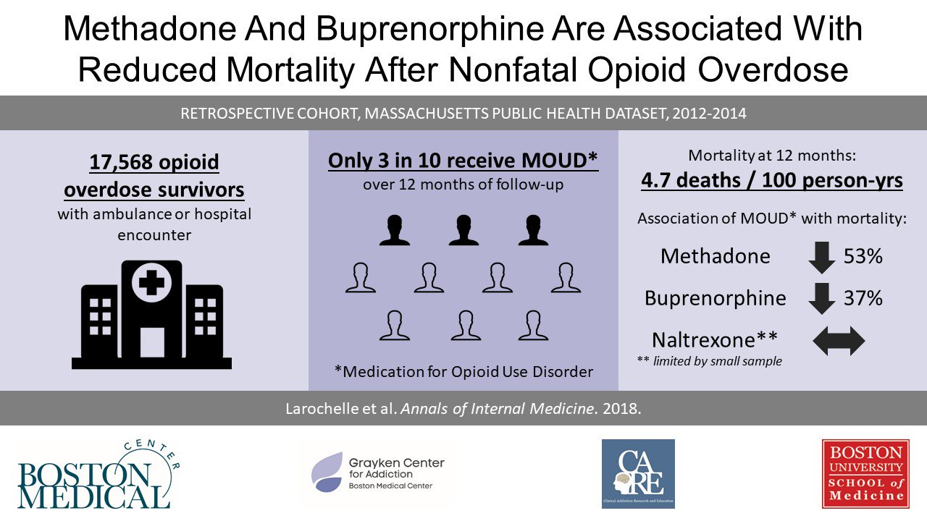
Notes:
One of largest cohort studies of OUD tx in US published recently in Annals of IM
Retrospective cohort study- (vs prospective)

Slide 32
MOC is here to help
Assisting MD, PA and NPs in completing the “x waiver” training
Access to a Behavioral Health Consultant for referral/resource information
Access to an MAT Specialist for a SAME DAY consultation
Tele-health (planned for Fall 2019)

Slide 33
ADDRESSING COMMON BARRIERS
Barrier to MAT Access | Program Feature
Cost of physician training | Organize in-person trainings and pay cost of online trainings
Lack of physician use, even after training | Peer consultation by an addiction psychiatrist
No link to counseling services | Program staff will assist and provide short-term
Lack of support staff knowledge | Provide training and materials to nurses and MAs
Mismatch of setting and patient | Staff provide bidirectional referrals with enrolled providers

Slide 34
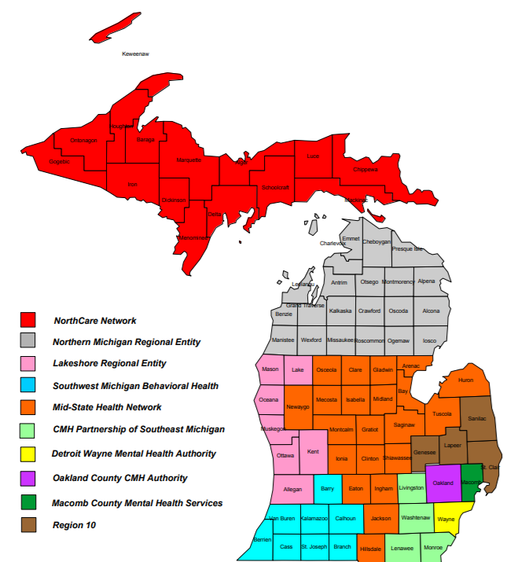
Who we serve
Behavioral Health Consultants located in the following regions:
Region 1 (upper peninsula)
Calhoun/Kalamazoo counties
Lenawee/Monroe counties
Washtenaw/Livingston counties
Technical Assistance and patient consultations provided to the ENTIRE state of Michigan

Slide 35
X waiver requirements for prescribing MAT
Who is eligible:
MD
Nurse Practitioner (with approved provider oversight by a waivered MD)
Physician Assistant
What is required:
MD- 8 hour approved training course
NP and PA- 24 hours of approved training (8 of which can be the MD training)

Slide 36
SUD Screening tools
ASAM Screening tools
  https://www.asam.org/education/live-online-cme/fundamentals-of-addiction-medicine/additional-resources/screening-assessment-for-substance-use-disorders/screening-assessment-tools
The AUDIT (Alcohol Use Disorder Identification Test)
  http://auditscreen.org/
DAST-10 (Drug Abuse Screen Test)
  https://www.psychcongress.com/saundras-corner/scales-screeners/suds/drug-use-questionnaire-dast-10
Adolescent Screening for Drugs and Alcohol
  CRAFFT
  http://www.ceasar-boston.org/clinicians/crafft.php
Opioid Risk Tool
    https://www.drugabuse.gov/sites/default/files/files/OpioidRiskTool.pdf
Clinical Opioid Withdrawal Scale
    https://www.drugabuse.gov/sites/default/files/files/ClinicalOpiateWithdrawalScale.pdf

Slide 37
Useful resources
Providers Clinical Support System (PCSS)
  https://pcssnow.org/resources/resource-category/medication-assisted-treatment-clinical-resources/
Medication Assisted Treatment
  https://www.samhsa.gov/medication-assisted-treatment
Medications for Opioid Use Disorders Treatment Improvement Protocol (TIP 63)
  https://store.samhsa.gov/product/TIP-63-Medications-for-Opioid-Use-Disorder-Full-Document-Including-Executive-Summary-and-Parts-1-5-/Most-Popular/SMA18-5063FULLDOC?sortByValue=4

Slide 38
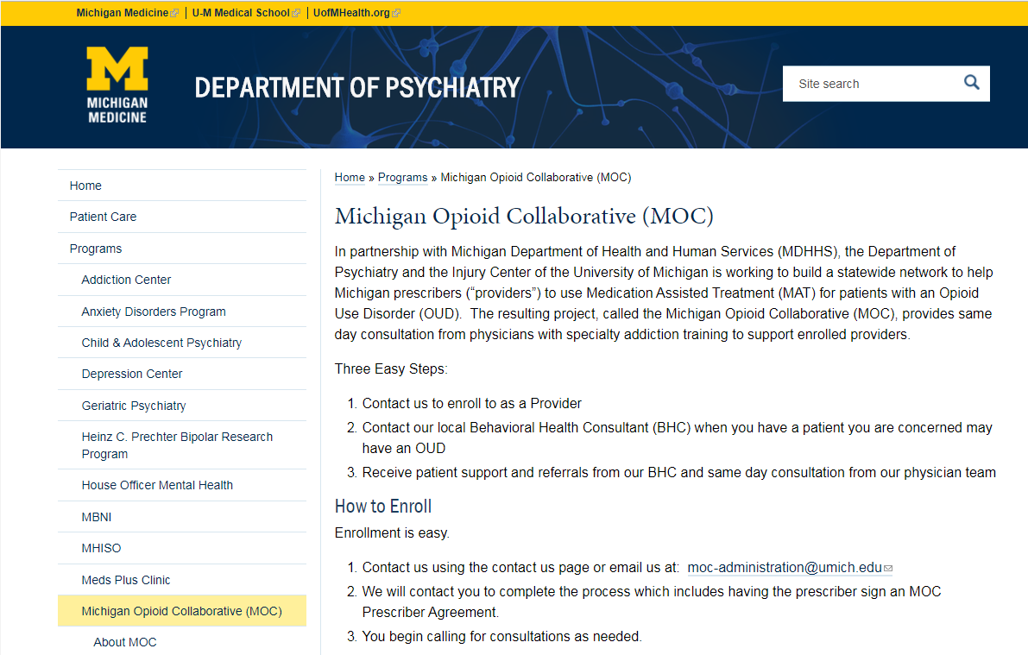
Find us online: https://medicine.umich.edu/dept/psychiatry/programs/michigan-opioid-collaborative-moc

Slide 39
Contact us
Audrey Hazelbaker - Behavioral Health Consultant
hazelbakera@washtenaw.org
734-292-5323
Suzanne Kapica- Project Manager
suzannlk@med.umich.edu
734-615-4227
www.michiganopioidcollaborative.org

