Slide 1
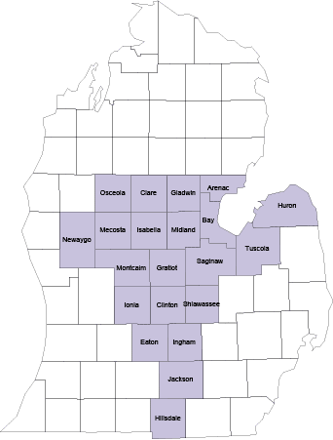
COVID-19 & Telemedicine
MSA Rules released March 18, 2020

Slide 2
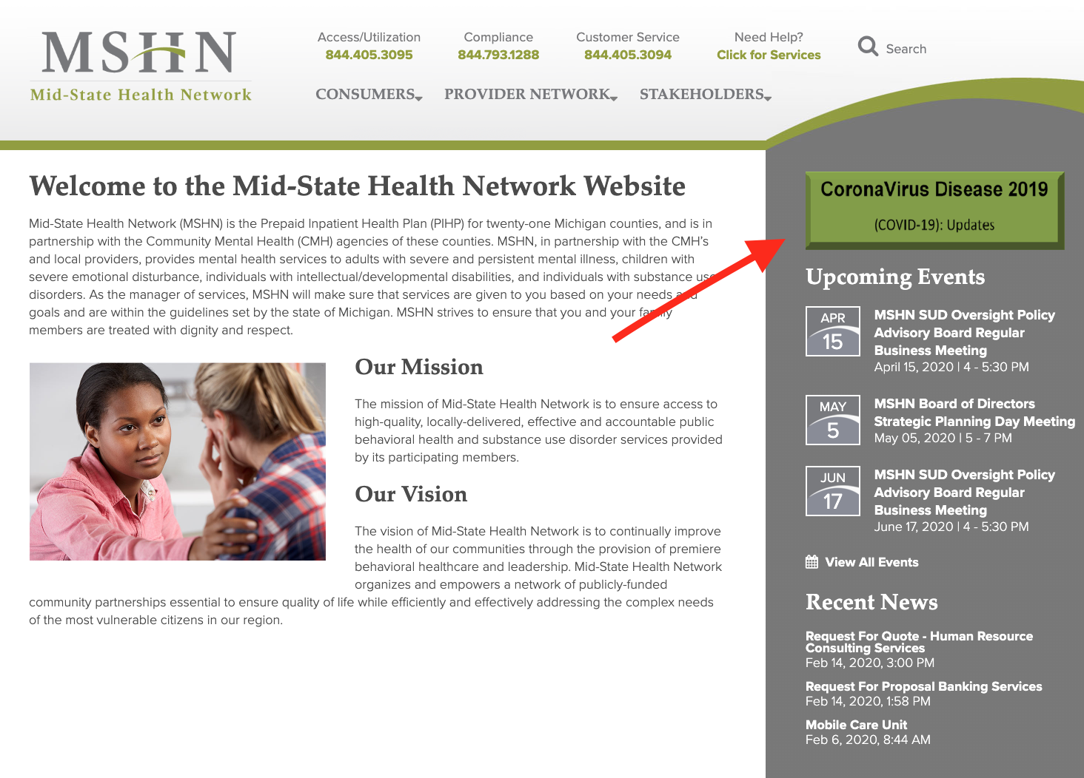
MSHN website
MSHN’s website: https://midstatehealthnetwork.org/

Slide 3
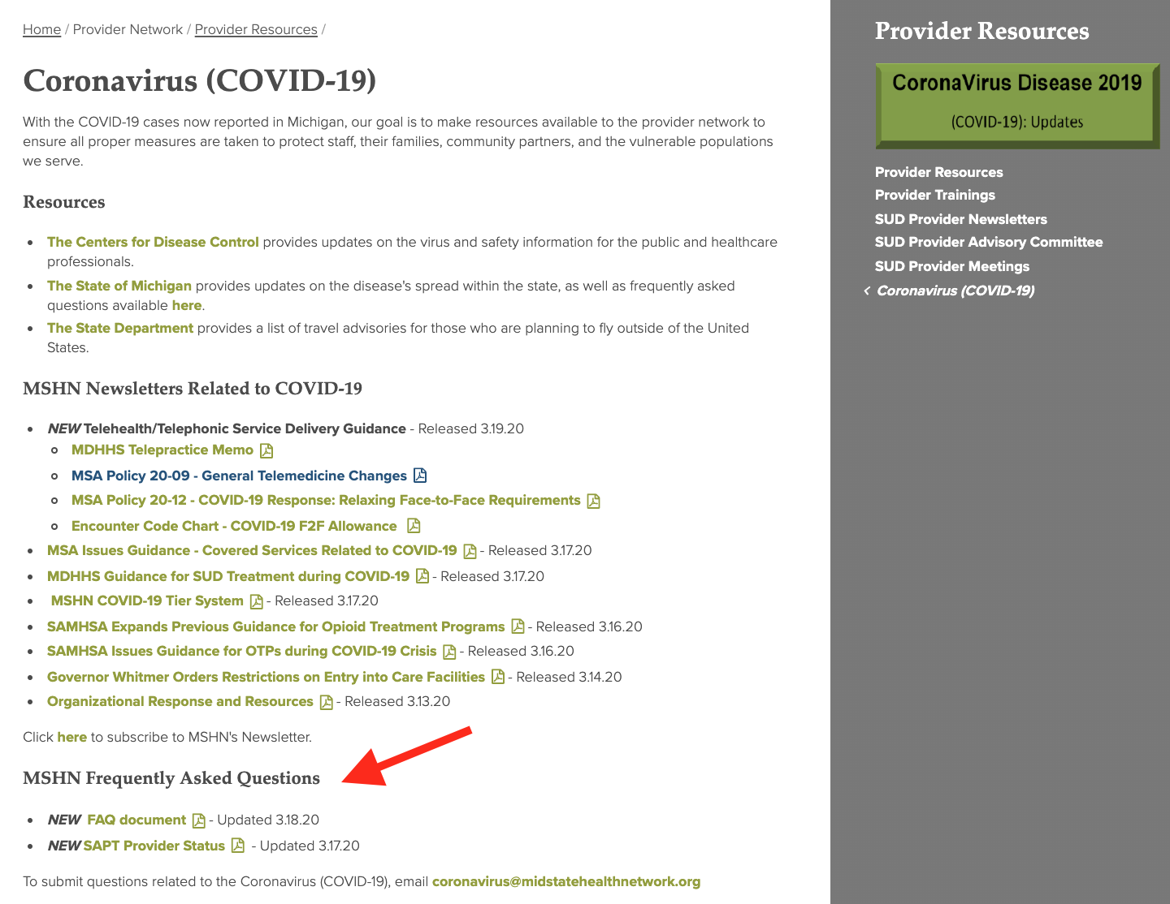
MSHN website
COVID-19 resource page: https://midstatehealthnetwork.org/provider-network-resources/provider-resources-1/coronavirus-covid-19

Slide 4
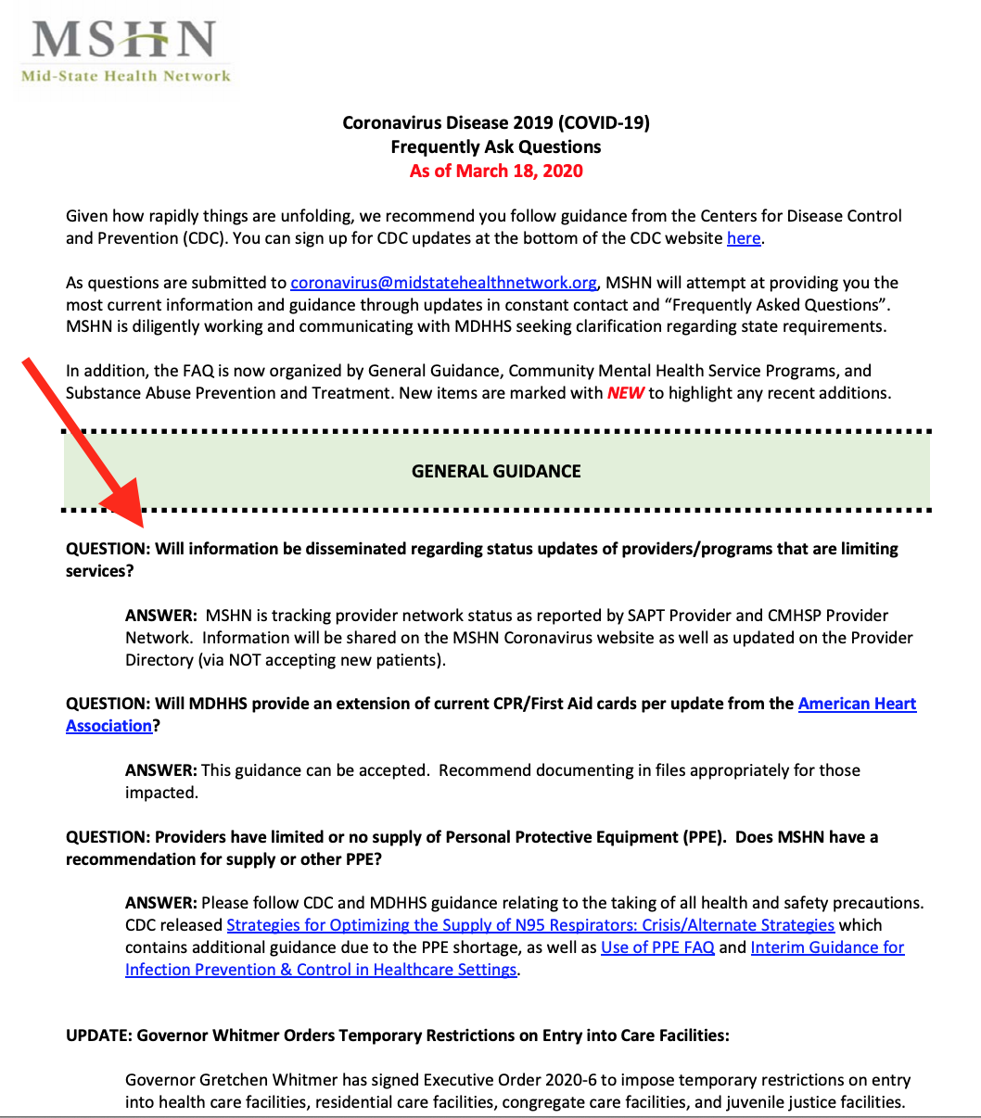
MSHN website
COVID-19 Q&A page: https://midstatehealthnetwork.org/application/files/7815/8457/0027/FAQ_03.18.2020_6pm.pdf

Slide 5
MSA 20-09 General Telemed Policy changes Link to policy document 20-09

Slide 6
Definitions & Consent

Slide 7
Privacy & Security

Slide 8
Contingency Planning: What if client is suicidal or appears to have overdosed?

Slide 9
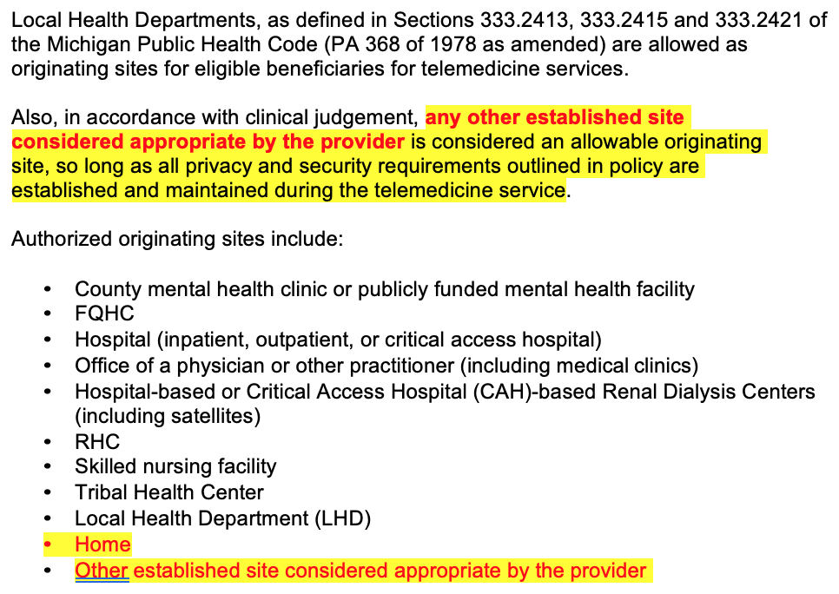
Originating Site (where the client is)

Slide 10
Distant Site (where the clinician is located)

Slide 11
Telemed Rates & Modifiers

Slide 12
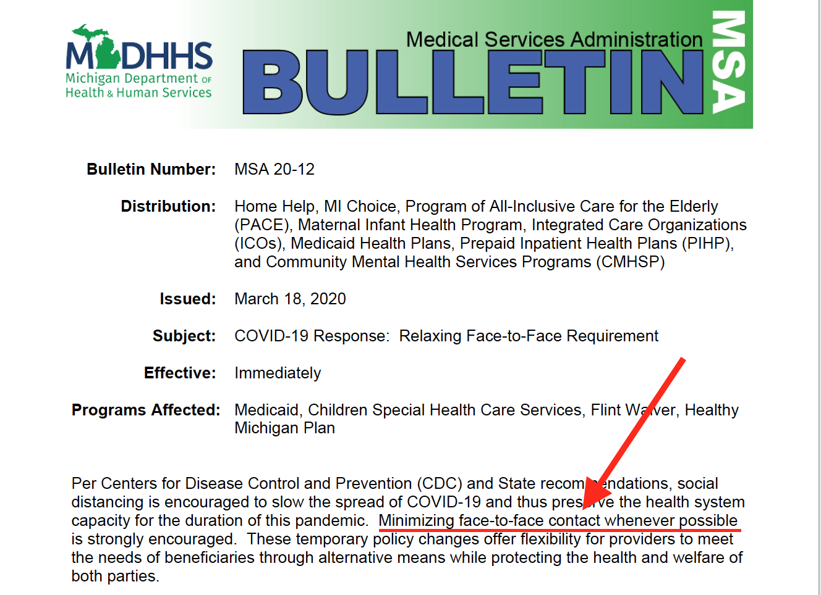
Relaxing the Telemed F2F requirement MSA 20-12
Link to MSA 20-12

Slide 13
Use of Telemed & Duration of this flexibility

Slide 14
Initial Assessments (when other parties are included)

Slide 15
Assessing health risk for COVID-19

Slide 16
Follow up & Validation when the State of Emergency is lifted

Slide 17
Questions?

