Slide 1
Treatment Breakout Session
SUD Quarterly Provider Meeting
3/18/2021

Slide 2
AGENDA
REMI Announcement: Adverse Benefit Determination, Grievance and Appeals Module
Reimbursement for Screenings
FY22 Treatment Annual Plans
ASAM Continuum Implementation Update

Slide 3
REMI Announcement
Adverse Benefit Determination, Grievance and Appeals Modules
Dan R. Dedloff, MA, LPC
Customer Service & Rights Specialist
517.657.3011 dan.dedloff@midstatehealthnetwork.org

Slide 4
REMI Customer Service Additions:
Adverse Benefit Determination
Appeals Module
Grievance Module
MSHN Grievance and Appeals Training

Slide 5
Reimbursement for Screenings
Skye Pletcher
Director of Utilization & Care Management
Skye.Pletcher@midstatehealthnetwork.org

Slide 6
Reimbursement for Screenings
Beginning 4/1/2021 providers can bill MSHN for completing screenings for individuals
  REMI will automatically create an authorization for H0002 (Screening Code) when the Level of Care (LOC) Determination document is completed and signed
  Admission record in REMI is not needed to bill H0002; allows for providers to bill for screenings completed when client does not get admitted
  Screening can be face-to-face or telephone
  The LOC Determination should be completed at the point of first contact, not at the time of assessment.
  Additional guidance will be published in an upcoming Constant Contact
  Questions??? Contact um@midstatehealthnetwork.org or 1-844-405-3095

Slide 7
FY22 Treatment Annual plans
Shannon Myers & Trisha Thrush

Slide 8
Purpose
  Annual plan meetings provide MSHN Treatment Specialists with the opportunity to:
    Discuss your agency’s goals for the upcoming fiscal year
    Provide an opportunity for the provider to share successes or innovative ideas
    Hear about challenges and support needs
    Opportunities for technical assistance
    Support relationship building between the provider and MSHN
  Annual Plans are completed during a collaborative meeting between the provider agency and the treatment specialists who support the agency. Some meetings may also be supported with Utilization Management specialists as well.

Slide 9
Process
  The agency’s lead treatment specialist will reach out and provide FY22 annual plan documents and information individualized to each agency.
  Meetings will be completed using the Zoom platform
  The annual plan document will be completed by your treatment specialist the day of the meeting
  Please review the annual plan documents and be prepared to discuss the items applicable to your agency.
  There is no need to complete the document prior to the meeting
  Please be prepared to share progress on the DDCAT and Trauma goals identified during the FY20 annual plan process.

Slide 10
Annual Plan Content
  Instructions
  Annual Plan Update
  Content Specific Areas:
    Recovery Housing
    Women’s Specialty Services
    Residential and Withdrawal Management

Slide 11
Timeframe
  March
    Provider will receive an email with FY22 annual plan documents and request dates and times they are available to meet
    Treatment Specialist will schedule annual plan meeting and provide a Zoom meeting invite.
  April-May
    Annual Plan meetings will take place
    Annual Plans will be finalized and placed in the “Annual Plan” folder in BOX for each provider
  June
    Cost Reimbursed budget requests are due COB 6/1/2021
    Please email budgets to Trisha Thrush at trisha.thrush@midstatehealthnetwork.org
    Please submit budget(s) early if they are prepared

Slide 12
Timeframe
  June
    Cost Reimbursed Budgets will be reviewed
    Questions regarding the budget will be shared with the provider
  July
    Treatment Team makes FY22 contract recommendations
    August
      FY22 Contract recommendations supported by PA2 funding go before Oversight Policy Board (OPB) for review and approval/denial.
      Items approved will move to MSHN Board of Directors (BOD) for final review of approval/denial.
      September
        FY22 Contract recommendations go before MSHN Board of Directions (BOD)
        If approved, MSHN Contract Manager, Kyle Jaskulka, will send contracts to providers.
        If denied, MSHN treatment specialist would be in contact and follow-up

Slide 13
Agency Self Assessment for Trauma Informed Care
Assessments are due every 3 years per MDHHS contract
The majority of providers are due this year
  The assessment will be provided at the annual plan
  Please complete the assessment within 90 days of the annual plan
  Please email the compiled assessment score to your treatment specialist
  If additional time is needed, please work with your treatment specialist

Slide 14

Questions?

Slide 15
ASAM Continuum Implementation Update
Trisha Thrush, Lead Treatment Specialist

Slide 16
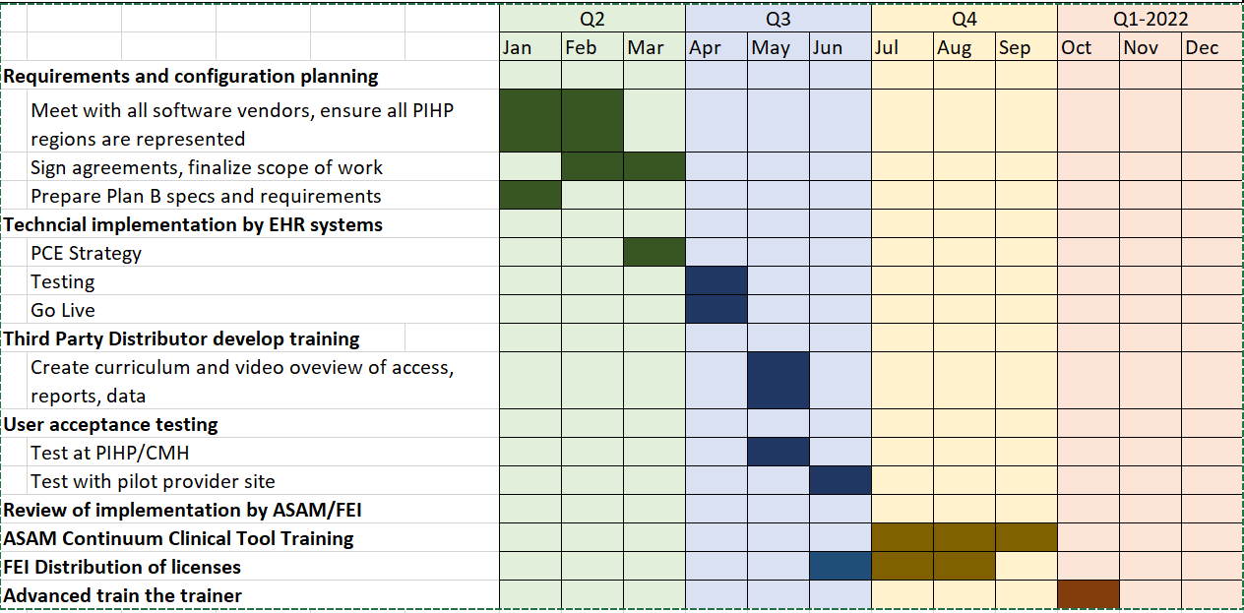
MSHN – ASAM Continuum Implementation Timeline

Slide 17
ASAM Continuum Implementation Update
Implementation items are on track for completion per timeline.
MSHN sending a targeted communication to providers regarding regional implementation update with an attached Frequently Asked Questions (FAQ) document.
Training of ASAM Continuum for clinicians will be scheduled to begin in June 2021.
  Clinical staff will need to attend only one training.
  Limited amount of trainings for the entire State – so please ensure clinicians attend the session they signed up for.
  ASAM "Basic" 2-day training is not a requirement – but highly recommended for use of the ASAM Continuum.

Slide 18
Questions?

