Slide 1
Quarterly SUD Provider Meeting
September 21, 2023
www.midstatehealthnetwork.org

Slide 2
Plenary Session Agenda
Joe Sedlock: Welcome
Sarah Andreotti: Regional Synar Update
Dr. Dani Meier:
MSHN FY24-25 Strategic Plan
Equity Upstream- Learning Collaborative
Heather English: SOR Year End Closeouts
www.midstatehealthnetwork.org

Slide 3
MSHN General Remarks
Joe Sedlock
Chief Executive Officer

Slide 4
MSHN General Remarks
Welcome
Region-Specific Provider Stabilization Initiatives
FY 24-25 Regional Strategic Plan – Priorities:
Better Health
Better Care
Better Equity
Better Provider Systems
Better Value
Regional SUD-Specific Strategic Plan – Dr. Meier covering shortly
FY 24 Budget Outlook
Fee for Service Rate Schedule Increase
Direct Care Worker Premium Pay is now built into rates (H0010, H0012, H0018, H0019) and will no longer require a separate request after 10/01/2023
www.midstatehealthnetwork.org

Slide 5
MSHN's Strategic Priorities

Slide 6
Regional Synar Update
Sarah Andreotti
Lead Prevention Specialist
www.midstatehealthnetwork.org

Slide 7
Regional Synar Update 2023
94 checks assigned, with 93 checks completed
13 sales
13.98% sales rate for MSHN region
12.6% sales rate for State of Michigan
Thanks to DYTURs for all of their work during Synar season!
Sales Stats:
Checked ID - 5
Did not check ID - 8
Sales to Female - 10
Sales to Male - 3
Sales by Female clerk - 8
Sales by Male clerk - 5
Sales by Age:
16 - 0
17 - 2
18 - 6
19 - 4
20 - 1
Sales by Vendor Type:
Gas Station - 8
Tobacco Store - 1
Other - 4
(party store, dollar store, etc.)
Sales of Cigarettes - 9
Sales of ENDS - 4
www.midstatehealthnetwork.org
Notes:
AMANDA
These are arranged by strengths and weaknesses (internal-looking), threats and opportunities (external-looking).

Slide 8
MSHN FY24-26 SUD-Specific Strategic Plan
Dani Meier, PhD, MSW, MA
Chief Clinical Officer
www.midstatehealthnetwork.org

Slide 9
Prevention Goals:
Reduce underage drinking & heavy/binge drinking among adults age 55+;
Reduce cannabis use among youth & young adults;
Reduce opioid prescription misuse; including a reduction in the misuse of opioids for non-medical purposes for youth & older adults (age 55+);
Reduce youth tobacco access and tobacco use including electronic nicotine devices and vape products;
Increase access to prevention services for Older Adults (55+)
Yellow = New/Revised
www.midstatehealthnetwork.org

Slide 10
Treatment Goals:
Increase access to:
OUD treatment & harm reduction for persons living with OUD;
Treatment & re-entry services for incarcerated individuals returning to communities;
Trauma-responsive services;
Women’s Specialty Services (WSS) to reduce # of infants exposed to NAS/FAS;
Treatment services for older adults 55+;
Improved coordination of care between primary care services & behavioral health services for persons with SUD.
Yellow = New/Revised
www.midstatehealthnetwork.org

Slide 11
Recovery Goals:
Increase access to:
Coordination of prevention, follow-up, and continuing care in recovery;
Coordinated strategies to support recovery;
Recovery services that promote life enhancing recovery & wellness for individuals and families.
Yellow = New/Revised
www.midstatehealthnetwork.org

Slide 12
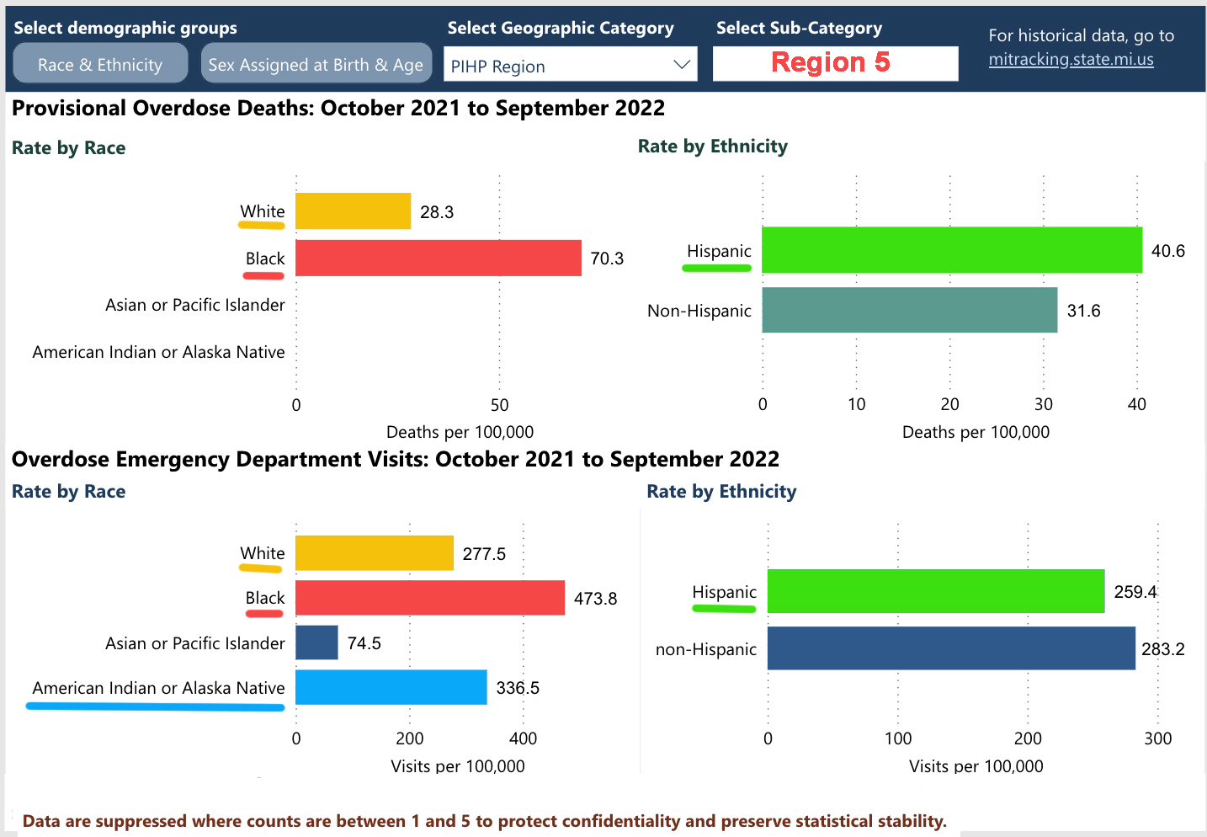
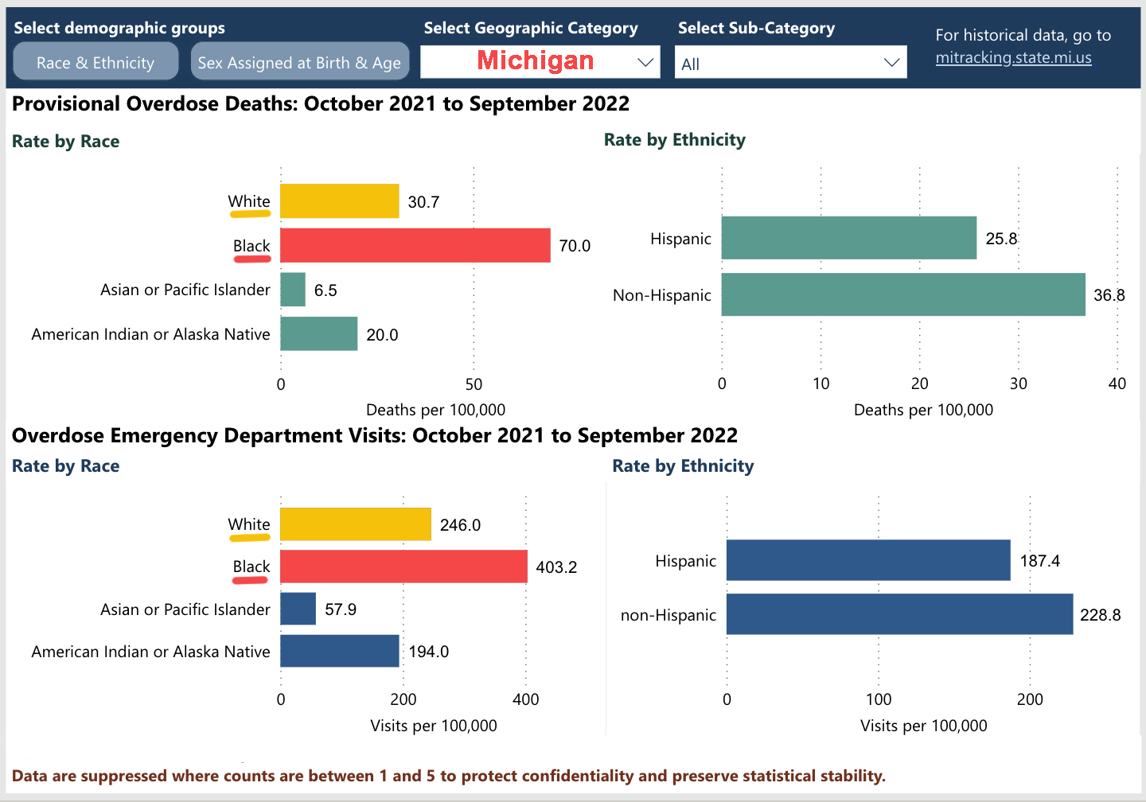
Equity Goal:
Increase cultural competence to reduce health disparities based on race, ethnicity, socioeconomic status, gender, etc.

Slide 13
MSHN’s Equity Upstream Initiative
Equity Upstream Lecture Series
Equity Upstream Learning Collaborative
www.midstatehealthnetwork.org

Slide 14
Equity Upstream: Spring Lecture Series
Featured national-level experts on health disparities in underserved populations;
Local panelists joined for Michigan context;
Hundreds of providers & community partners around Region 5 & Michigan participated;
Videos can be watched on MSHN’s website here.
www.midstatehealthnetwork.org

Slide 15
Equity Upstream: Learning Collaborative
Pilot with 8 MSHN providers located in diverse communities
Represent multiple levels of care:
Residential, Outpatient, OTP (MOUD) & a CMH
Recovery Housing & Community Recovery
Prevention
Reviewing internal data
Seeking community input
Developing action plans to increase access, initiation & engagement
www.midstatehealthnetwork.org

Slide 16
Grant Funding Update
Heather English
Grant Coordinator
www.midstatehealthnetwork.org

Slide 17
State Opioid Response (SOR)
SOR-3 Year 2 begins 10/1
SOR-4 pending
www.midstatehealthnetwork.org

Slide 18
COVID/ARPA/Other
COVID funding ends 3/14/24
ARPA through FY26
Many local twps. have unspent funds
www.midstatehealthnetwork.org

Slide 19
Opioid Settlement Funds
Many townships have unspent funds
https://micounties.org/opioid-settlement-resource-center/
www.midstatehealthnetwork.org

Slide 20
Data & Resources
Michigan Association of Counties https://micounties.org/opioid-settlement-resource-center/
Michigan Opioid Advisory Commission http://council.legislature.mi.gov/Council/OAC
MDHHS SUD Data Repository https://mi-suddr.com/data/
MDHHS Overdose to Action Dashboard https://www.michigan.gov/opioids/category-data
National Association of Counties https://www.naco.org/resources/opioid-solutions-center
National Opioid Settlement https://nationalopioidsettlement.com/
Opioid Settlement Tracker https://www.opioidsettlementtracker.com/
www.midstatehealthnetwork.org

Slide 21
www.midstatehealthnetwork.org​

Slide 22
Treatment Breakout Session
www.midstatehealthnetwork.org

Slide 23
Treatment Breakout Session Agenda
Cammie Myers: Updates to Incarcerated Services
Evan Godfrey: MDOC Referral Process
Tammy Foster: Veteran Navigator Update
Sandy Gettel: QAPI Site Review & Tool Updates for FY24
Sherrie Donnelly: SUD Workgroups
www.midstatehealthnetwork.org

Slide 24
NEW Incarcerated Services Benefit & Guidance
Cammie Myers
Utilization Management Administrator
www.midstatehealthnetwork.org

Slide 25
New Incarcerated Services Technical Requirement
Provide a foundation for consistent services for incarcerated individuals across the MSHN region.
Clinical focus of incarcerated services
LOCs allowed for incarcerated individuals
Guidelines for services
MAT for incarcerated individuals
Juvenile detention centers
UM Guidelines
Where can this technical requirement be found?
www.midstatehealthnetwork.org

Slide 26
Incarcerated Services Benefit Grids
Each authorization can be for 30 days maximum duration
Treatment episodes are limited to 90 days maximum duration (unless otherwise specified).
Each authorization will be reviewed by the Utilization Management Team (no automatic approvals for incarcerated services)
Changes will begin on 10/1/2023
New benefit grids for FY24 will be located in the Help Menu of REMI.
Questions?
www.midstatehealthnetwork.org

Slide 27
MDOC Referral Process
Evan Godfrey,
SUD Care Navigator
(517) 657-3358
Evan.Godfrey@midstatehealthnetwork.org
www.midstatehealthnetwork.org

Slide 28
Update to MDOC Residential Referral Procedure
MDOC agents are to send CFJ 306 and MDHHS 5515 forms to MSHN for review
MSHN reviews and issues response within 3 business days
If client appears appropriate for residential, SUD Care Navigator will inform MDOC agent or this, contact the provider chosen by the client, inform them of the incoming MDOC priority population referral, and either email or fax the CFJ 306 and MDHHS 5515
Client then contacts provider directly for full screening/LOC determination
If client does not appear appropriate for residential, SUD Care Navigator will inform MDOC agent of this and refer to a local OP provider for a full ASAM-C assessment
MSHN will continue to monitor referral and assist provider network and MDOC until client has an admission documented in REMI
Effective 10/1/2023
Questions? Email MDOCreferrals@midstatehealthnetwork.org
www.midstatehealthnetwork.org

Slide 29
SUD Care Navigator – Other Duties
Engage priority population clients within MSHN's region and manage referrals to appropriate ASAM levels of care for them
Assist in complex coordination of care efforts between different service organizations (primary care, CPS, MDOC, etc.).
Network with community organizations in MSHN's service region to gather information on resources and information available to MSHN-funded clients
Inform clients of provider choice, accessing treatment at the appropriate and desired level of care
And much more!
Questions?
www.midstatehealthnetwork.org

Slide 30
Veteran Navigator Updates
Tammy Foster,
Veteran Navigator
517-483-2742
Tammy.Foster@midstatehealthnetwork.org
www.midstatehealthnetwork.org

Slide 31
Veteran Navigator- Compact Act
Emergency Suicide Care and treatment for a veteran in suicide crises can go to any health care facility in the community or the VA.
The VA will pay for or provide treatment for all costs associated with acute suicide crisis, this includes treatment for SUD.
Transportation costs
Social Work

Slide 32
Veteran Navigator- Compact Act
30 Days inpatient and up to 90 days outpatient​
​
Previous enrollment in VA Health care not necessary​
​
Any discharge other than dishonorable​
​
Determine eligibility for other VA services and benefits​ such as enrollment to VA Health Care.

Slide 33
Veteran Navigator – Compact Act
VA is required to refer eligible Veterans for appropriate VA programs and benefits following the period of emergent suicide treatment.
An example of this in addition to a referral to mental health resources would be housing services for veterans who are homeless.
Refer to pdf for details of Compact Act eligibility and notification steps
Questions?
Compact Act pdf
www.midstatehealthnetwork.org

Slide 34
QAPI Site Review & Tool Updates for FY24
Sandy Gettel
Quality Manager
www.midstatehealthnetwork.org

Slide 35
QAPI Site Review Updates for FY24
**Site reviews will be transitioned to a fiscal year instead of calendar year schedule effective 10-1-2023.
In October 2023:
MSHN will post approved tools to website.
MSHN will send out notification in Constant Contact (usually for 3 weeks which includes link to website) upon review tool approval.
MSHN will be sending appointments out for the SUD reviews in 2024 in October which includes the link to the tools on website.
Provider review dates will also be added to the MSHN web calendar.
2024 folders will be created and added to the provider folders.
Questions?
www.midstatehealthnetwork.org

Slide 36
QAPI Review Tool Updates for FY24
2-3 new standards added, currently under review, specific to MAT and Residential (Quality focused- medication mistakes, critical incidents).
Changes included combining like standards, removing repeat standards and standards no longer relevant (based on rev SUD Admin rules), and updating language in some standards for clarification.
Questions?
www.midstatehealthnetwork.org

Slide 37
SUD Workgroups
Sherrie Donnelly, MA, LBSW
Treatment & Recovery Specialist
www.midstatehealthnetwork.org

Slide 38
SUD Workgroups: Women's Specialty
Women's Specialty meets quarterly
Next meeting: December 6, 2023 at 1 pm
Contact: Rebecca.Emmenecker@midstatehealthnetwork.org
www.midstatehealthnetwork.org

Slide 39
SUD Workgroups: MAT Workgroup
MAT meets every 6 months
Next meeting: November 1, 2023 at 1 pm
Contact: Rebecca.Emmenecker@midstatehealthnetwork.org
www.midstatehealthnetwork.org

Slide 40
SUD Workgroups: Recovery Provider Workgroup
Recovery Provider Workgroup meets quarterly
Next meeting: October 25, 2023 at 10 am
Contact: Sherrie.Donnelly@midstatehealthnetwork.org
www.midstatehealthnetwork.org

Slide 41
SUD Workgroups: Outpatient Provider Workgroup
Outpatient Provider Workgroup meets quarterly
Next meeting: October 10, 2023 at 10 am
Contact: Sherrie.Donnelly@midstatehealthnetwork.org
www.midstatehealthnetwork.org

Slide 42
SUD Workgroups: ROSC Provider Workgroup
Each ROSC group meets every other month - East, NW and South
Next meeting:
East: November 8, 2023 at 1 pm
NW: October 12, 2023 at 1 pm
South: October 26, 2023 at 11 am
Contact: Sherrie.Donnelly@midstatehealthnetwork.org
www.midstatehealthnetwork.org

Slide 43
SUD Workgroups: Residential Provider Workgroup
The Residential Provider Workgroup meets monthly
Next meeting: October 11, 2023 at 10 am
Contact: Kathrine.Flavin@midstatehealthnetwork.org
www.midstatehealthnetwork.org

Slide 44
Quarterly SUD Provider Meeting Prevention Breakout
September 21, 2023
• MPDS
FY23 Closeout and Timeline
New “Completed” Procedure
FY24 Changes
FY24 Provider Manual Updates
Media Campaign Policy
Out-of-State Travel
Ethics Training Requirement
• Reminders and Updates
End of Year Reporting
Direct Service Requirements
Older Adults Workgroup
Notes:
AMANDA
These are arranged by strengths and weaknesses (internal-looking), threats and opportunities (external-looking).
viewed as a highly collaborative in region and with external partners, and a statewide leader in reciprocity. MSHN is known to “listen” to the needs of region and incorporate network feedback into services and operations. MSHN is a trailblazer in new state waiver initiatives, for example: HCBS, Autism, Influence, leading to systems change. MSHN has operationalized innovation when developing programs like the Mobile Care Unit.

Slide 45
MPDS
FY24
Staffing levels at activities should only involve people actively facilitating the meeting/group.
Read the User Manual when entering new groups for FY24. This will help eliminate errors that can impact your groups throughout the year.
Groups listed as Ongoing Other can only be used for groups that meet continuously (coalition, taskforce, planning committees).
Groups like health fairs, drug take-back, trainings, etc. should be listed at One Time. You cannot make an Ongoing Other group for all health fairs; they must be entered as individual One Time groups.
Notes:
AMANDA
These are arranged by strengths and weaknesses (internal-looking), threats and opportunities (external-looking).

Slide 46
MPDS
FY23 Closeout
Any groups you have that run in both fiscal years will have to be ended in MPDS on 9/30/23 and started as a new group again on 10/1/23.
Closeout must be completed by October 31, 2023
COMPLETED- should only be participants that completed the program/cohort according to developer’s standards. Coalitions and community groups should not have any COMPLETED attendees.
Notes:
AMANDA
These are arranged by strengths and weaknesses (internal-looking), threats and opportunities (external-looking).

Slide 47
FY24 Provider Manual Updates
Media Campaign Policy
Request form must be completed and submitted for any campaigns using MSHN funding.
This does not include promoting your services/groups/activities.
Must have approval before using MSHN logo
Out-of-State Travel
Travel or conferences outside of the state of Michigan using MSHN funds must be pre-approved.
Notes:
AMANDA
These are arranged by strengths and weaknesses (internal-looking), threats and opportunities (external-looking).

Slide 48
MPDS
FY24
EBP Service Type Field (pg. 17-19 in MPDS User Manual)
Please read descriptions for each option
NREPP should only be chosen if the EBP was on the original NREPP listing
None of the Above can be chosen if your activity is Evidence-based, but does not fit into one of the listed options
Notes:
AMANDA
These are arranged by strengths and weaknesses (internal-looking), threats and opportunities (external-looking).

Slide 49
Reminders and Updates
End of Year Reporting
Report templates were emailed 9/18/23
Remember to submit both the report AND the Outcomes Attachment related to item 5 on the report
Please rename documents to include your agency’s name
Synar YAT Report due 9/22/23 (tomorrow!)
FY23 FSRs
The September FSR is due October 10th. The final FSRs or invoices for SOR, COVID, or ARPA funded projects should also be submitted by October 10th. The final FY2023 FSR to capture any expenses not previously billed is due November 10th. If there are no expenses remaining to bill, a final report does not need to be submitted.
Notes:
AMANDA
These are arranged by strengths and weaknesses (internal-looking), threats and opportunities (external-looking).

Slide 50
FY24 Older Adult Workgroup
MSHN will be implementing an Older Adult Workgroup in FY24 to work to achieve our FY24-26 Strategic Plan objective of increasing access to Prevention services for Older Adults (ages 55+)
Look for email from Kari to gather interested providers for a Zoom meeting in November.
Notes:
AMANDA
These are arranged by strengths and weaknesses (internal-looking), threats and opportunities (external-looking).

Slide 51
Questions?
kari.gulvas@midstatehealthnetwork.org
sarah.surna@midstatehealthnetwork.org
sarah.andreotti@midstatehealthnetwork.org
Notes:
AMANDA
These are arranged by strengths and weaknesses (internal-looking), threats and opportunities (external-looking).

Slide 52
Reminders and Updates
FY24 Additional Hours Report (AHR)
600 hours of direct service are required for FY24
The AHR can include travel but should only be for travel to direct service activities such as programming, or conferences. Travel should not be included for errands like trips the store, post office, etc.
FY25 Requirements
Staff must have taken the Prevention Ethics course within one year of hire. This applies to Specifically Focused Staff as well.
Notes:
AMANDA
These are arranged by strengths and weaknesses (internal-looking), threats and opportunities (external-looking).

Slide 53
Questions?
www.midstatehealthnetwork.org

Slide 54
Upcoming SUD Provider Meetings
**December 8, 2023 10am - 12pm
March 21, 2024 12-2pm
June 20, 2024 12-2pm
NOTE: All meetings will be held via Zoom
Agendas and old meeting notes can be found on our website here: https://tinyurl.com/mshnsudmtgs
Sign up for the Constant Contact weekly SUD Provider Newsletter here: https://tinyurl.com/mshnnews
www.midstatehealthnetwork.org

