Slide 1
Quarterly SUD Provider Meeting
March 16, 2023
www.midstatehealthnetwork.org

Slide 2
Plenary Session Agenda
Dr. Dani Meier: Welcome
Joe Sedlock: MSHN FY24-25 Strategic Planning
Amanda Ittner: Public Health Emergency (PHE) Ending & Related Policy Updates
Amanda Ittner: SUD Treatment Data on MSHN Website
Dr. Dani Meier: Equity Upstream-Lecture Series & Learning Collaborative
Heather English: State Opioid Response (SOR) Grant FY22 Activity Report
Heather English: Narcan Vending Machines in Region 5
www.midstatehealthnetwork.org

Slide 3
MSHN General Remarks
Joe Sedlock, Chief Executive Officer
The MSHN Governing Board has approved Administration’s recommendation to extend the regional Provider Staffing Crisis Stabilization Initiative through 09/30/2023.
Updated regional guidance is available on the MSHN Website, Coronavirus page. There have only been changes to dates in the regional application.
MSHN does not anticipate that this program will be extended into FY 2024.
Direct Care Worker wage supports:
Funding by the legislature is structured as “permanent” and are thus expected to continue.
Regional guidance documents are available on the MSHN Website, Coronavirus Page.
MSHN will continue to require its SUD provider system to submit requests for reimbursement of increased DCW Wage expense. Questions can be directed to Leslie Thomas, MSHN Chief Financial Officer
The regional general provider stabilization initiative will continue through 09/30/2023. We have not determined whether this program will continue beyond that date.
www.midstatehealthnetwork.org

Slide 4
FY24-25 Strategic Planning
Joe Sedlock, Chief Executive Officer
Better Health
Better Care
MSHN will improve access to services and supports across the region.
Better Provider Systems
MSHN ensures that it engages a provider network with adequate capacity and competency.
Better Value
Public Resources are used efficiently and effectively.
MSHN will improve its population and integrated health activities.
MSHN will enhance regional quality and compliance.
MSHN will advocate for public policies that promote an adequately compensated, safe, effective and well trained workforce.
Regional public policy leadership supports improved health outcomes and system stability.
Better Equity
MSHN will improve behavioral health services and supports, inclusive of all populations served and will develop and implement behavioral health and opioid health homes and other regional strategies to impact opioid and other substance use disorders.
MSHN will lead local and statewide key initiatives, including complex care management, population health, expansion of Medication Assisted Treatment, physical health integration at the point of service so that health equity and health outcomes are improved for all beneficiaries.
MSHN will expand value-based purchasing and financing systems and will develop financing structures to incentivize performance based on adopted outcomes measures.
MSHN will ensure adequate internal capacity to accomplish its responsibilities effectively and efficiently.
MSHN will partner with MDHHS and others to ensure capacity and competency to implement regional and stratewide innovative programming.
MSHN ensures all persons have the same opportunities to be healthy, especially those who belong to socially disadvantaged or historically marginalized groups (health equity).
MSHN will utilize population health data to identify and reduce health disparities that exist in the region.
MSHN will ensure there is strong regional infrastructure for diversity, equity, and inclusion in all aspects of organizational responsibility and operations.
MSHN REGIONAL PRIORITIES AND GOALS
www.midstatehealthnetwork.org

Slide 5
FY24-25 Strategic Planning
Joe Sedlock, Chief Executive Officer
MSHN is in the process of updating its strategic plan for 2024/2025.
MSHN Strategic Priorities will continue
MDHHS Strategic Priorities will be taken into account in our regional planning process.
Unfortunately, MDHHS is expected to continue to require a separate SUD prevention, treatment, and recovery strategic plan.
SUD Provider input will be most beneficial when the region begins that effort, expected to be late Spring/early Summer.
MSHN will make available a draft strategic plan for provider review and comment in June/July.
Input or recommendations are welcome at any time – please contact me directly or any member of our staff with your input and it will be routed to me for consideration.
www.midstatehealthnetwork.org

Slide 6
FY24-25 Strategic Planning
Joe Sedlock, Chief Executive Officer
One key area in our planning process is work to be better in the diversity, equity, and inclusion space and to design and implement strategies to reduce/eliminate health disparities.
Dani Meier will provide more information on our “Equity Upstream” initiative later in this provider meeting.
We invite our provider partners and all stakeholders to engage with MSHN in this important work
www.midstatehealthnetwork.org

Slide 7
FY24-25 Strategic Planning
Joe Sedlock, Chief Executive Officer
Thank you for your partnership with MSHN in these efforts and in our mission to ensure all residents of the region have access to high quality, locally-delivered, effective and accountable public behavioral health and substance use disorder services.
www.midstatehealthnetwork.org

Slide 8
Public Health Emergency (PHE) Ending & Related Policy Updates
Amanda Ittner, Deputy Director
www.midstatehealthnetwork.org

Slide 9
Public Health Emergency (PHE) Ending
The Biden Administration has indicated its intent to end the COVID-19 Public Health Emergency on May 11, 2023
MDHHS has created a website page for COVID-19 PHE end
https://www.michigan.gov/mdhhs/end-phe
MSHN created a website page for COVID-19 UNWIND Phase
Post new/updated policies
Communicate via Constant Contact
https://midstatehealthnetwork.org/provider-network-resources/provider-resources-1/coronavirus-covid-19-unwind-phase
www.midstatehealthnetwork.org

Slide 10
Public Health Emergency (PHE) Ending
What’s Changing?
https://midstatehealthnetwork.org/provider-network-resources/provider-resources-1/coronavirus-covid-19-unwind-phase
Effective May 12, 2023, MSA 23-10: MDHHS Telemedicine Policy Post-COVID-19 Public Health Emergency
Discontinued Policies Effective May 12, 2023
MSA 20-13: Telemedicine Policy Expansion allowing audio-only
MSA 20-15:Behavioral Health Telepractice
Proposed Policies:
Reversal of the Face-to-Face Relaxation
www.midstatehealthnetwork.org

Slide 11
MDHHS Telemedicine Policy Post-COVID-19 Public Health Emergency
Effective May 12, 2023: MSA 23-10
General Telemedicine Principles
Effective (equivalent to in-person)
Appropriate (right visit, right time, right access, right utilization)
Choice (must be choice of beneficiary)
Value (desired outcome, quality)
Privacy/Security (must ensure both)
Determination
Prior Authorization (if required via in-person)
www.midstatehealthnetwork.org

Slide 12
MDHHS Telemedicine Policy Post-COVID-19 Public Health Emergency
Face-to-Face (can be in-person or via audio/visual)
Privacy & Security (must be in place and documented)
Telemedicine Reimbursement Rate (same as in-person)
Audio Only (only allowed for a specific set)
Substance Use Disorder Individual Assessment (H0001)
Substance Use Disorder Outpatient Treatment (H0004)
Substance Use Disorder Early Intervention (H0022)
Substance Abuse—Outpatient Care-Recovery Supports (T1012)
New Billing Requirements
Reversal of Relaxation for Rounding Rules: Return to prior COVID rules (15min HCPCS codes will need to reach the full 15min)
MSHN will be reviewing and amending policies where needed
www.midstatehealthnetwork.org

Slide 13
MDHHS Telemedicine Policy Post-COVID-19 Public Health Emergency
Proposed Policy: Reversal of Relaxation of Face-to-Face
Discontinues MSA 20-12, MSA 20-30
Updated Definitions on face-to-face and in person
Face-to-Face: in person or using telehealth (audio and visual)
In person: physically together in the same location
Medicaid Provider Manual will be updated to reflect changes
https://www.mdch.state.mi.us/dch-medicaid/manuals/MedicaidProviderManual.pdf
Current version January 2023
Coming Soon: Frequently Asked Questions
Questions: coronavirus@midstatehealthnetwork.org
www.midstatehealthnetwork.org

Slide 14
Medicaid Continuous Enrollment Updates
CMS: Temporary Exceptional Circumstances Special Enrollment Period (SEP) for consumers losing Medicaid or CHIP coverage
Redetermination process to begin April 1
Links to assist individuals:
FAQ and the
eligibility renewal timeline
Renewals for traditional Medicaid and the Healthy Michigan Plan will take place monthly starting in June 2023 and run through May 2024.
Monthly renewal notices will be sent three months prior to a beneficiaries’ renewal date starting with June renewal dates.
Beneficiaries can check their renewal month at www.michigan.gov/MIBridges
https://www.michigan.gov/mdhhs/end-phe
From March 31, 2023 -July 31, 2024, the Marketplaces will be providing additional flexibility for Marketplace-eligible consumers losing Medicaid or CHIP to enroll in Marketplace coverage during and immediately following the end of the Medicaid Continuous Enrollment Condition unwinding period.
This flexibility will be provided by facilitating access on HealthCare.gov to an SEP, referred to as the “Unwinding SEP.”
The guidance is available at https://www.cms.gov/technical-assistance-resources/temp-sep-unwinding-faq.pdf.
www.midstatehealthnetwork.org

Slide 15
Public Health Emergency (PHE) Ending
What’s NOT Changing
MSHN’s commitment to the Provider Network
MSHN Provider Stabilization – Extended to September 2023
https://midstatehealthnetwork.org/download_file/view/2704/626
MSHN Staffing Crisis Stabilization – September 2023
https://midstatehealthnetwork.org/download_file/view/2805/626
www.midstatehealthnetwork.org

Slide 16
Treatment Data on MSHN Website
Amanda Ittner, Deputy Director
Joseph Wager, Technology Project Manager
www.midstatehealthnetwork.org

Slide 17
Treatment Data MSHN Website
Transparency
Consumers
Providers
Stakeholders
Data Sharing
Increase use of data
Increase monitoring of performance metrics
Develop performance improvement initiative
Future Goal:
Set performance standards
Incentivize performance
Value based funding for positive outcomes
www.midstatehealthnetwork.org

Slide 18
Treatment Data on MSHN Website
Contractual Performance Objectives
SUD Detox Re-Admission:
Percentage of SUD Detox discharges with a subsequent SUD Detox Admission within 30 days of the previous SUD Detox Discharge
Percentage of SUD Detox discharges with a subsequent SUD Detox Admission within 60 days of the previous SUD Detox Discharge
Percentage of SUD Detox discharges with a subsequent SUD Detox Admission within 90 days of the previous SUD Detox Discharge
Scope: Inclusive of all persons discharged from a SUD Detoxification Unit who then had a re-admission to detoxification (within 30 days, 60 days, or 90 days) to any SUD provider.
www.midstatehealthnetwork.org

Slide 19
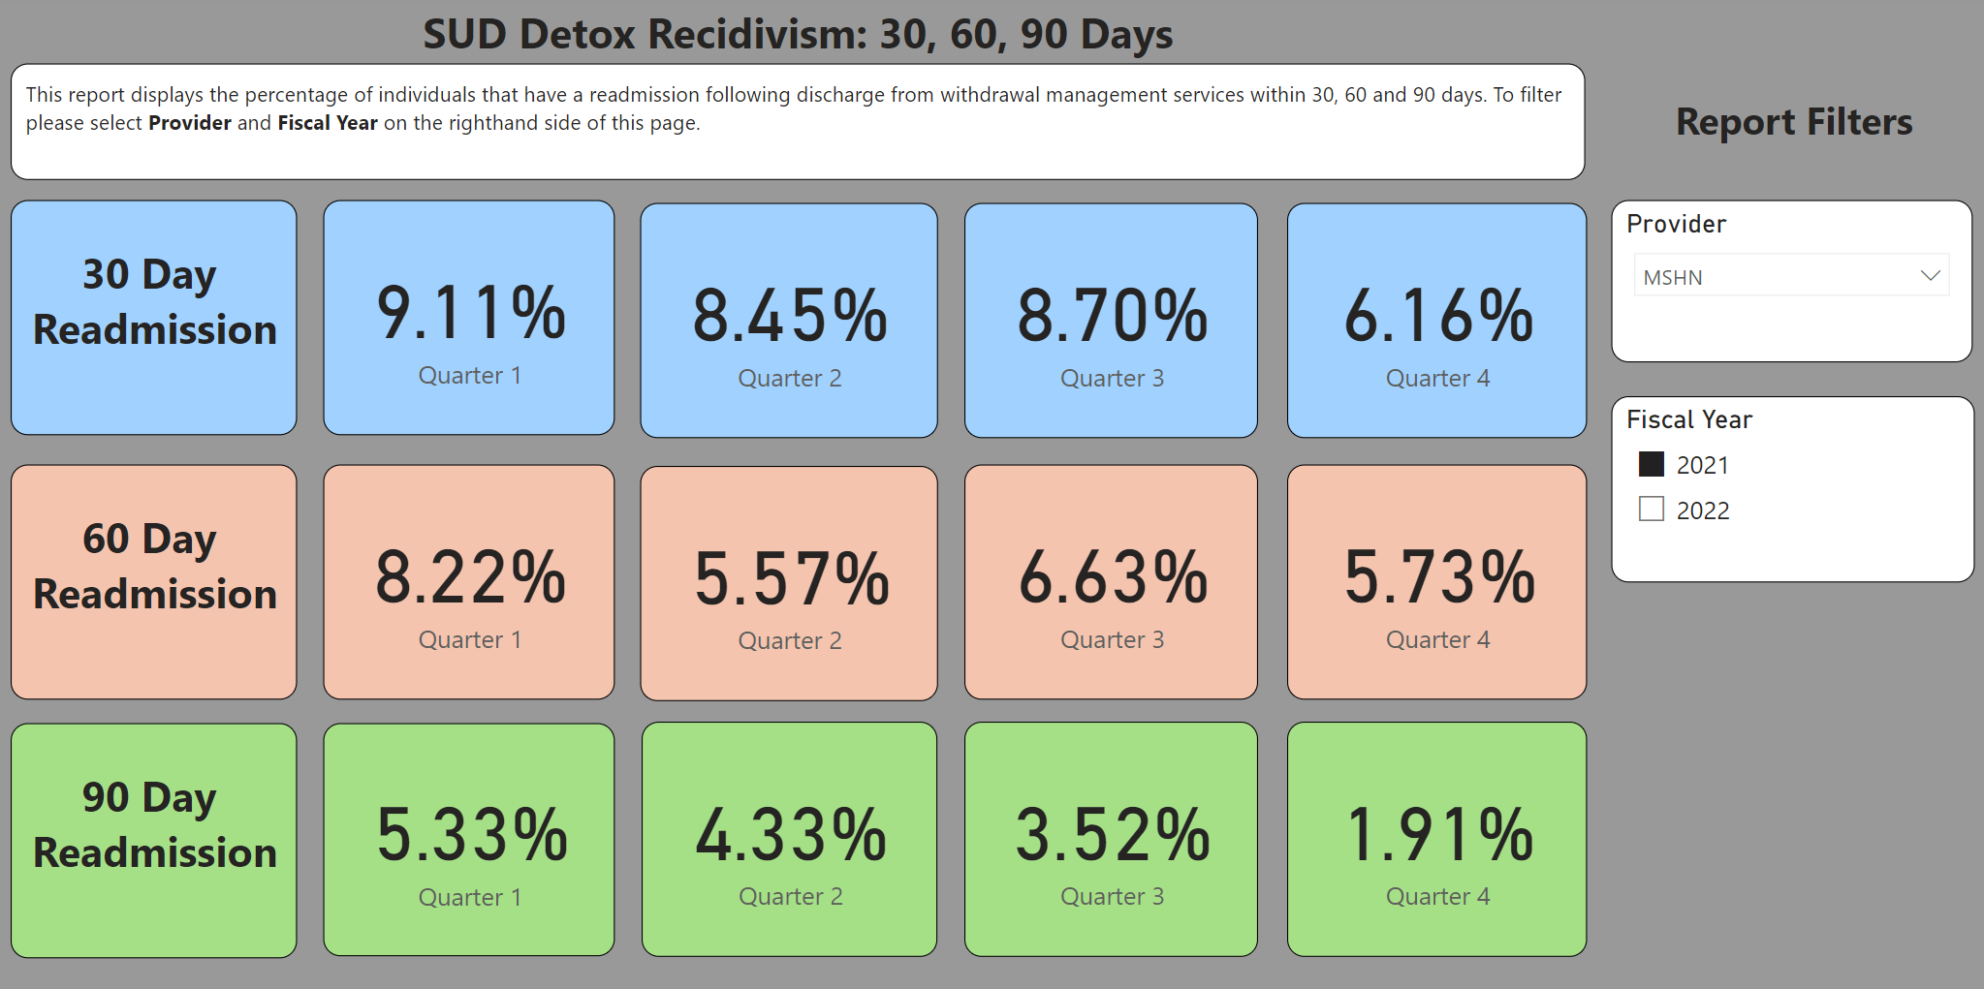
www.midstatehealthnetwork.org

Slide 20
Treatment Data on MSHN Website
Contractual Performance Objectives
Initiation and Engagement of Alcohol and Other Drug (AOD) Dependence
Percent Initiation: Percent of new AOD episodes where treatment was initiated within 14 days of the diagnosis
Scope: Inclusive of all persons (adolescents 13 years or older and adult) who request a new SUD treatment/service and receives that service/encounter within 14 days. This includes inpatient AOD admission, outpatient visit, intensive outpatient encounter or partial hospitalization, telehealth or medication assisted treatment.
Percent Engagement: Percent of new AOD episodes where treatment was initiated and there were two or more additional services with a diagnosis of AOD within 30 days of the initiation visit
Scope: Inclusive of all persons (adolescents 13 years or older and adult) who had treatment/service initiated, followed by two or more services within 30 days of the first treatment. This includes AOD services and medication assisted treatment.
www.midstatehealthnetwork.org

Slide 21
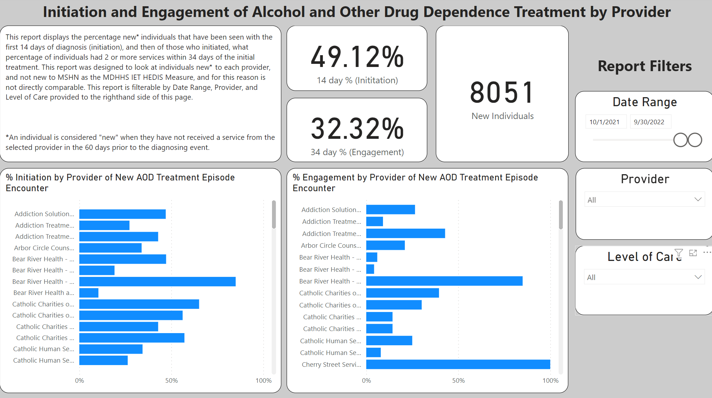
www.midstatehealthnetwork.org​

Slide 22
Treatment Data on MSHN Website
Contractual Performance Objectives
Michigan Mission Based Performance Indicators (MMBPIS)
Indicator 2e.: The percentage of new persons during the quarter receiving a face-to-face service for treatment or supports within 14 calendar days of a non-emergency request for service for persons with Substance Use Disorders.
Scope: All new persons approved/authorized for SUD services (including Medicaid and Non-Medicaid) r the person does not have an open admission at this provider or was discharged from this SUD provider more than 60 days ago.
Indicator 4.b.: The percent of discharges from a substance abuse detox unit who are seen for follow-up care within seven days.
Scope: All Medicaid eligible persons who are seen by a Substance Use Professional within seven (7) days from date of discharge from a substance use detox provider.
Standard: 95% or above
2e – Coming Soon
www.midstatehealthnetwork.org

Slide 23
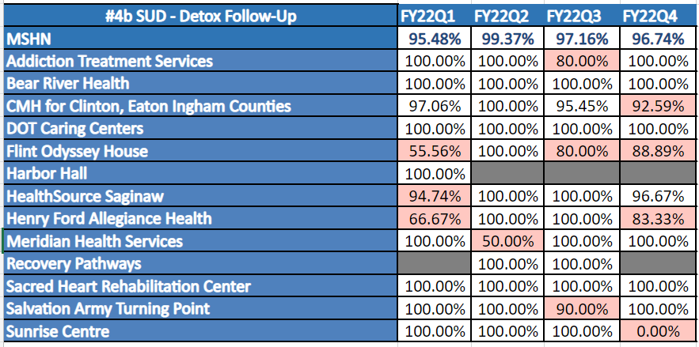
www.midstatehealthnetwork.org​

Slide 24
Treatment Data on MSHN Website
Live on Website March 18
Quarterly Data Workgroup
Optional
Virtual
Available/Open
Discuss metrics
Q&A
www.midstatehealthnetwork.org

Slide 25
Lecture Series
Dani Meier, PhD, MSW, MA
Chief Clinical Officer
www.midstatehealthnetwork.org

Slide 26
The "Why:" OD Death Rate Disparities (Michigan)
NOTE:
OD Death
Rates are
Shown per
100,000
Data Source: MDHHS MODA Dashboard
www.midstatehealthnetwork.org​

Slide 27
OD Death Rate Disparities (Jackson)
NOTE:
OD Death
Rates are
Shown per
100,000
Data Source: MDHHS MODA Dashboard
www.midstatehealthnetwork.org​

Slide 28
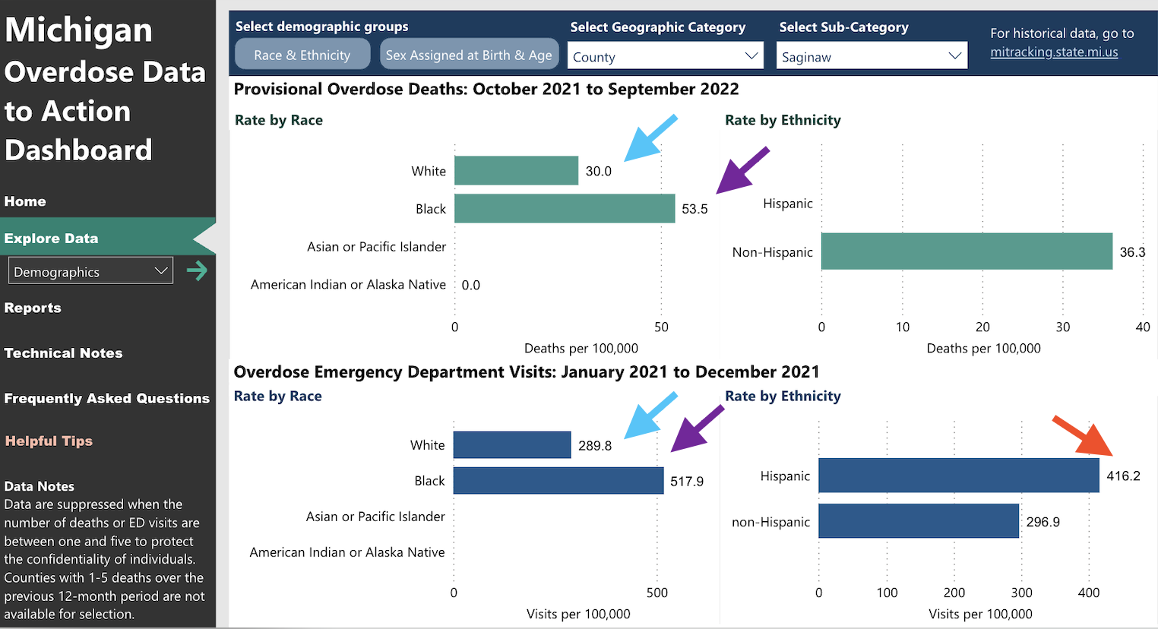
OD Death Rate Disparities (Saginaw)
NOTE:
OD Death
Rates are
Shown per
100,000
Data Source: MDHHS MODA Dashboard
www.midstatehealthnetwork.org​

Slide 29
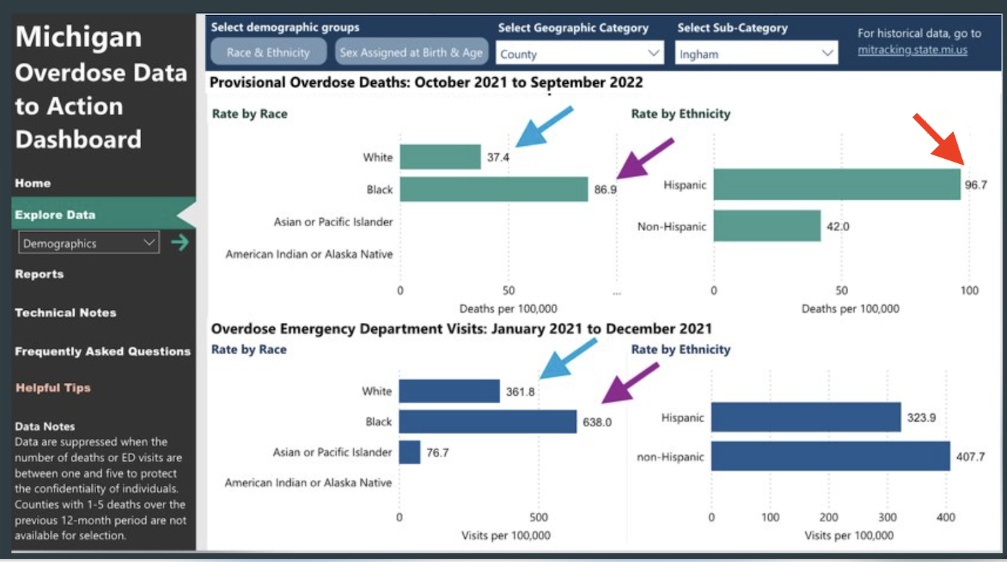
OD Death Rate Disparities (Ingham)
NOTE:
OD Death
Rates are
Shown per
100,000
Data Source: MDHHS MODA Dashboard
www.midstatehealthnetwork.org​

Slide 30
OD Death Rate Disparities (Clare)
NOTE:
OD Death
Rates are
Shown per
100,000
Data Source: MDHHS MODA Dashboard
www.midstatehealthnetwork.org​

Slide 31
Why do some Counties have no data?
Data Source: MDHHS MODA Dashboard
www.midstatehealthnetwork.org​

Slide 32
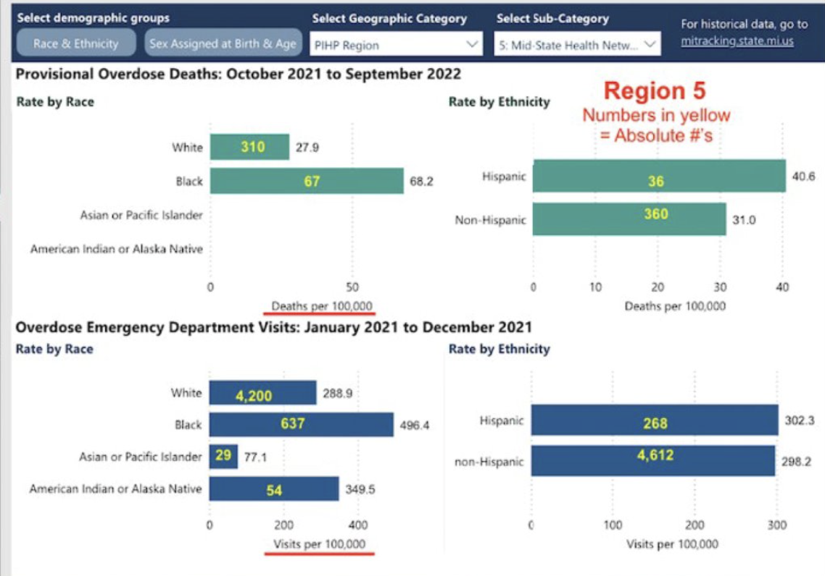
Region 5: Rates per 100,000 & Absolute Numbers
Data Source: MDHHS MODA Dashboard
www.midstatehealthnetwork.org​

Slide 33
MSHN’s Health Equity Commitments
MSHN’s Mission:
“To ensure access to high-quality ... public behavioral health and substance use disorder services.”
This mission applies to all Region 5 residents.
MSHN’s Strategic Priority for Better Equity:
“To ensure all persons have the same opportunities to be healthy, especially those who belong to socially disadvantaged or historically marginalized groups.”
MSHN’s Strategic Priority to Reduce Overdose Deaths:
“To identify regional strategies for the prevention and treatment of substance use disorders and for reducing overdose deaths.
www.midstatehealthnetwork.org​

Slide 34
“Equity Upstream” Underlying Premises
Equity Upstream references the parable in which someone travels upstream to solve a problem that keeps manifesting downriver.
Downstream are racial & ethnic disparities in overdose death rates.
Going upstream: Can improve understanding of the underlying systemic barriers, social determinants of health, intergenerational trauma & embedded biases.
www.midstatehealthnetwork.org​

Slide 35
Spring 2023 Lectures
FOCUS: To illuminate the landscape of health disparities in the SUD realm with an overview of baseline disparity data, etc. and to contextualize what’s known re: WHY these disparities exist (systemic racism, implicit bias, access issues, mistrust of the medical system, etc.).
April 26, 2023 - Camara Jones, MD, MPH, PhD
May 9, 2023 - Haner Hernandez, PhD, CPS (ATTC)
May 25, 2023 - Donald Warne, MD, MPH (Indigenous Health Policy, JHU)
June (TBD) 2023 - Larke Huang, PhD (Office of Behavioral Health Equity, SAMHSA)
Fall Lecture Series – TBD
(Focus on Evidence-Based Practices)
www.midstatehealthnetwork.org​

Slide 36
Two Tracks
Lecture Series:
To deepen understanding of systemic barriers & structural challenges to eliminating health disparities in substance use disorder (SUD) access & service delivery.
Learning Collaborative (Pilot):
A cohort of providers will examine their own data and will work with each other to apply data, community input & best practices to inform action plans to improve access to quality care and to reduce overdose deaths.
www.midstatehealthnetwork.org​

Slide 37
Defining Success
Widespread attendance for Lecture Series
Learning Collaborative (LC) participants have action teams & action plans informed by data & community input
Action plans are implemented with interventions and/or improvements to policy & practices to reduce overdose death disparities
Evidence of declining disparities
Creation of a model for broad regional & statewide (national?) change
www.midstatehealthnetwork.org​

Slide 38
www.midstatehealthnetwork.org​

Slide 39
SOR Grant FY22 Activity Report
Heather English, Grant Coordinator
www.midstatehealthnetwork.org

Slide 40
State Opioid Response (SOR) Grant Update
MSHN has received SOR funds since 2018
Funds expanded to include both opioid and/or stimulant use disorders in 2021
Projects & programs include:
Jackson Engagement Center with Home of New Vision
Post-Overdose Response Team in Lansing with the Ingham Co. Health Dept.
Mobile Care Unit with Recovery Pathways
Expansion of Prime for Life & Botvin's LifeSkills drug education/prevention programs
Hidden in Plain Sight drug education trailer
Expansion of jail-based MAT
www.midstatehealthnetwork.org​

Slide 41
State Opioid Response (SOR) Grant Update (cont.)
Increased local overdose education/harm reduction efforts in all 21 counties, bringing down over $1,250,000 in federal funds to our region since 2019 for just the coalitions alone
Several law enforcement agencies received stick-proof gloves
Medication lock boxes for individuals in MAT and recovery homes
Expanded access to safe medication disposal through community-based drop boxes, individual disposal pouches, and incineration costs
Increased community-based peer recovery coaching and support groups
www.midstatehealthnetwork.org​

Slide 42
Narcan Vending Machines in Region 5
Heather English, Grant Coordinator
www.midstatehealthnetwork.org

Slide 43
Narcan Vending Machines in Region 5
The below agencies have been approved through MSHN to purchase vending machines to be placed in the following locations:
Eaton RESA
Ingham County Health Department
Barry Eaton District Health Department
Family Service & Children's Aid
Jackson County
Gratiot County Substance Abuse Coalition of Child Advocacy
Gratiot Integrated Health Network
Ionia County Health Department
Ionia County Health Department
www.midstatehealthnetwork.org

Slide 44
Narcan Vending Machines in Region 5
Mid-Michigan Recovery Services
Ingham County
List Psychological Services
Tuscola County Health Department
Wellness InX, LLC
Ingham County
www.midstatehealthnetwork.org

Slide 45
More Harm Reduction Activity in Region 5
Since October 1st, our region has distributed...
6,600 fentanyl test strips | 325 HIV tests | 300 HCV tests
www.midstatehealthnetwork.org

Slide 46
More Harm Reduction Activity in Region 5
As of October 1st, our region has helped launch...
8 NEW Narcan vending machines in
6 counties
www.midstatehealthnetwork.org

Slide 47
Tuscola County's Harm Reduction Vending Machine
As of January 1st, Tuscola County's machine has distributed...
41 Narcan kits | 21 fentanyl test strips | 32 condoms | 32 med disposal bags
www.midstatehealthnetwork.org

Slide 48
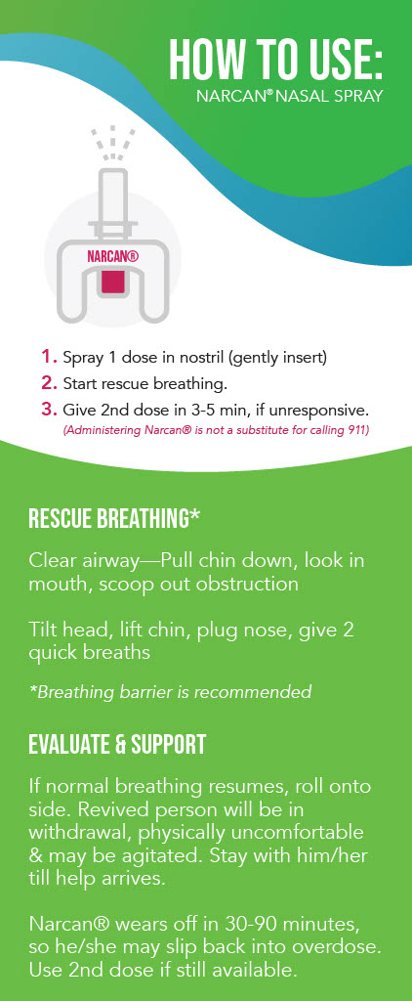
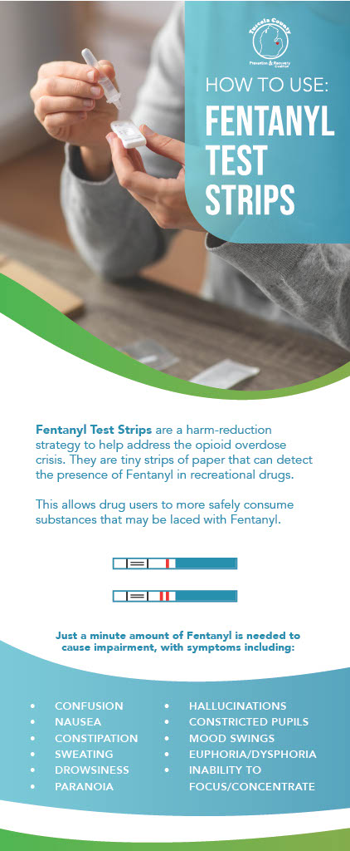
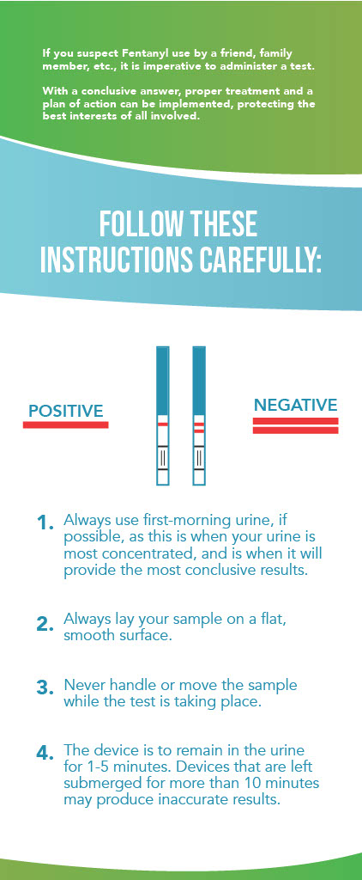
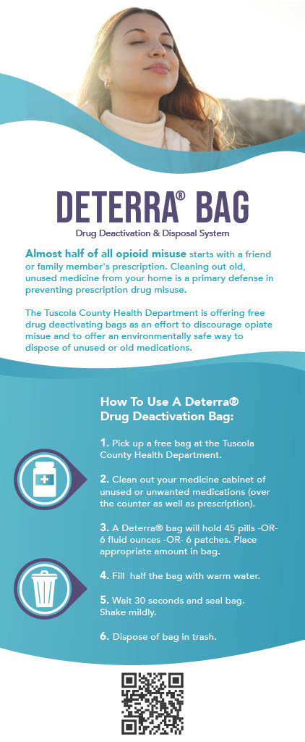
Tuscola County's Harm Reduction Vending Machine
All items are available free of charge
Vending machine is located at the health department
Harm reduction brochures, materials available nearby
www.midstatehealthnetwork.org

Slide 49
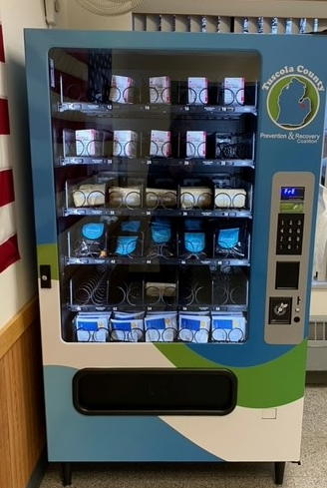
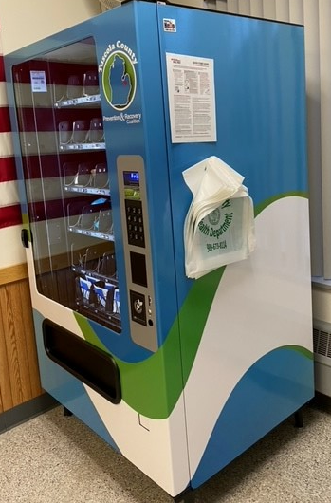
www.midstatehealthnetwork.org

Slide 50
Shiawassee County’s Safer Use Cards
Hillsdale County’s Harm Reduction Kits
www.midstatehealthnetwork.org

Slide 51
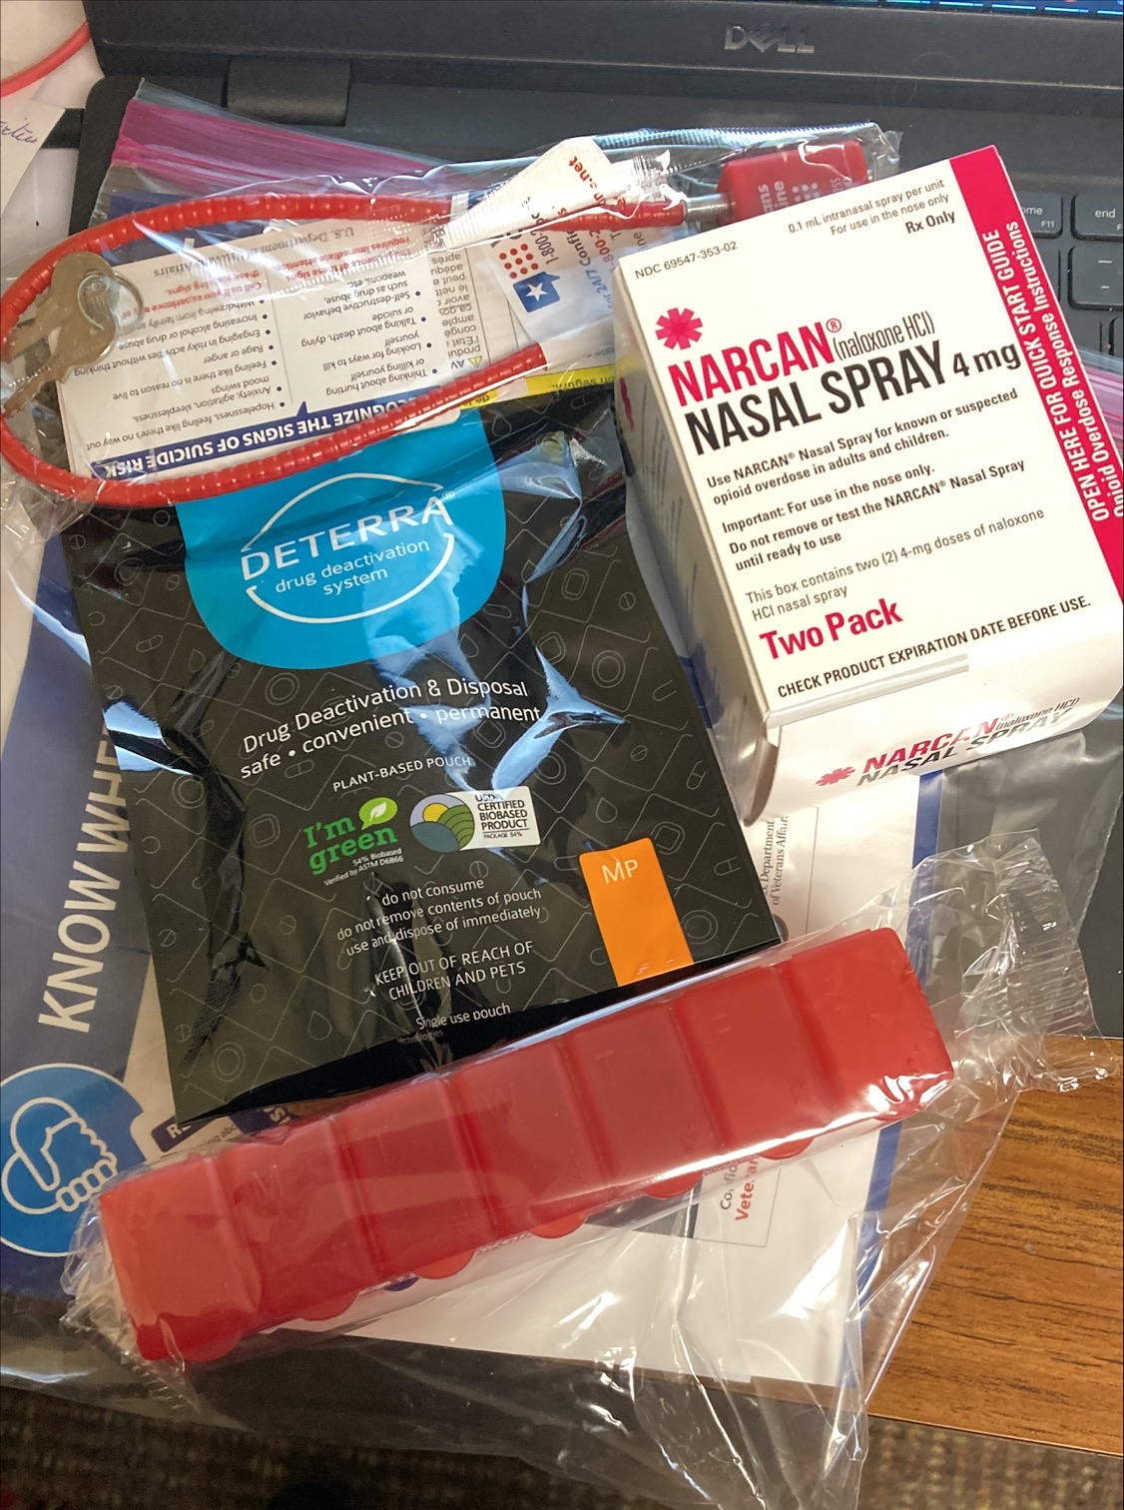
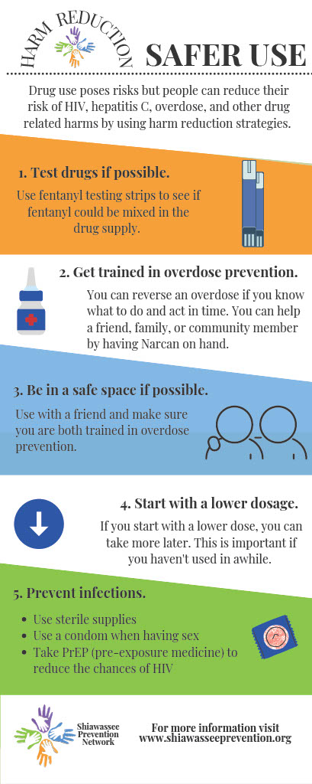
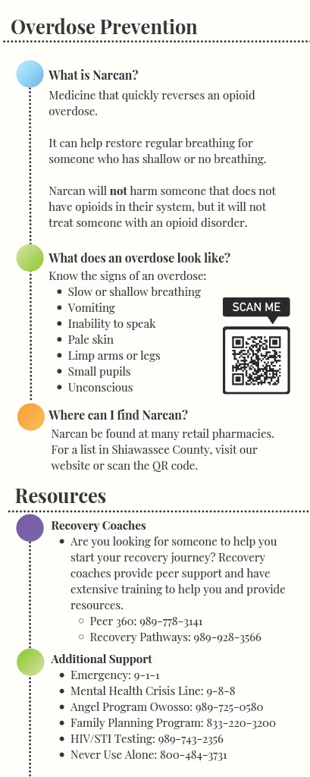
Shiawassee County’s Safer Use Cards
Hillsdale County’s Harm Reduction Kits
www.midstatehealthnetwork.org

Slide 52
Treatment Breakout Session
www.midstatehealthnetwork.org

Slide 53
Treatment Breakout Session Agenda
Trisha Thrush: MSHN Staffing Updates for Treatment, Integrated Care, QAPI & Compliance
Sherrie Donnelly: FY24 Annual Planning Process
Trisha Thrush: ASAM Continuum FAQ & Clinician Process for Access in REMI
Tammy Foster: Veteran Navigator Referral Process
Evan Godfrey: SUD Care Navigator
Trisha Thrush: Residential Workgroup Update
Sherrie Donnelly: BH-TEDS Update
Sherrie Donnelly: Peer Certification Updates for CPSS & CPRC
Sherrie Donnelly: Training Opportunities
www.midstatehealthnetwork.org

Slide 54
MSHN Staffing Updates for Treatment, Integrated Care, QAPI & Compliance
Dr. Trisha Thrush, Director of SUD Serivces & Operations
www.midstatehealthnetwork.org

Slide 55
MSHN Staffing Updates for Treatment, QAPI & Integrated Care
Treatment Team:
Welcome Kate Flavin: Treatment Specialist
Utilization & Care Management:
Welcome Keeley Hapanowicz and Stacey Lehmann: Utilization Management Specialists
Welcome Evan Godfrey: SUD Care Navigator
QAPI:
Welcome Shannon Myers: Quality Assurance & Performance Improvement Manager
www.midstatehealthnetwork.org

Slide 56
MSHN SUD Review Team
Kim Zimmerman
Chief Quality and Compliance Officer 517.657.3018 kim.zimmerman@midstatehealthnetwork.org
Amy Dillon
Compliance Administrator 517.220.2335 amy.dillon@midstatehealthnetwork.org
Bria Perkins
Medicaid Event/Internal Auditor 517.318.6346 bria.perkins@midstatehealthnetwork.org
Shannon Myers
Quality Assurance & Performance Improvement Manager 517.657.3012 shannon.myers@midstatehealthnetwork.org
Melissa Davis
Quality Assurance & Performance Improvement Manager 517.657.3005 melissa.davis@midstatehealthnetwork.org
Focus Specific Reviewers
Brandilyn Mason (Financial Review)
Financial Specialist 517.993.5702 brandilyn.mason@midstatehealthnetwork.org
Dan Dedloff (Grievance, Appeals, ABD Review)
Customer Service and Rights Manager 517.657.3011 dan.dedloff@midstatehealthnetwork.org
Sandy Gettel (Residential Provider reviews-Quality and Critical Incidents)
Quality Manager 517.220.2422 sandy.gettel@midstatehealthnetwork.org
www.midstatehealthnetwork.org​

Slide 57
FY24 SUD Treatment & Recovery Annual Planning Process
Sherrie Donnelly, Treatment & Recovery Specialist
www.midstatehealthnetwork.org

Slide 58
Purpose
Annual plan meetings provide MSHN Treatment Specialists with the opportunity to:
Discuss your agency’s goals for the upcoming fiscal year
Provide an opportunity for the provider to share successes or innovative ideas
Hear about challenges and support needs
Opportunities for technical assistance
Support relationship building between the provider and MSHN
Annual Plans are completed during a collaborative meeting between the provider agency and the treatment specialists who support the agency. Some meetings may also be supported with Utilization Management specialists as well.
www.midstatehealthnetwork.org

Slide 59
Process
The agency’s lead treatment specialist will reach out and provide FY24 annual plan documents and information individualized to each agency.
Meetings will be completed using the Zoom platform
The annual plan document will be completed by your treatment specialist the day of the meeting
Please review the annual plan documents and be prepared to discuss the items applicable to your agency.
There is no need to complete the document prior to the meeting
Please be prepared to share progress on the DDCAT and Trauma goals identified during the FY23 annual plan process.
www.midstatehealthnetwork.org

Slide 60
Annual Plan Content
Instructions
Annual Plan Update
Content Specific Areas:
Recovery Housing
Women’s Specialty Services
Residential and Withdrawal Management
www.midstatehealthnetwork.org

Slide 61
Timeframe
March
Provider will receive an email with FY24 annual plan documents and request dates and times they are available to meet
Treatment Specialist will schedule annual plan meeting and provide a Zoom meeting invite.
April-May
Annual Plan meetings will take place
Annual Plans will be finalized and placed in the “Annual Plan” folder in BOX for each provider
June
Cost Reimbursed budget requests are due COB 6/1/2023
Please email budgets to Trisha Thrush at trisha.thrush@midstatehealthnetwork.org
Please submit budget(s) early if they are prepared
www.midstatehealthnetwork.org

Slide 62
Timeframe Continued
June
Cost reimbursed budgets will be reviewed
Questions regarding the budget will be shared with the provider
July
Treatment Team makes FY24 contract recommendations
August
FY24 contract recommendations supported by PA2 funding go before Oversight Policy Board (OPB) for review and approval/denial.
Items approved will move to MSHN Board of Directors (BOD) for final review of approval/denial.
September
FY24 contract recommendations go before MSHN Board of Directions (BOD)
If approved, MSHN Contract Manager, Kyle Jaskulka, will send contracts to providers.
If denied, MSHN treatment specialist would be in contact and follow-up
www.midstatehealthnetwork.org

Slide 63
Questions?
www.midstatehealthnetwork.org

Slide 64
ASAM Continuum FAQ & Clinician Process for Access in REMI
Dr. Trisha Thrush, Director of SUD Serivces & Operations
www.midstatehealthnetwork.org

Slide 65
ASAM Continuum & GAIN I-Core FAQ
MSHN is hoping to get provider feedback to update the existing ASAM Continuum & GAIN I-Core FAQ document for regional guidance.
What items should MSHN be aware of that are struggles/challenges/unknown how to support, that we can assist with?
Please send feedback to Trisha Thrush at trisha.thrush@midstatehealthnetwork.org
www.midstatehealthnetwork.org

Slide 66
Process to request ASAM Continuum access in REMI
For a clinician to have access to ASAM Continuum in REMI, they need to have the following in place:
Completed the 8 hour virtual/self-paced ASAM Continuum training and have the certificate of completion
Appropriate education/credentials to support the ASAM Continuum in practice
Have an active account in REMI as a provider clinician
Contact your agency lead Treatment Specialist to request access to ASAM Continuum in REMI with the following information:
Clinicians name
Education/credentials
Active email
ASAM Continuum Certificate of Completion
**Treatment specialist will work internally to provide access. Clinician will receive an email with instructions about how to access ASAM Continuum, when available.
www.midstatehealthnetwork.org

Slide 67
Veteran Navigator Referral Process
Tammy Foster, Veteran Navigator
www.midstatehealthnetwork.org

Slide 68
Veteran Navigator
Offer veterans & military families (VMF) supports from a person with lived military experience
Help connect VMF to SUD, behavioral health and other health services
Provide VMFs support with navigating benefits & other social services, links to basic needs like housing & food
Provide military cultural competency trainings
Expand strategies for reducing stigma & suicide
Follow up with SUD & CMH providers
www.midstatehealthnetwork.org

Slide 69
SUD Care Navigator
Evan Godfrey, SUD Care Navigator
(517) 657-3358
Evan.Godfrey@midstatehealthnetwork.org
www.midstatehealthnetwork.org

Slide 70
SUD Care Navigator
Serves as regional liaison with Michigan Dept of Corrections (MDOC) and facilitates referrals to treatment for individuals under supervision of MDOC
This includes residential and MAT re-entry referrals
Responsible for supporting SUD providers with meeting the needs of priority population individuals
Partners with SUD providers to facilitate discharge planning and transitions of care for individuals
Assists with care coordination among and between SUD Providers for individuals with complex needs
Raises awareness of available resources and community supports to all SUD clients in the region
Housing, education, employment, food assistance, etc.
www.midstatehealthnetwork.org

Slide 71
Residential Workgroup Update
Dr. Trisha Thrush, Director of SUD Serivces & Operations
www.midstatehealthnetwork.org

Slide 72
BH-TEDS Updates
Sherrie Donnelly, Treatment & Recovery
Specialist
www.midstatehealthnetwork.org

Slide 73
BH-TEDS Update
BH-TEDS information must be updated annually
The State Provider identifier is the LARA or MDHHS assigned number
Discharge Considerations
WM-No services for 3 days
Outpatient- No services for 45 days
The discharge date must be the last day of billable services
The discharge date could reflect back up to 45 days
In cases that a death has occurred, the end date should be the date of death. Data based on the individual’s last face-to-face service should be used when the information is not available for date of death.
www.midstatehealthnetwork.org

Slide 74
Peer Certification Updates for CPSS & CPRC
Sherrie Donnelly, Treatment & Recovery Specialist
www.midstatehealthnetwork.org

Slide 75
Peer Certification Updates for CPSS & CPRC
New changes related to peer continuing education and certification:
Certification expires in 2 years unless the 32 hours of CEs, including 6 hours of Ethics, has been completed
Trainings must be completed through MDHHS
A complete listing of the requirements is available at:
www.michigan.gov/mdhhs/keep-mi-healthy/mentalhealth/drugcontrol/peer-recovery-information
www.midstatehealthnetwork.org

Slide 76
Training Opportunities!
Sherrie Donnelly, Treatment & Recovery Specialist
www.midstatehealthnetwork.org

Slide 77
Upcoming Training Opportunities
Loss, Grief and Substance Use (virtual, 2 half days)
April 4-5, all providers
Trauma-Focused Yoga (in-person, in-region)
May 9-10, Doubletree, Bay City
May 17-18, Comfort Inn, Okemos
$100 registration fee per person
Solution-Focused Brief Therapy (virtual, 2 full days)
June 1-2, in-region
Essentials of CBT (virtual, 2 full days)
August 28-29, in-region
www.midstatehealthnetwork.org

Slide 78
Questions?
www.midstatehealthnetwork.org

Slide 79
Upcoming SUD Provider Meetings
June 15, 2023
September 21, 2023
Note: date may be adjusted based on dates of MDHHS SUD & Co-Occurring Conference in 2023
December 14, 2023
NOTE: All meetings will be held via Zoom from 12-2pm
Agendas and old meeting notes can be found on our website here: https://tinyurl.com/mshnsudmtgs
Sign up for the Constant Contact weekly SUD Provider Newsletter here: https://tinyurl.com/mshnnews
www.midstatehealthnetwork.org

