Slide 1

Quarterly SUD Provider Meeting
Welcome!
We’ll get started at 12:05.
The meeting will be recorded and posted to the MSHN website afterwards.

Slide 2

Quarterly SUD Provider Meeting
December 18, 2025

Slide 3
Plenary Agenda
Amanda Ittner: Welcome & Regional Update
Britte'Nee Simpson: OPEN Warmline
Stacey Lehmann:
  FY25 SOR Annual Report
  FY26 SOR Updates:
    Treatment Providers: SUPRT A/C Tools & Resources
    SUD Prevention Coalitions: Mini Grant Awards
  FY25 MSHN Opioid Settlement Fund Annual Report
  Narcan Resource & New MDHHS Process for Requests
  SOR Overdose Prevention Request Process
Kara Laferty: FY25 SUD Satisfaction Survey Results
Dr. Allison Lin & Andrew Coleman: Coalition for Harm Reduction & Prevention (CHRP)

Slide 4
Welcome
&
MSHN General Remarks
Amanda Ittner
MSHN Deputy Director

Slide 5
General Remarks – Amanda Ittner
Joe Sedlock has an unavoidable conflict and sends his greetings.
Welcome and Gratitude
MDHHS PIHP Procurement Update
MSHN and five other parties have filed suit against the State intended to secure a preliminary injunction to stop the RFP from being implemented.
MSHN legally restricted to its current 21 counties
Court of Claims ruled that MDHHS has the authority to use a competitive procurement process and to establish the number of regions.
  Request for reconsideration around the issue of defining Regional Entity Regions.
  12/8, 12/9 and 12/10 hearing, arguments, and testimony on that question and legality of elements within the RFP.
  Decision expected by next week.

Slide 6
General Remarks
MSHN Submitted a non-conforming bid – meaning the bid did not comply with all bid specifications
  In the event that the lawsuit is successful in stopping the RFP, there will be no bid awards
  In the event that the lawsuit is unsuccessful in stopping the RFP, MDHHS is expected to announce bid awards “mid-December”
FY 26 Budget Update
MSHN’s financial position has improved significantly.
MSHN will maintain it’s posture to not support new initiatives this fiscal year.
Federal/State
Medicaid reductions coming – prepare!

Slide 7

Questions?

Slide 8
OPEN Warmline
Britte'Nee Simpson
Warmline Manager

Slide 9
Questions?

Slide 10
FY25 SOR Annual Report
Stacey Lehmann
Data & Grant Coordinator

Slide 11
FY25 SOR Annual Report
Prevention EBP
  Served 762 youth utilizing Botvin Lifeskills
Jail-based MOUD
  Support providers in 7 facilities: Isabella County Jail, Midland County Jail, Bay County Jail, Bay County Juvenile Home, Gladwin/Clare County Jail, Eaton County Jail, and Ingham County Jail.
  Served 656 individuals
  Services provided included: Group and individual therapy, MOUD, case management, and peer recovery coaching.

Slide 12
FY25 SOR Annual Report
Peer Outreach and Linkage
  The Engagement Center in Jackson County supported a total number of 1265 admissions and 1530 telephone screenings.
  Most common substances reported during intake: methamphetamines, alcohol, cocaine, and opiates/heroin.
  Referrals to SUD Treatment: 487
  Referrals to Mental Health Treatment: 567

Slide 13
FY25 SOR Annual Report
Quick Response Team (QRT)
  220 successful contacts with individuals post overdose.
  Substances reported: Fentanyl, heroin, cocaine, methamphetamine, alcohol, and MDMA
  Reported a total of 130 referrals to SUD residential & outpatient treatment services.
  Distributed 735 fentanyl test strips.

Slide 14
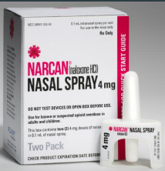
FY25 SOR Annual Report
Overdose Education & Naloxone Distribution
  In FY25 through the MDHHS portal, MSHN region ordered 6,422 cases (77,064 cartons) of Naloxone.

Slide 15
FY26 SOR Updates
Stacey Lehmann
Data & Grant Coordinator

Slide 16
FY26 SOR Updates: SUPRT-A/C
State Opioid Response – SUPRT A/C Resources
  SOR SUPRT-A/C Links
  Frequently Asked Questions Documents
  SUPRT-A/C Training
The WSU Evaluation team will continue to host SUPRT Q & A sessions throughout the year. These will be held the third Thursday of each month from 11 AM - 11:30 AM.
  You can register and submit questions ahead of time here: SOR SUPRT-A/C Q & A Registration

Slide 17
FY26 SOR Updates:
SUD Prevention Coalition Mini Grant Awards
$197,229 approved and allocated to 13 coalitions
Award notices have been sent to all providers who submitted a proposal.
Reporting Requirements:
  Monthly reporting is due by the 5th of the subsequent month, unless the 5th falls on a weekend then it is due the following Monday.
  Outcome reporting templates sent to Stacey Lehmann at Stacey.Lehmann@midstatehealthnetwork.org
  Providers were given calendar reminders for SOR Reporting requirements and templates to use for submission.

Slide 18
FY26 SOR Updates:
SUD Prevention Coalition Mini Grant Awards
Finance/Reimbursement Information:
  A Financial Status Report (FSR) will be used for billing and reimbursement purposes, similar to the process for billing prevention.
  Submit the FSR by the 10th of each month.
    If the 10th falls on a weekend, the FSR is due the following Monday. FSRs will be paid on the third Friday of each month. The final FSR will be due August 10th.
  In addition to the FSR, please upload documentation (i.e., payroll records, vendor invoices) to support the amount being requested in the folder corresponding to the month being billed.
    Note: Vendor invoices should indicate invoice; vendor quotes are not acceptable. The term of the grant is November 1, 2025, through June 30, 2026. Any expenses being billed must occur during the grant period.

Slide 19
FY25 MSHN Region
Opioid Settlement Fund Annual Report
Stacey Lehmann
Data & Grant Coordinator

Slide 20
FY25 MSHN Region Opioid Settlement Fund Annual Report
Opioid Settlement Transparency & Accountability – Mid-State Health Network
  Annual reporting update available on the MSHN website to share progress per provider in MSHN counties
$549,313 was approved/allocated for FY25
Projects went from 4/1/25-9/30/25 with 21 providers receiving funding
Projects included ordering and distributing overdose prevention and infectious disease prevention materials, transportation to get to/from appointments, technology upgrades, groups for children and adolescents impacted by SUD overdose and death, support for Rainbow Days summer camp, services in Tuscola County Jail, and more!

Slide 21
FY25 MSHN Region Opioid Settlement Fund Annual Report
Overdose Prevention & Infectious Disease Control
  1,091 Medication lock boxes/bags
  2,357 First aid and wound care kits
  2,477 Deterra pouches/medication disposal pouches
  5,847 Fentanyl test strips
  3,487 Xylazine test strips
  1,265 Sharps containers
  And many other items!

Slide 22
FY25 MSHN Region Opioid Settlement Fund Annual Report
Increasing Access to Special Populations
  Groups for children and adolescents impacted by SUD overdose and death
    10 groups held
    63 encounters with youth over this reporting period
  Rainbow Days Summer Camp – Camp Connection
    16 campers and 11 Teens Advocating Prevention volunteers
    Pre/post survey indicated 15% increase in positive self-esteem and awareness
  SUD Treatment Groups in Tuscola County Jail
    18 groups with 8 - 10 participants on average for each group

Slide 23
FY25 MSHN Region Opioid Settlement Fund Annual Report
Community Education & Recovery Events
  Harm Reduction Summit in Mecosta and Osceola Counties
    115 attendees.
    Focus was to help reduce the stigma surrounding substance use, fostering a community culture rich in support, collaboration, and preventative strategies.
  Recovery Symposium in Montcalm County
    84 attendees
    Goal was to foster hope among those touched by addiction, offer recovery/prevention resources to those and need, and help make personal connections to increase wellness within the recovery community.
  Spring Symposium in Montcalm County
    75 attendees
    Foster anti-stigma prevention and education.

Slide 24
FY25 MSHN Region Opioid Settlement Fund Annual Report
Transportation to/from SUD Treatment
  82 trips supported in Bay County
  2,200 gas cards for Lansing, Jackson, and Saginaw
  $4,150 worth of bus passes for Lansing
  $1,960 worth of bus passes for Saginaw
  60 CATA 31-day bus passes and 66 CATA 10-ride bus passes for Lansing
  Two staff completed CDL training and passed the skills tests to be able to drive the agency bus to support transportation for people in services.

Slide 25


FY26 Opioid Settlement Funds
MSHN has been granted the ability to roll over opioid settlement funds that were unallocated from FY25 into FY26 by MDHHS.
Opportunity for feedback: What recommendations do you have for ways MSHN could utilize the funds to support the region, and/or individual county needs?

Slide 26



NARCAN: FREE Resource
Any organization can reach out to the state’s NARCAN representative, Amanda Lick (licka@ebsi.com), and she can place an order for resources you may be interested in.
They provide the reusable demonstration devices, pins, window stickers, and various informational brochures, at no cost.

Slide 27
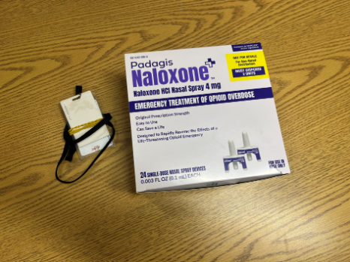
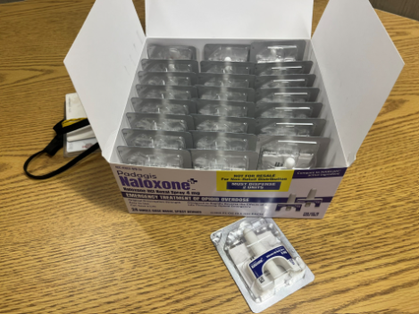
New MDHHS Naloxone Ordering Form
Order by clicking "Order Naloxone to distribute to my community": Naloxone
MDHHS will only be accepting the Microsoft form moving forward. Please delete the PDF if you have it saved.
New bulk order option with Padagis (generic naloxone; 24-count box)
  If you would like to request this option, indicate so in the last question on the form that asks for additional information related to your request
  Reduces packaging waste for agencies that assemble their own overdose response kits

Slide 28
SOR Overdose Prevention Request Process for Supplies & Materials
For FY26, MSHN has allocated a portion of SOR grant funds to offer Overdose Prevention and Infectious Disease Control supplies and materials to the SUD provider network.
Eligible Providers:
  SUD Treatment Providers
  Recovery Housing Providers
  Community Recovery Providers
Supplies ordered through NASEN (North American Syringe Exchange Network)
Data and Grant Coordinator will send out the FY26 NASEN order form with items such as fentanyl test strips, xylazine test strips, HCV tests, HIV antibody tests, and other items.
Provider will fill out the form in its entirety and return to stacey.lehmann@midstatehealthnetwork.org
Documentation will be reviewed internally and if approved items will be ordered and mailed directly to the provider.

Slide 29
Questions?

Slide 30
FY2025 SUD Satisfaction Survey Results
Kara Laferty
Quality Manager
**Please note that the full SUD Satisfaction survey analysis can be found on the MSHN Website under the Provider Network section, under Provider Information, then Satisfaction Surveys
FY25 Satisfaction Survey Report

Slide 31
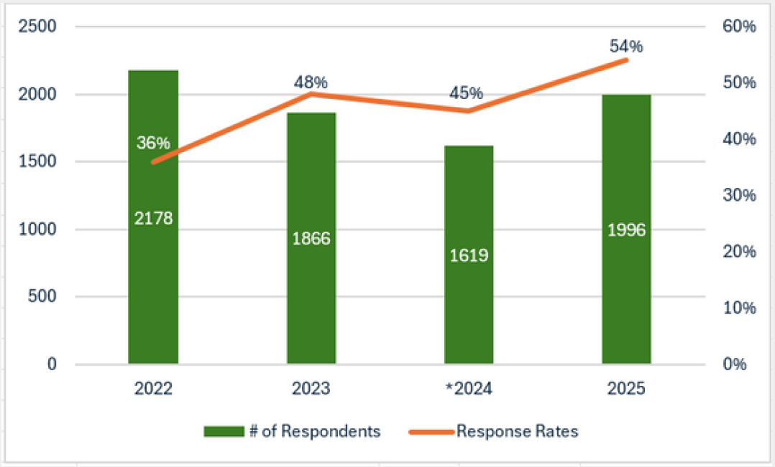
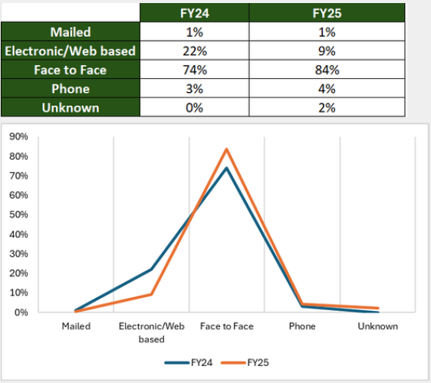
SUD Survey Response Rates
Three thousand six hundred and sixty-five (3,665) individuals received an SUD service during the distribution period
One thousand nine hundred and ninety-six (1,996) completed a MHSIP (Mental Health Statistics Improvement Program) survey during the surveying period resulting in a response rate of 54%
This response rate is the highest response rate when compared to the past six fiscal years with demonstrated improved engagement across nearly all program types
Overall, face-to-face distribution methods were the primary method of distribution in FY25

Slide 32

SUD Survey Quotes

Slide 33
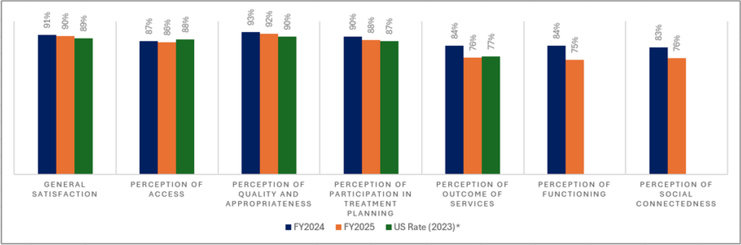
SUD Survey Responses
In comparing FY25 results with FY24, overall satisfaction and perceptions of access, quality, and participation in treatment planning remain strong with only minimal declines across those domains (if any)
Outcome related areas have sharper decreases of note. These results indicate that while consumers continue to report high satisfaction with service quality and engagement, perceptions tied to recovery outcomes and broader social well-being show a downward trend
When comparing FY25 MSHN results to national averages, MSHN continues to meet or exceed U.S. benchmarks in nearly all domains where data exists (other than perception of access and outcomes)

Slide 34

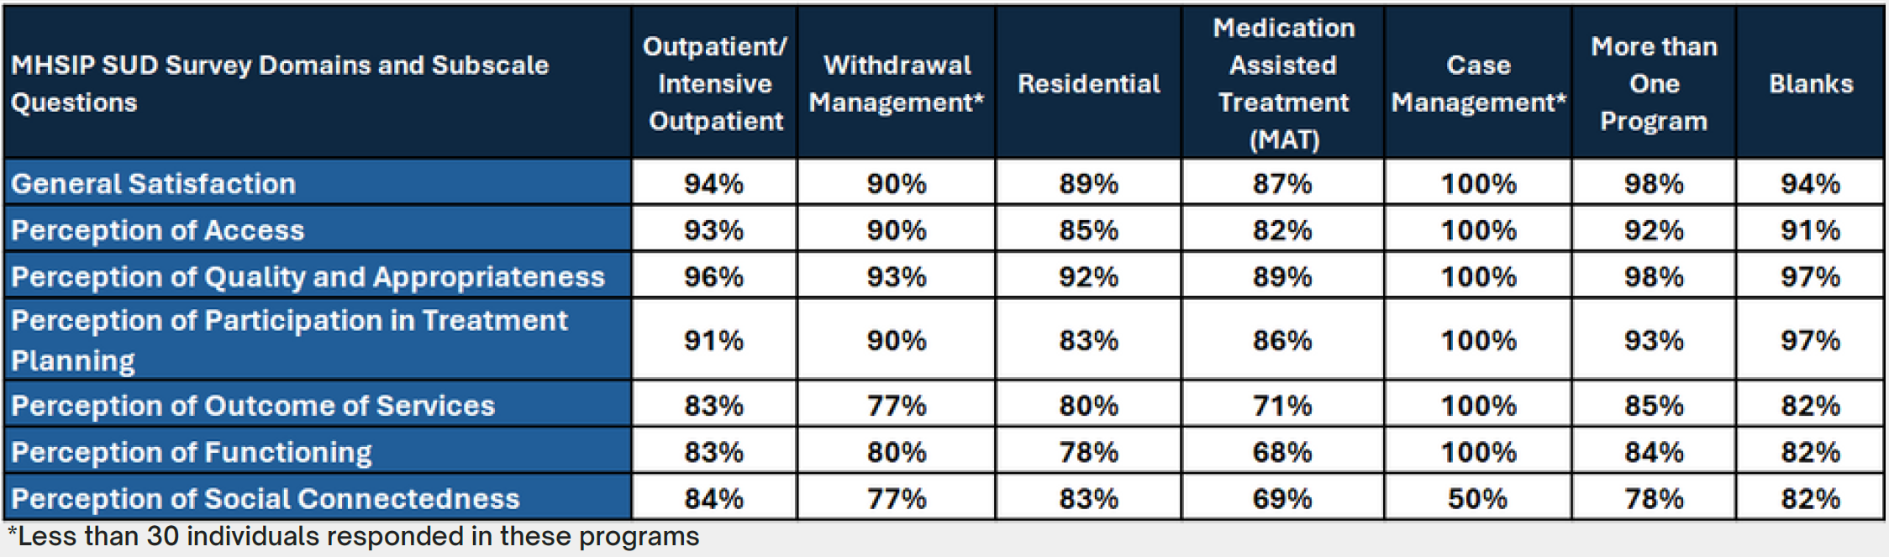
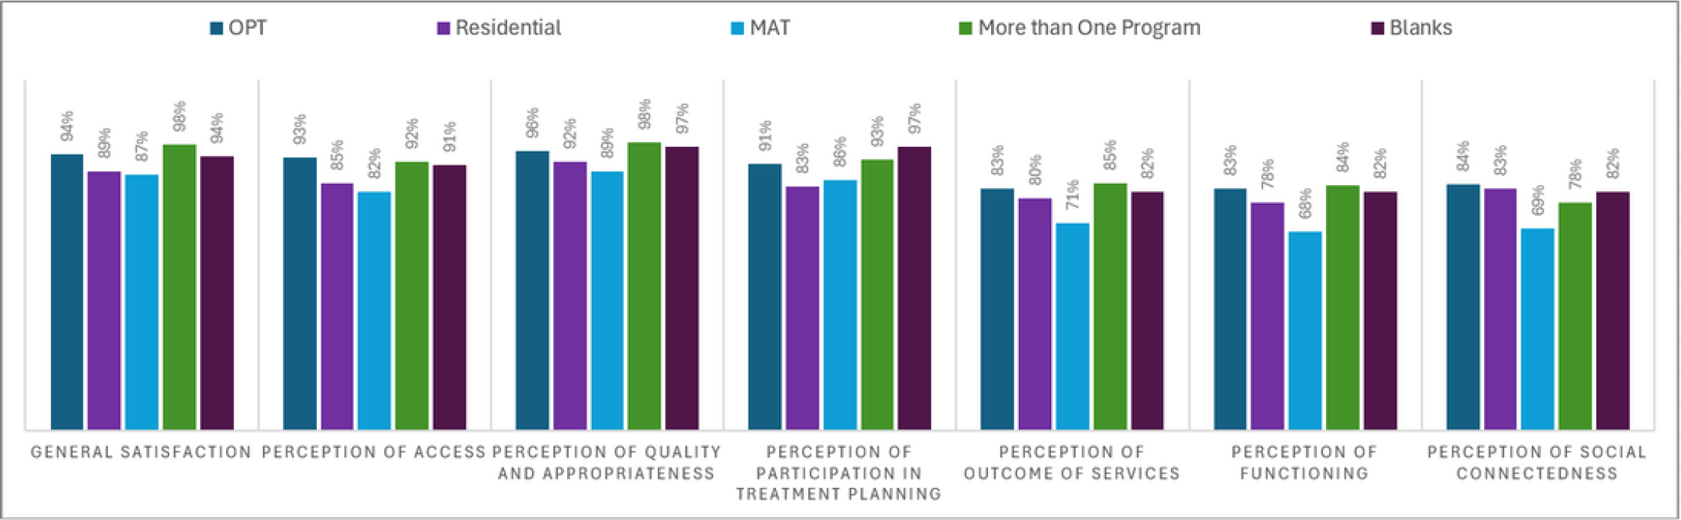
SUD Survey Analysis
Across programs, satisfaction trends for SUD providers in FY25 highlight variations in consumer experience. Outpatient and consumers receiving More than one Program consistently reported the highest levels of satisfaction, with ratings above 90% in most domains
Residential and Medication Assisted Treatment (MAT) participants showed more mixed results: while still strong in general satisfaction and quality, both groups reported lower perceptions of outcomes

Slide 35
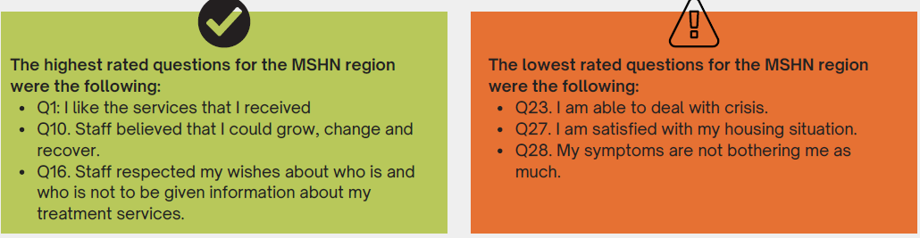
SUD Survey Analysis

Slide 36
Next Steps
A full report was provided to the MSHN leadership team in October
Upon request of the provider, Individualized provider data will be distributed to those providers who utilized the electronic survey
MSHN will review for any systemic barriers and actions needed, including technical assistance needed for individual providers
Providers should reach out to those individual clients who requested to be contacted in your surveying process
Each provider should review their individual information, identify barriers, and develop interventions to improve growth areas
The surveying process will be reviewed and evaluated for FY26 from suggestions obtained from providers

Slide 37

Thank you!
Questions?
Please reach out to Kara Laferty, Quality Manager at: kara.laferty@midstatehealthnetwork.org

Slide 38
Coalition for Harm Reduction & Prevention (CHRP)
Dr. Allison Lin & Andrew Coleman

Slide 39
Treatment Breakout

Slide 40
Treatment Breakout Agenda
NIH Clinical Trial for CM (U of M)
SUD Data Review
FY25 Lunch & Learn Series
ASAM Criteria 4th Ed. Manuals

Slide 41
NIH Clinical Trial for CM (U of M)
Dr. Allison Lin

Slide 42
Questions?

Slide 43
SUD Data Update
Joe Wager
Technology Project Manager

Slide 44
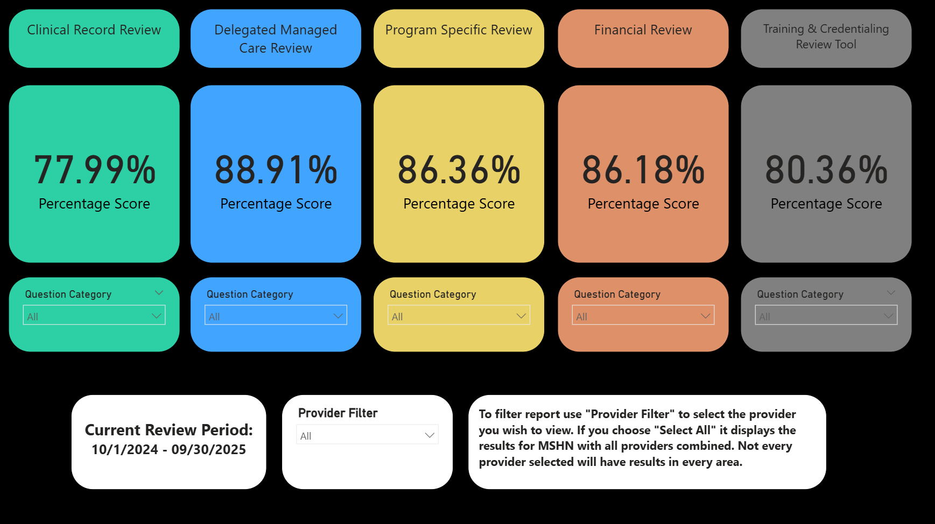
SUD Delegated Managed Care Review

Slide 45
Additional SUD Reports Available
SUD MMBPIS Indicator 4b
SUD Withdrawal Management Readmission
AOD Initiation and Engagement
SUD Residential Readmission and Follow Up
Primary Drug at SUD Admission
Access MSHN Data on Website Here.

Slide 46
Questions?
Please contact Joseph Wager with any questions:
joseph.wager@midstatehealthnetwork.org

Slide 47
FY25 Lunch & Learn Series
Kate Flavin
Treatment Administrator

Slide 48
FY25 Lunch & Learn Series
Lunch and Learn Series has concluded for 2025
No additional trainings are scheduled for 2026
If you have ideas for possible future lunch and learn trainings, please share those with your lead treatment specialist
Provider Trainings - Lunch and Learn Training Series are available on the MSHN website.

Slide 49
Questions?

Slide 50
ASAM Criteria 4th Ed. Manuals
Kate Flavin
Treatment Administrator

Slide 51

ASAM Criteria 4th Ed. Manuals
MSHN has several manuals left from the ASAM Criteria trainings held earlier this year. If you are interested in obtaining an extra manual for your agency, please reach out to Kate Flavin, Treatment Administrator, at: kathrine.flavin@midstatehealthnetwork.org
Manuals will be first come first serve until they are gone
Manuals will be shipped directly to your agency

Slide 52
Upcoming Quarterly SUD Provider Meetings
March 19, 2026
June 18, 2026
September 17, 2026
MSHN SUD Provider Meeting Agenda's & Recordings can be found on the MSHN website: SUD Provider Meetings - Mid-State Health Network

Slide 53
Prevention Breakout

Slide 54
Quarterly SUD Provider Meeting
Prevention Breakout
December 18, 2025
MPDS Update
Coalition TA Requests
Prevention Conference Update
Reminders
Notes:
AMANDA
These are arranged by strengths and weaknesses (internal-looking), threats and opportunities (external-looking).
viewed as a highly collaborative in region and with external partners, and a statewide leader in reciprocity. MSHN is known to “listen” to the needs of region and incorporate network feedback into services and operations. MSHN is a trailblazer in new state waiver initiatives, for example: HCBS, Autism, Influence, leading to systems change. MSHN has operationalized innovation when developing programs like the Mobile Care Unit.

Slide 55
MPDS Update
Development is still underway for the new MPDS
No date has been identified to go live with the system
No dates for training have been identified, but virtual trainings are planned be held prior to going live
Spreadsheets used to collect data will still need to be used after the new system goes live since the reporting feature is yet to be developed
Updates will include:
  changes to Service Population Codes- new/deleted codes and updated definitions
  Changes to Primary Strategy Codes- new/deleted codes and updated definitions and examples
  User Log-in process
Notes:
AMANDA
These are arranged by strengths and weaknesses (internal-looking), threats and opportunities (external-looking).

Slide 56
Coalition TA Requests
Annual Report feedback indicated a possible need for coalition TA and connections across counties for collaboration.
What information would be most helpful?
Contact info
Types of activity being done
Coalition meeting occurrence
Workgroups and subcommittees
Notes:
AMANDA
These are arranged by strengths and weaknesses (internal-looking), threats and opportunities (external-looking).

Slide 57
Prevention Conference Update
SAVE THE DATE!
Annual Prevention Conference held May 6 and 7, 2026
Bavarian Inn, Frankenmuth
Call for Presentations
Notes:
AMANDA
These are arranged by strengths and weaknesses (internal-looking), threats and opportunities (external-looking).

Slide 58
Reminders
CPS Exam Study Group
MSHN Closed for holidays December 25, 26, 31 and January 1
Block Grant funds cannot be used for promotional or commemorative items.
  This includes pens, pencils, notepads, shirts, bags, cups/mugs, awards, coloring books, lanyards, etc.
Using EBPs with fidelity
  Contact the developer to see if changes are acceptable
Out-of-state travel and conferences
  Require MSHN approval
  We will not approve attendance/travel to Prevention Innovation Conference Cruise
Notes:
AMANDA
These are arranged by strengths and weaknesses (internal-looking), threats and opportunities (external-looking).

Slide 59
Questions?
cari.patrick@midstatehealthnetwork.org
sarah.surna@midstatehealthnetwork.org
sarah.andreotti@midstatehealthnetwork.org
Notes:
AMANDA
These are arranged by strengths and weaknesses (internal-looking), threats and opportunities (external-looking).

