Slide 1

Quarterly SUD Provider Meeting
June 20, 2024
www.midstatehealthnetwork.org

Slide 2
Agenda
Dani Meier: Welcome & General Remarks
Amanda Ittner: FY23 Network Adequacy Assessment
Amy Dolinky: Opioid Settlement Funds
Katrina Hernandez: Overdose Prevention Engagement Network (OPEN)
Cammie Myers: Partial Centralization for WM, Residential & Recovery Housing
Tammy Foster: PACT Act & VA Health Care & Benefits
Joe Wager: Social Determinates of Health Data
www.midstatehealthnetwork.org

Slide 3
Welcome
&
MSHN General Remarks
Dani Meier
Chief Clinical Officer
www.midstatehealthnetwork.org

Slide 4
Network Adequacy Assessment
Amanda Ittner
Deputy Director
www.midstatehealthnetwork.org

Slide 5
Opioid Settlement Funds
Amy Dolinky
Technical Adviser, Opioid Settlement Funds Planning and Capacity Building
Michigan Association of Counties
www.midstatehealthnetwork.org

Slide 6
Overdose Prevention Engagement Network (OPEN)
Katrina Hernandez
Behavioral Health Consultant
Overdose Prevention Engagement Network (OPEN)
www.midstatehealthnetwork.org

Slide 7
Partial Centralization for WM, Residential and Recovery Housing
Cammie Myers
Utilization Management Administrator
www.midstatehealthnetwork.org

Slide 8
Partial Centralization
MSHN’s current delegated “no wrong door” access model for SUD services has the important advantage of allowing individuals to directly access a service provider of their choice.
That model has also presented a number of ongoing challenges which have led to inconsistent access and screening practices throughout the region resulting in system inefficiencies and in many cases, a poor access experience for individuals seeking services.
For this reason, MSHN has made the decision to move to a centralized access for better efficiency beginning 10/1/24.
www.midstatehealthnetwork.org

Slide 9
Partial Centralization
The plans are to centralize access for high-cost high-intensity SUD services to the MSHN Utilization Management Department, including withdrawal management, residential treatment, and recovery housing.
Access to all other types of service and levels of care would continue to be delegated to the CMHSP and SUD provider networks.
Centralizing access for high-cost high-intensity services will allow for a more streamlined and consistent process by having highly trained MSHN staff facilitate access to services and supports that have complex eligibility requirements.
MSHN staff are uniquely positioned to seamlessly link and bridge referrals between behavioral health, substance use, and physical health systems of care for individuals with complex care needs, as well as facilitating transfers between different SUD levels of care.
www.midstatehealthnetwork.org

Slide 10
Partial Centralization
The proposed changes will also ensure that individuals under the supervision of MDOC are correctly identified and offered an array of appropriate SUD treatment options since probation and parole agents will no longer be able to refer an individual directly to residential treatment programs.
Additionally, a MSHN-centralized access process will ensure responsible and efficient use of fiscal resources by coordinating referrals to the most appropriate services and reducing the occurrence of unnecessary readmissions to high-cost high-intensity levels of care.
www.midstatehealthnetwork.org

Slide 11
Additional Information
Network training is planned for September 2024.
  Providers will be notified as soon as possible when those are scheduled.
You may see slight changes in REMI before 10/1. A banner will be posted explaining these.
Contract and SUDSP Manual draft updates will be available for review in the upcoming months.
For additional questions, please contact:
Cammie Myers- 517-657-3013
  Cammie.myers@midstatehealthnetwork.org
www.midstatehealthnetwork.org

Slide 12
Questions?
www.midstatehealthnetwork.org

Slide 13
PACT Act & VA Health Care
& Benefits
Tammy Foster
Veteran Navigator

Slide 14
PACT Act & VA Health Care
& Benefits
The PACT ACT has a similar name as the COMPACT ACT (which covers inpatient and outpatient mental health services) The PACT Act is separate and much different.
From va.gov website: "The PACT Act is perhaps the largest health care and benefit expansion in VA history. The full name of the law is The Sergeant First Class (SFC) Heath Robinson Honoring our Promise to Address Comprehensive Toxics (PACT) Act."
SFC Heath Robinson passed away from cancer related to exposure to toxic fumes from burn pits. This year the PACT Act was signed into law, ensuring all veterans and active duty service members exposed to toxic burn pits receive proper medical care from the VA.
www.midstatehealthnetwork.org

Slide 15
PACT Act & VA Health Care
& Benefits
Heath Robinson video
As of March 2024 The PACT Act expands VA Health Care and eligibility to enroll in VA health care now, veterans do not have to wait to file a claim for disability benefits potentially caused by exposure to toxins, they can enroll in VA Health care now if they meet the requirements for eligibility, while they wait on their VA disability claim to be processed.
www.midstatehealthnetwork.org

Slide 16

PACT Act & VA Health Care
& Benefits
Changes that were made with the PACT Act:
Added 20+ presumptive medical conditions from burn pit exposure, Agent Orange and other toxic exposures https://www.va.gov/resources/the-pact-act-and-your-va-benefits/
Added more locations (duty stations) of presumptive exposures
800-698-2411 VA number to call for questions about PACT Act
Scan the QR code for the Public Health page for quick reference and more information on the PACT Act and the toxic exposure disease related research
www.midstatehealthnetwork.org

Slide 17
Questions?
www.midstatehealthnetwork.org

Slide 18

MSHN VIRTUAL TRAINING REMINDER
Military and Veteran Culture
Building Trust by Building Understanding
Wednesday, 7/31/24 ~9:30 AM - 11:30 AM
Scan the QR code to go directly to the CMHA registration link.
Link to brochure: HERE
www.midstatehealthnetwork.org

Slide 19
Social Determinates of Health (SDOH) Data
Joseph Wager
Information Technology Project Manager
www.midstatehealthnetwork.org

Slide 20
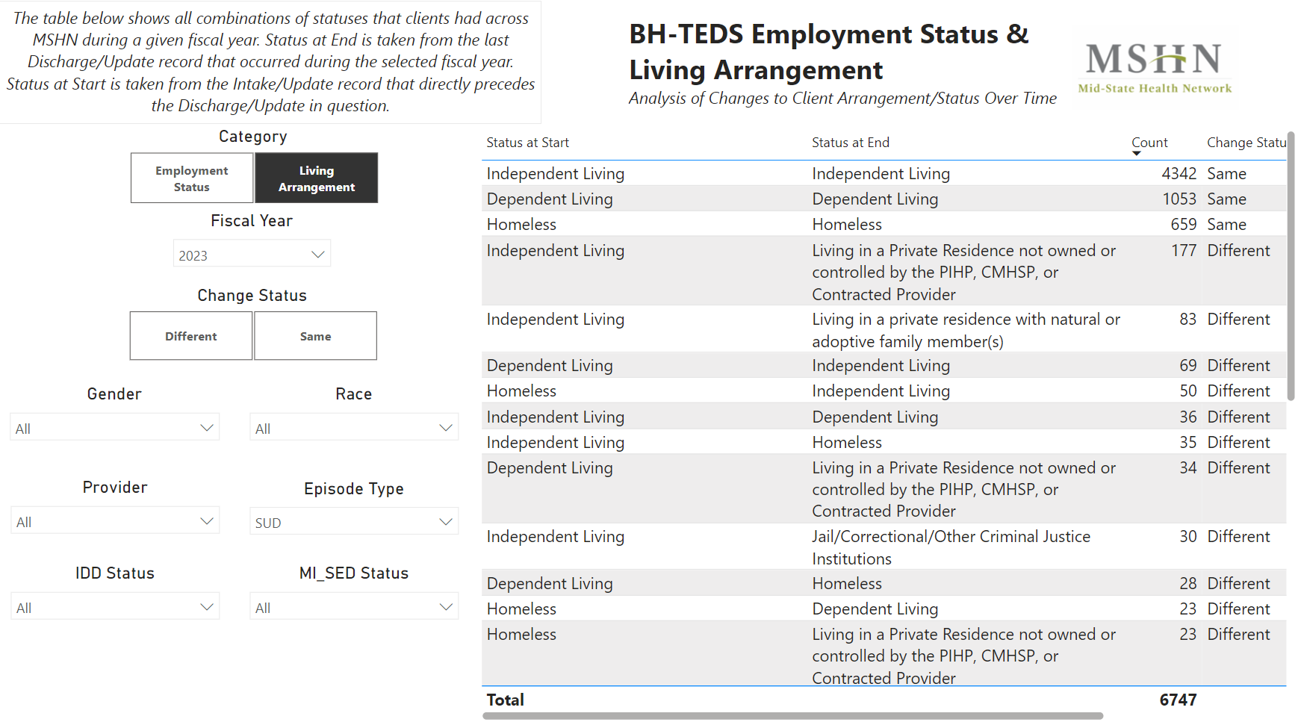
Housing and Employment Report
www.midstatehealthnetwork.org

Slide 21


BH-TEDS ‘S’ Update Record
REMI has a report: SUD BH-TEDS ‘S’ (Update) Record Completion Report
To access the report:
1:
2:
3:
www.midstatehealthnetwork.org

Slide 22
Questions?
www.midstatehealthnetwork.org

Slide 23
Upcoming SUD Provider Meetings
September 19, 2024 12-2pm
December 19, 2024 12-2pm
March 20, 2025 12-2pm
NOTE: All meetings will be held via Zoom
Agendas and old meeting notes can be found on our website here: https://tinyurl.com/mshnsudmtgs
Sign up for the Constant Contact weekly SUD Provider Newsletter here: https://tinyurl.com/mshnnews
www.midstatehealthnetwork.org

