Slide 1




Partnering to Support Clinics Helping Rural Michigan
CHRP
Coalition for Harm Reduction & Prevention
Andrew Coleman, LMSW
Deb Manderachia, LMSW
Allison Lin MD, MS, DFASAM

Slide 2
Overdose and substance use disorder (SUD) epidemics
~105,000 Americans died from overdose in 2023

Slide 3
Challenges and successes in caring for people who use substances
Psychosocial barriers including transportation, etc
Stigma and symptoms of substance use disorder makes it hard for patients to followup with referrals
Mental health staff don’t always get training on working with patients who use substances
Providing life-saving treatments is rewarding!
Patients truly appreciate our help

Slide 4
Setting the Scene
1/3 patients with a mental health disorder has a co-occurring SUD
Every clinic is unique – important to tailor support
Goal: Sustainable network of diverse “hubs and spokes” in Michigan
Notes:
CHRP is funded by NIH and very different. Broad overview of the goals of CHRP and why the team has an interest in rural addiction care
Review Hub and Spoke model
NIH – there are assessments and requirements – this is rare opportunity from NIH to put into practice a new program and test it
Goal – impact readiness and knowledge in HR and prevention
Get your clinic more comfortable with substance work, risk reduction
2 Goals for clinic
OD prevention and HR
Ex – naloxone procedures
Other Sub related goal that our experts can help with
CHRP is all about building networks across rural MI and support feasibility and sustainability of SUD care across the state

Slide 5
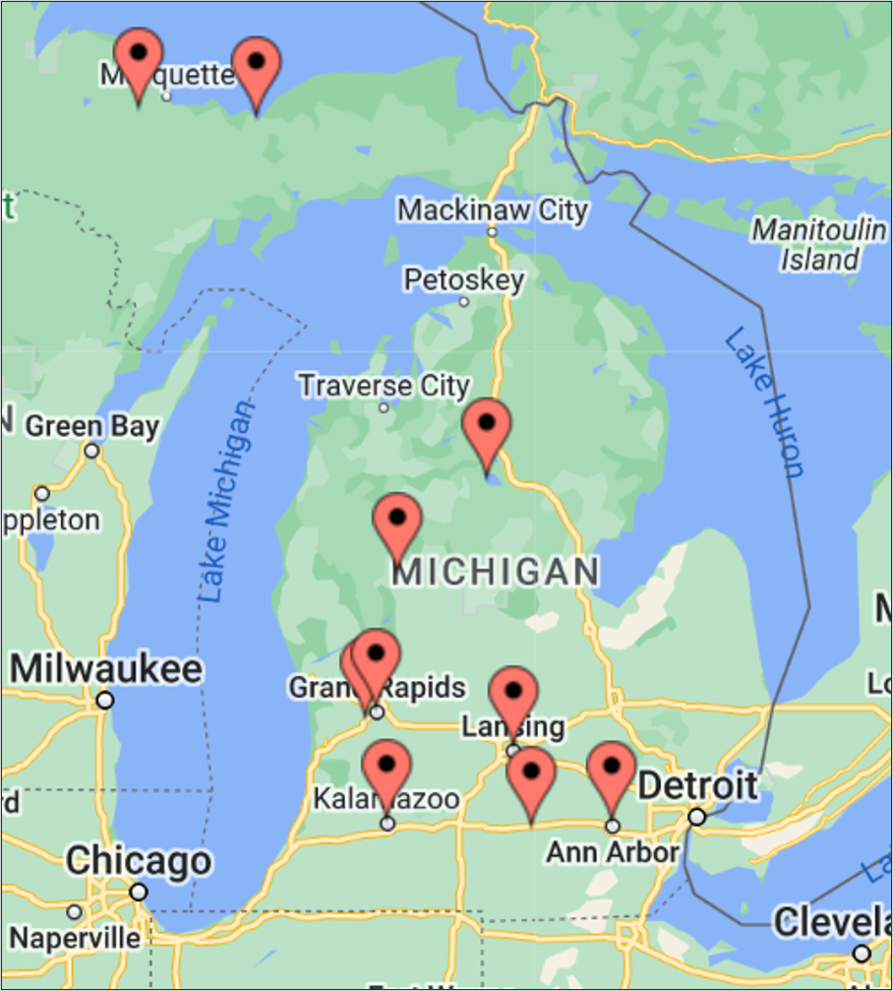
Working with diverse group of clinics
Tailoring of this education and support program to your clinic needs
Notes:
This has been informed by CAB members from all over the state – people with lived experience and other providers/advocates
We are aware that each region has their own resources, strengths and needs – so this intervention focuses on the clinic’s being the experts and utilizing our added support to work towards goals around overdose prevention and risk reduction.

Slide 6
What are your prevention/risk reduction goals?
What is working well? What could use some extra help?
What resources do you wish you had more access to for supporting patients who use substances?
Notes:
*Reference email sent to Allison before meeting*, what the site is, services provided, service area, qualitative information (if qual completed)

Slide 7
What can CHRP do to help?
  CHRP can provide you with FREE tailored services including:
2. Implementation support tailored to needs of your clinic with our Hub Champion
3. Free Resources for your patients - Service Navigator, tele-counseling, transportation cards
1. Monthly case-based education/training for your clinic staff
Notes:
What is CHRP: toolkit of strategies and materials to assist clinics in harm reduction and addiction prevention services
If you sign on to CHRP: free partnership with specialists to help you implement things to help address the needs of patients who use substances and the staff who encounter them.
CHRP is a toolkit of options to help. You choose what is most helpful and realistic.

Slide 8


Some Topics…
  Overdose Prevention Education
  Naloxone Distribution
  Illness of Addiction 101
  Supporting Clinic Staff: Well-being, Burnout, Perspectives & Beliefs
  Reducing Risks: Overview of Harm Reduction
  Addiction Prevention
  And More!
Notes:
Review Components
Focus discussion on not just medical/clinical staff, but also support and admin staff

Slide 9

CHRP Study Details
Hub and Spoke Clinical Trial
Goal: Support rural clinics in improving prevention & risk reduction services
When: Clinics begin in 2027-2028. Intervention is 6 months
Who: 16 clinics across Michigan
Cost: FREE!
Notes:
Funded by NIH
Review Hub and Spoke
Place significant emphasis on the community building aspect of CHRP. Spokes to become Hubs in the future.

Slide 10
What Spoke Clinics Can Expect
Clinic Staff
  Monthly case-based educational webinars led by clinical experts
  Ask at least 4 staff attending monthly (not necessarily the same staff) who will complete brief surveys
  Free CEs and lunches
Clinic Spoke Champion
  Bi-weekly check-ins (~30 min) with Hub Champion to support progress on clinic goals
  Brief surveys conducted at intervals
Resources/incentives for your staff and your patients
  Transportation vouchers
  Stipend for you spoke champ (or those funds can be used for transportation vouchers)
Notes:
Add lots of discussion here – address any questions
Assessments are collected through 30m

Slide 11

CHRP Timeline and Next Steps
  Clinic Agreement: Due by Feb. 2026
  CHRP Communication: Quarterly updates
  Assignment of CHRP start date: Sent to clinics in Fall 2026
  CHRP start dates: 2027 – 2028; Randomized
Notes:
We will have 4 cohorts that start every 6 months

Slide 12

How can CHRP be helpful in your Clinic?
Your CHRP Contact:
Andrew Coleman, LMSW, Hub Champion
andrco@med.umich.edu; 734-881-7106
Notes:
CHRPStudyUM <CHRPStudyUM@med.umich.edu>

Slide 13
Developing and Testing Low-Barrier Telehealth Contingency Management Treatment for Stimulant Use Disorder
Summary: Stimulant use disorder (including cocaine and methamphetamine) is hugely under-addressed. Contingency Management is by far the most effective treatment (associated with 40% decreased mortality) but currently not available to most. We are submitting a research proposal to develop and test a Contingency Management treatment program that would be more feasible for patients and clinics, including reducing barriers for rural patients.
We would provide:
  Tele-CM training with support for treatment delivery including remote urine testing across 20 clinics in MI
  Incentives for your patients and a user-friendly platform to provide incentives
  Financial support for your clinic for your involvement
Timeline: Earliest anticipated funding 2027
Clinic Participation: Our Ask
  At this stage, we are trying to show that clinics may be interested in better addressing stimulant use and CM
  Asking for a letter of support indicating your clinic may be willing to participate

