Slide 1


Quarterly SUD Provider Meeting
Welcome!
We’ll get started at 12:05.
The meeting will be recorded and posted to the MSHN website afterwards.

Slide 2
Quarterly SUD Provider Meeting
June 26, 2025

Slide 3
Plenary Agenda
Joe Sedlock: Welcome & Regional Update
Trisha Thrush: Data & Grant Coordinator Introduction
Stacey Lehmann:
  Opioid Settlement Fund Update
  Update for Regional Provider Requests for Evidence – Based Materials

Slide 4
Welcome
&
MSHN General Remarks
Joe Sedlock
Chief Executive Officer

Slide 5
General Remarks
Welcome and Gratitude!
Regional Financial Status Update
MDHHS-Initiated PIHP Procurement – MSHN Status

Slide 6
MSHN Data & Grant Coordinator Introduction
Stacey Lehmann
Trisha Thrush, PhD., LMSW
Director of SUD Services & Operations

Slide 7
FY25 MSHN Region
Opioid Settlement Fund Update
Stacey Lehmann
Data & Grant Coordinator

Slide 8

FY25 MSHN Region OSF Update
Opioid Settlement Transparency & Accountability - Mid-State Health Network
  18 proposals approved by BOD in March 2025; Contracts implemented 4-1-25 thru 9-30-25.
  $549,313 approved/allocated for FY25.
    $24,231 spent of allocations in April 2025
    FY25 OSF Allocation by County
    Provider monthly reporting and invoices due by the 5th of the subsequent month.
    Monthly reporting updates available on the MSHN website to share progress per provider in MSHN counties:
      OSF Funding - Provider Reporting for April 2025
MDHHS now requiring monthly reporting of OSF funds from MSHN by the 15th of the subsequent month.

Slide 9
FY25 MSHN Region OSF Update
Finance/Reimbursement Information:
  For providers with no staffing: For reimbursement requests, please submit an invoice on your agency invoice along with all documentation (i.e., vendor invoices) to support the amount being requested. Invoices should be submitted with the monthly outcome report and will be paid by the third Friday of each month. The final fiscal year invoice will be due with the October report so please ensure that all purchases are finalized by or before September 30th. MSHN will not be approved any carry forward funds requests for opioid settlement funds.
  For providers with staffing: For reimbursement requests, please submit an invoice on your agency invoice along with all documentation (i.e., payroll records, vendor invoices) to support the amount being requested. Invoices should be submitted with the monthly outcome report and will be paid by the third Friday of each month. The final fiscal year invoice will be due with the October report so please ensure that all purchases are finalized by or before September 30th. MSHN will not be approved any carry forward funds requests for opioid settlement funds.

Slide 10
FY25 MSHN Region OSF Update
Reporting Requirements:
  Providers are required to complete outcome reporting monthly.
  An individualized outcome reporting template has been provided to each provider with their contract information.
  Outcome reporting is due by the 5th of the subsequent month.
  Please submit outcome reporting templates and reimbursement invoices and documentation to Stacey Lehmann at Stacey.Lehmann@midstatehealthnetwork.org
FY26 OSF Allocation from MDHHS?
  At present, there is no version of the FY26 state budget that has included Healing and Recovery Funds being allocated to the PIHPs.
  Please be planning for and seeking continuation funding for county level initiatives from county level opioid settlement opportunities for FY26.

Slide 11

Questions?

Slide 12
Update for Regional Provider Requests for Evidence – Based Materials
Stacey Lehmann
Data & Grant Coordinator

Slide 13

EBP Provider Requests - Update
$175,000 allocated to support EBP material requests for in-region MSHN contracted providers who support SUD prevention, treatment, recovery, and community recovery activities
Received requests from 28 providers for materials
Requests will go to the Board of Directors meeting for approval on July 1st
Award notices will be sent out after BOD meeting
Upon BOD approval, items will be ordered and shipped directly to provider locations.

Slide 14
Treatment Breakout

Slide 15
Treatment Breakout Agenda
New Staff Introductions
2025 SUD Satisfaction Survey
MSHN SUD Data Updates
Updates on Residential and Outpatient Treatment Policies
FY25 Lunch & Learn Series
Veteran Navigator announcement of FY2
MSHN-Hosted ASAM Criteria 4th Edition Trainings
STAR Loan Repayment Program
SUDHH Updates

Slide 16
New Staff Introductions
MarChare Canada – Treatment Specialist
Christina Romero – SUD Care Navigator
Evan Godfrey – Utilization Management Specialist

Slide 17
2025 SUD Consumer Satisfaction Survey
Kara Laferty
Quality Manager

Slide 18
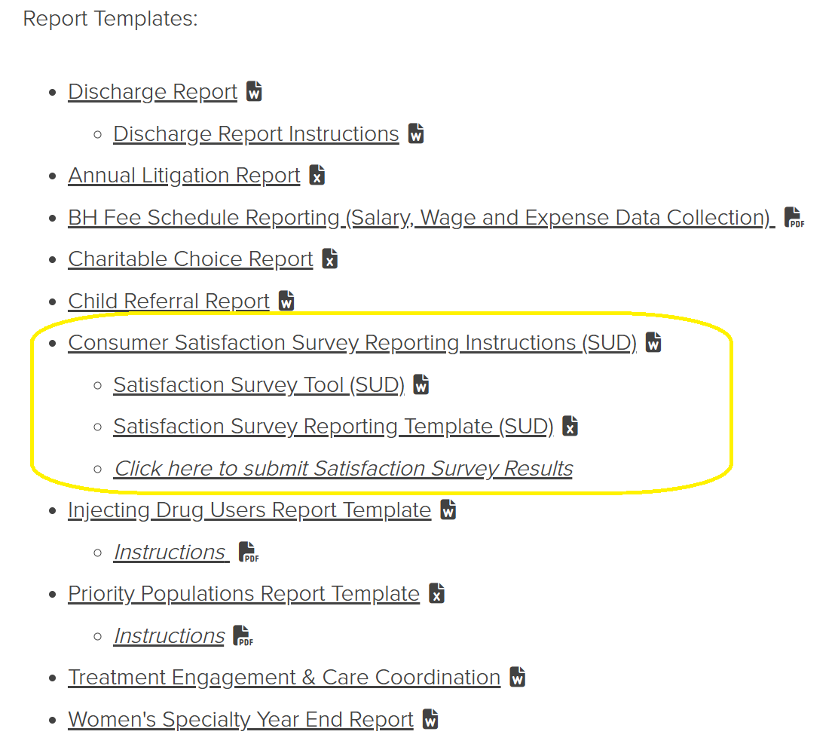
SUD Consumer Satisfaction Survey
Satisfaction Survey Dates: June 16th – July 18th 2025
  All MSHN funded individuals receiving SUD treatment services during this timeframe should be provided a chance for feedback using the MSHN Satisfaction survey tool
  Survey tools, instructions and data submission links can be found on the MSHN website under the Reporting Requirements page
  Survey Data is due back to MSHN by August 30th, 2025

Slide 19
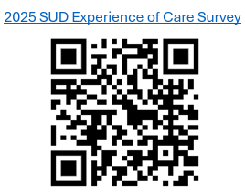
SUD Consumer Satisfaction Survey
Survey Distribution Methods
You may distribute the surveys using any of the following methods:
  Electronic/web-based survey (MSHN provided link)
  Mailed surveys (please allow a 4-week return window, so send as soon as possible)
  Phone surveys
  Face-to-face surveys
If using the MSHN electronic survey, the results will come directly to MSHN. MSHN will then share the individualized response data with the organizations provided by the individual after the survey has ended
MSHN will compile regional data for analysis and identification of regional improvement opportunities

Slide 20

SUD Consumer Satisfaction Survey
Data Submission (if not using the electronic surveying method)
Use the FY2025 MSHN SUD Consumer Satisfaction Survey Reporting Template for recording results
Ensure the file is named appropriately, following this format: <INSERT PROVIDER NAME> FY2025 SUD Consumer Satisfaction Survey Reporting Template
Submit one completed template per MSHN-contracted provider location before August 30, 2025, via the MSHN submission portal: Submit Satisfaction Survey Results

Slide 21

SUD Consumer Satisfaction Survey
Support and Questions:
For any questions or technical support regarding the survey process or to schedule a one-on-one consultation regarding the survey process, please contact: Kara Laferty, Quality Manager at:
kara.laferty@midstatehealthnetwork.org

Slide 22
MSHN SUD Data Updates
Joseph Wager, MSW
Information Technology Project Manager

Slide 23
Other MSHN SUD Reports:
SUD MMBPIS Indicator 4b
SUD Delegated Managed Care Review
SUD Withdrawal Management Readmission
SUD Residential Readmission and Follow Up
Primary Drug at SUD Admission
35

Slide 24
MSHN SUD Data Update
Questions?
Email further questions:
joseph.wager@midstatehealthnetwork.org

Slide 25
Residential and Outpatient Treatment Policy Updates
Kate Flavin
Treatment Administrator

Slide 26
Residential and Outpatient Treatment Policy Updates
SUD Outpatient:
  Public comment closed in April 2025
SUD Residential:
  Public comment closed in May 2025
SUD Withdrawal Management:
  No updates
Outpatient and Residential Treatment Policies are currently in the approval process with MDHHS. MSHN will continue to provide updates as they are released.

Slide 27
FY25 Lunch & Learn Series
Sherrie Donnelly
Treatment & Recovery Specialist

Slide 28
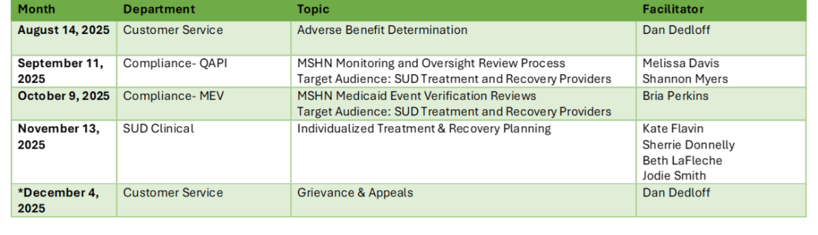
FY25 Lunch & Learn Series: Schedule
All Sessions 12-1pm
Join Zoom Meeting: https://us02web.zoom.us/j/3125295892
Meeting ID: 312 529 5892
Provider Trainings - Lunch and Learn Training Series are available on the MSHN website.

Slide 29




Save the date Aug 26
This training will help the behavioral health workforce to increase understanding in their work with those who have served in the military.
~FREE~
~VIRTUAL~
CONTINUING ED HOURS
Tammy Foster
Veteran Navigator
517-483-2742
Scan code or click link to register
link to register

Slide 30
MSHN Hosted ASAM Criteria 4th Edition Trainings for FY25
Kate Flavin
Treatment Administrator

Slide 31
MSHN – ASAM Criteria 4th Edition Trainings
MSHN is providing 7 ASAM Criteria 4th Edition Trainings for contracted SUD Treatment providers.
Coordinated by CMHAM with a $50 registration fee.
Everyone who registers and completes the training will receive an ASAM Criteria 4th edition manual.
CMHAM has opened the registration information for all 7 trainings.

Slide 32
MSHN – ASAM Criteria 4th Edition Trainings, cont.
MSHN has given priority to contracted SUD Providers for registration.
MSHN has now opened registration to CMHSPs in our region.
  Note: For CMHSPs with an SUD contract directly with MSHN, you are able to register now. Access Staff only
  **Reach out to your MSHN Treatment Specialist with any questions.

Slide 33
MSHN – ASAM Criteria 4th Edition Trainings
Virtual Training Dates
Still Available
In-Person Training Dates
Still Available
July 7-8
August 5-6
July 22-23 - Lansing

Slide 34
Questions?

Slide 35
Star Loan Repayment Program
Kate Flavin
Treatment Administrator

Slide 36
STAR Loan Repayment Program
Application is open now through July 10 at 7:30 p.m. ET
Basic Eligibility Requirements
  US Citizen, national or permanent resident
  Fully licensed, credentialed in an eligible discipline, a registered SUD professional
  Full-time employee at a STAR LRP-approved facility
  *Links with more information can be found in our weekly Constant Contact or by contacting your Lead Treatment Specialist

Slide 37
SUDHH Updates
Liz Philpott
Integrated Health Administrator

Slide 38
Upcoming Quarterly SUD Provider Meetings for FY25
September 18, 2025
December 18, 2025
March 19, 2026

