Slide 1
Prepared by: Mid-State Health Network (MSHN) Customer Service Committee (CSC)
Medicaid Adverse Benefit Determination Process
Notes:
Welcome to the Mid-State Health Network’s (MSHN) regional Medicaid Adverse Benefit Determination Process training.

Slide 2
Training Overview
Length of Training: 30 minutes
Target Audience: Staff who provide direct service to Medicaid and Healthy Michigan consumers.
Training Intent: Each Medicaid consumer engaged in services has the
right to receive notice in changes to services and supports. It is important that staff are aware of the policies and procedures in place that ensure a timely, fair, accessible and understandable process for service-related changes based upon the Michigan Department of Health and Human Services (MDHHS) technical requirements. The following training will provide an overview of these technical requirements regarding Adverse Benefit Determinations.

Slide 3
Training Note (disclaimer)
This training was prepared by a workgroup of members of the MSHN Customer Service Committee (CSC) with the intention of providing information/education in a standardized format, inclusive of the minimum requirements as outlined in the MDHHS Appeal and Grievance Resolution Process Technical Requirement.
The training can be utilized as a starting point for Community Mental Health Service Providers (CMHSP) and Substance Use Disorder Service Providers (SUDSP) to supplement their own training curriculum.
Note: Some agencies, by virtue of their own established Policies/Procedures, may have set timeframes that allow for additional days beyond the “minimum” 10-day standard(s), this is an acceptable practice since this allows for an increased benefit for the individual served.

Slide 4
Adverse Benefit Determination:
The Appeal Process begins with the issuance of an Adverse Benefit Determination (ABD) notice. An ABD is a decision that adversely impacts a Medicaid enrollee’s services due to:
Denial or limited authorization (of a requested service)
Delay (for a request or start of service)
Reduction (of a previously authorized service)
Suspension (of a previously authorized service)
Termination (of a previously authorized service)

Slide 5
Medicaid Due Process Rights
Under the Due Process Clause of the U.S. Constitution, Medicaid enrollees are entitled to "Due Process" whenever their Medicaid benefits are denied, delayed, reduced, suspended, and/or terminated.
Due Process requires that enrollees receive:
prior written notice of a decision that adversely impacts services;
a fair hearing before an impartial decision maker;
continued benefits pending a final decision; and
a timely decision that begins from the date the grievance and/or appeal is first made.
The Medicaid Due Process rights are intended to protect enrollees. These rights and dispute resolution protections are granted through the authority of 42 CFR Subpart F – Grievance and Appeal System.

Slide 6
Adverse Benefit Determination:
The timing of the effective date for an ABD is defined as either Adequate or Advanced:
Adequate Notice: is a decision to deny or limit authorization of requested Medicaid services on the same date the Adverse Benefit Determination takes effect/is provided.
Advance Notice: is a decision to reduce, suspend, or terminate Medicaid services currently provided at least 10 calendar days prior to the proposed date the Adverse Benefit Determination takes effect.
Note: If an enrollee has an active authorization and is receiving services than an Advanced Notice must be provided before services are impacted.

Slide 7
Adverse Benefit Determination:
Advanced notice exceptions:
The provider may give an adequate notice of action instead of an advance notice of action IF:
Substantiated information is received confirming the death of the enrollee.
A clear written statement signed by the enrollee is received that states the enrollee no longer wishes to receive services, or that gives information that requires termination or reduction of services and indicates that the enrollee understands that this must be done as a result of supplying the information.
If enrollee has been admitted to an institution where he/she is ineligible under the plan for further services. (ie. Incarceration)

Slide 8
Adverse Benefit Determination:
Advanced notice exceptions: (cont.)
If the enrollee’s whereabouts are unknown, and the post office returns the provider’s mail directed to the enrollee without a forwarding address.
If it is proven that the enrollee has been accepted for Medicaid services by another county or state.
A change in the level of medical care is prescribed by the enrollee’s physician.
The date of action must occur in less than 10 calendar days. (discharged due to violating program rules)
Please refer to Appeals and Grievance Technical Requirement for the full list of exceptions.

Slide 9
Denial (or limited authorization)
A Denial could occur when: (see definitions section)
The Beneficiary does not meet medical necessity for the requested service(s).
The Beneficiary does not meet Medicaid eligibility for services as a person with a serious mental illness, a person with a development disability, a child with a serious emotional disorder or a person with a substance use disorder.
Clinical documentation provided does not establish medical necessity.
Other insurance or resources are available to meet the requested service (Medicaid is a payer of last resort).
A duplication of service(s) is/are currently being provided.
Residency – individual lives outside of county service area.
The individual resides in a setting (institution) such as a jail, state hospital or a Child Caring Institution where the provider cannot provide services.

Slide 10
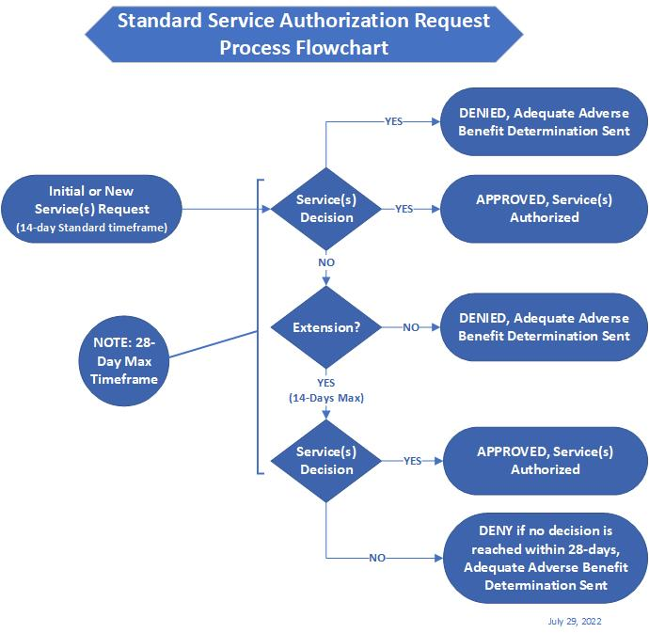
Notes:
This flowchart represents the process flow for a standard service authorization request.

Slide 11
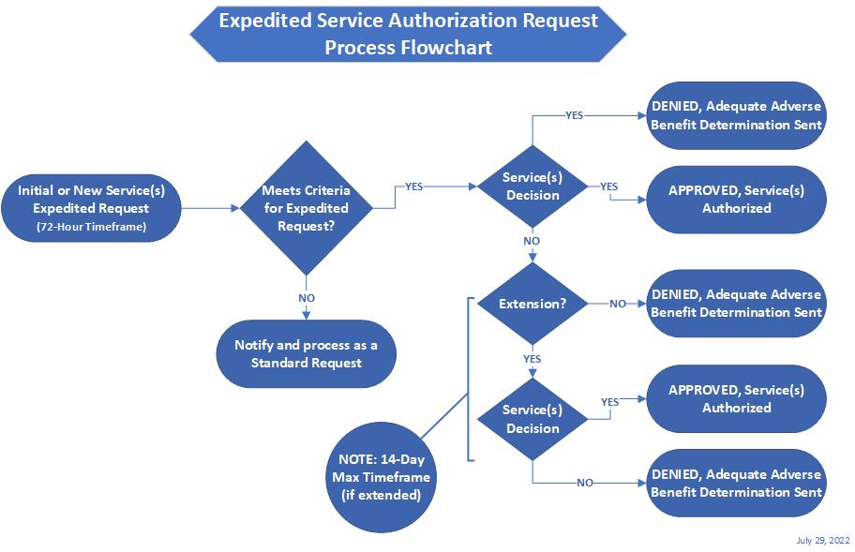
Notes:
This flowchart represents the process flow for an expedited service authorization request.

Slide 12
Delay
A delay occurs when: (see definitions section)
The provider fails to make a standard authorization decision and provide notice about the decision within 14 calendar days from the date of receipt of a standard request for service.
The provider fails to make an expedited authorization decision within 72 hours from the date of receipt of a request for expedited service authorization.
The provider fails to provide services within 14 calendar days of the start date agreed upon during the person-centered planning and as authorized by the provider.

Slide 13
Reduction:
A reduction may occur when: (see definitions section)
The current level of service is reduced in the amount, scope, or duration as previously authorized due to…
Services are determined to be no longer medically necessary in the amount, scope, or duration as previously authorized,
The individual or guardian requests the reduction in services,
The individual refuses to fully participate or is not participating in services,
A temporary incapacity of the provider to fully fulfill the service(s) in the amount, scope, or duration as authorized.

Slide 14
Suspension:
The authorized service(s) could be suspended (put on a temporary hold) when: (see definitions section)
The individual is temporarily residing in a location in which the provider cannot authorize services, such as jail, prison, extended care facility, or state hospital.
When the provider lacks the capacity to provide the authorized service.
The conduct of the person served caused the subcontracted provider to discontinue services and the service is on hold until a different provider begins.
When the individual/guardian requests the service to be temporarily on hold.
Lack of participation in a service that has been previously authorized.

Slide 15
Termination:
Services may be terminated (current authorization ends) when:
(see definitions section)
The active Person-Centered Plan goals are met.
The individual requests to end their service.
The individual moves outside of the county service area.
The individual is no longer actively engaged (using) the service(s).
The individual is residing in a location for an extended period in which the provider cannot authorize services, such as jail, prison, extended care facility, or state hospital. (may have been previously suspended)

Slide 16
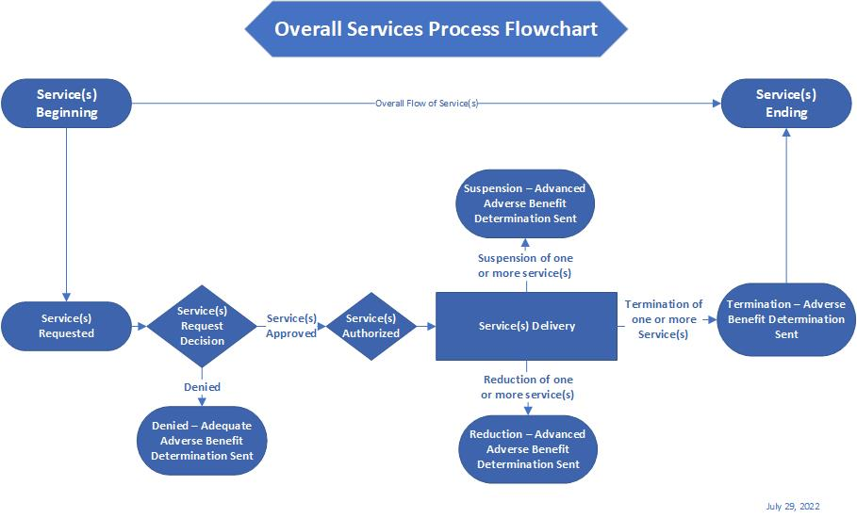
Notes:
This flowchart represents the process flow for the overall flow of a service or services from the beginning to end.

Slide 17
Example
A beneficiary has chosen to suspend services due to the current COVID-19 pandemic. Do I have to send an Adverse Benefit Determination Notice?
It is best practice to provide an Adverse Benefit Determination any time an authorized service is not being provided, even when the person served chose the option. It is recommended for the primary case holder to check in, at minimum of monthly, with the individual to ensure that the temporary suspension in services is still the choice of the consumer.
Notes:
What follows are examples provided to help in your understanding of how to apply the adverse benefit determination process.

Slide 18
Example
A contracted service provider requests an increase in direct service hours for a beneficiary, but the increase is not medically necessary. Do I send an Adverse Benefit Determination Notice?
Yes, it would be a denial.
Since the provider’s increase is being denied an ABD must be sent. It is best practice to also send a copy of the ABD to the requesting contracted service provider.

Slide 19
Example
The assigned Community Living Support (CLS) staff quits without giving notice. The CLS provider indicated that it will be 3 weeks, at minimum, until they have another staff trained and ready to provide CLS services. The beneficiary is authorized to received 4 hours of CLS per week. Should an Adverse Benefit Determination Notice be sent?
Yes, it would be a suspension.
The service would be suspended until staff becomes available since the Individual Plan of Service (IPOS) is specific that 4 hours of CLS will be provided per week. When a service is not able to be provided according to the authorized amount in the IPOS, an ABD is required. It should also be noted how the current CLS need will be met until the new staff is hired and trained.
A cancellation, short illness, or rescheduled time would not require an ABD to be sent.

Slide 20
Example
A beneficiary requests to terminate all her services. Should an Adverse Benefit Determination Notice be sent?
Yes, it would be a termination of services.
If the person served requests to terminate services in writing, an Adequate Notice would be provided to the individual with the date the action would take effect being the date in which they provided the request.
If the person served provided the request verbally, an Advanced Notice would be provided to the individual with the date for which the action to be take effect being no less than 10 days from the date of the request.

Slide 21
Example
A beneficiary has requested a service that in my clinical opinion is not medically necessary. Do I need to provide her with an Adverse Benefit Determination Notice?
Yes, it would be a denial.
Anytime a decision is made to deny a person served a requested service, an Adequate Adverse Benefit Determination Notice is required.

Slide 22
Example
A beneficiary requests to terminate her outpatient therapy service while keeping her other services. Would I need to send an Adverse Benefit Determination Notice?
Yes, it would be a termination for that specific service.
A Person-Centered Plan Addendum should be completed with the individual removing all goals and objectives related to the service being terminated in addition to early terminating the authorization.

Slide 23
Example
A beneficiary was arrested. He will be in jail for at least 90 days. Before his arrest he received daily CLS through a CLS provider, Case Management, and quarterly medication reviews. Would an Adverse Benefit Determination Notice need to be sent?
Yes, services would be terminated.
The jail is an institution which takes on the obligation of care.
Situations such as this fall under the Limited Exceptions to Advance Notice therefore, an Adequate Notice would need to be sent suspending services effective the date of determination.

Slide 24
Examples
During the Person-Centered Planning (PCP) Meeting the agreed upon start date for CLS services was October 1st. The CLS provider reached out to say that CLS would not be able to start until November 1st. Would I need to send an Adverse Benefit Determination Notice?
Yes, since the CLS service would be delayed.
This is due to the failure to provide services within 14 calendar days of the agreed upon start date during the PCP Meeting.
The ABD notice should be provided at the time it becomes known that service will be delayed more than 14 calendar days from the agreed upon start date.

Slide 25
Example
A beneficiary did not show for her Psychiatric Evaluation. When her case manager called the number on file, it was no longer in service. A follow-up letter was sent but was returned indicating “no forwarding address on file.” It has been 2 months since her last contact, should an Adverse Benefit Determination Notice be sent?
Yes, services would be terminated due to lack of engagement.
At times in which the recipient’s whereabouts are unknown and the post office has no forwarding address on file, an Adequate Notice should be completed, saved in the file, and a note added stating that the individual’s whereabouts are unknown.

Slide 26
Example
A 15-year-old beneficiary was placed in a juvenile detention center for 30 days. Before this placement he was receiving Therapy and Med reviews services. Would I need to send an Adverse Benefit Determination Notice?
Yes, due to the short duration services would be Suspended.
Services would resume when he becomes available to return to services.

Slide 27
Definitions:
Adverse Benefit Determination: A decision that adversely impacts the Medicaid Enrollee's claim for services due to: (42 CFR 438.400)
Denial or limited authorization of a requested service, including determinations based on the type or level of service, requirements for medical necessity, appropriateness, setting, or effectiveness of a covered benefit. 42 CFR 438.400 (b)(1).
Reduction, suspension, or termination of a previously authorized service. 42 CFR 438.400(b)(2).
Denial, in whole or in part, of payment for a service. 42 CFR 438.400(b)(3).
Failure to make a standard Service Authorization decision and provide notice about the decision within 14 calendar days from the date of receipt of a standard request for service. 42 CFR 438.210(d)(1).
Failure to make an expedited Service Authorization decision within seventy-two (72) hours after receipt of a request for expedited Service Authorization. 42 CFR 438.210(d)(2).
Failure to provide services within 14 calendar days of the start date agreed upon during the person-centered planning (PCP) meeting and as authorized by the PIHP. 42 CFR 438.400(b)(4).

Slide 28
Definitions:
Adverse Benefit Determination: A decision that adversely impacts the Medicaid Enrollee's claim for services due to: (42 CFR 438.400) (cont.)
Failure of the PIHP to resolve standard appeals and provide notice within 30 calendar days from the date of a request for a standard appeal. 42 CFR 438.400(b)(5); 42 CFR 438.408(b)(2).
Failure of the PIHP to resolve expedited appeals and provide notice within 72 hours from the date of a request for an expedited appeal. 42 CFR 438.400(b)(5); 42 CFR 438.408(b)(3).
Failure of the PIHP to resolve grievances and provide notice within 90 calendar days of the date of the request. 42 CFR 438.400(b)(5); 42 CFR 438.408(b)(1).
For a resident of a rural area with only one Managed Care Organization (MCO), the denial of the Enrollee's request to exercise his/her right, under § 438.52(b)(2)(ii), and to obtain services outside the network. 42 CFR 438.400(b)(6).
Denial of the Enrollee’s request to dispute a financial liability, including cost-sharing, copayments, premiums, deductibles, coinsurance, and other Enrollee financial responsibility. 42 CFR 438.400(b)(7).

Slide 29
Definitions:
Adequate Notice of Adverse Benefit Determination: Written statement advising the Enrollee of a decision to deny or limit authorization of Medicaid services requested, which notice must be provided to the Medicaid Enrollee on the same date the Adverse Benefit Determination takes effect. 42 CFR 438.404(c)(2).
Advance Notice of Adverse Benefit Determination: Written statement advising the Enrollee of a decision to reduce, suspend, or terminate Medicaid services currently provided, which notice must be provided to the Medicaid Enrollee at least 10 calendar days prior to the proposed date the Adverse Benefit Determination takes effect. 42 CFR 438.404(c)(1); 42 CFR 431.211.
Appeal: A review at the local level by the PIHP of an Adverse Benefit Determination, as defined above. 42 CFR 438.400.
Authorization of Services: The processing of requests for initial and continuing services delivery. 42 CFR 438.210(b).
Consumer: Broad, inclusive reference to an individual requesting or receiving mental health services delivered and/or managed by the PIHP, including Medicaid beneficiaries, and all other recipients of the PIHP and/or the CMHSP services.

Slide 30
Definitions:
Enrollee: A Medicaid beneficiary who is currently enrolled in an MCO, PIHP, Prepaid Ambulatory Health Plan (PAHP), Primary Care Case Manager (PCCM), or Primary Care Case Management (PCCM) Entity in a managed care program. 42 CFR 438.2.
Expedited Appeal: The expeditious review of an Adverse Benefit Determination, requested by the Enrollee or the Enrollee's provider, when the appropriate party determines that taking the time for a standard resolution could seriously jeopardize the Enrollee's life, physical, or mental health, or ability to attain, maintain, or regain maximum function. If the Enrollee requests the expedited review, the PIHP determines if the request is warranted. If the Enrollee’s provider makes the request, or supports the Enrollee's request, the PIHP must grant the request. 42 CFR 438.410(a).
Grievance: The Enrollee’s expression of dissatisfaction about the PIHP and/or the CMHSP services issues, other than an Adverse Benefit Determination. Possible subjects for grievances include, but are not limited to, quality of care or services provided, aspects of interpersonal relationships between a service provider and the Enrollee, failure to respect the Enrollee’s rights regardless of whether remedial action is requested, or the Enrollee’s dispute regarding an extension of time proposed by the PIHP to make a service authorized decision. 42 CFR 438.400.
Grievance Process: Impartial local level review of the Enrollee’s Grievance.

Slide 31
Definitions:
Grievance and Appeal System: The processes the PIHP implements to handle Appeals of Adverse Benefit Determinations and Grievances, as well as the processes to collect and track information about them. 42 CFR 438.400.
Medicaid Services: Services provided to the Enrollee under the authority of the Medicaid State Plan, 1915(c) Habilitation Supports Waiver, and/or Section 1915(b)(3) of the Social Security Act (SSA).
Notice of Resolution: Written statement of the PIHP of the resolution of an Appeal or Grievance, which must be provided to the Enrollee as described in 42 CFR 438.408.
Recipient Rights Complaint: Written or verbal statement by the Enrollee, or anyone acting on behalf of the Enrollee, alleging a violation of a Michigan Mental Health Code protected right cited in Chapter 7, which is resolved through the processes established in Chapter 7A.
Service Authorization: The PIHP processing of requests for initial and continuing authorization of services, either approving or denying as requested, or authorizing in an amount, duration, or scope less than requested, all as required under applicable law, including but not limited to 42 CFR 438.210.
State Fair Hearing: Impartial state-level review of the Medicaid Enrollee's appeal of an Adverse Benefit Determination presided over by a MDHHS Administrative Law Judge. Also referred to as an "Administrative Hearing". The State Fair Hearing Process is set forth in detail in Subpart E of 42 CFR Part 431.

Slide 32
Questions?
Please contact:
Dan Dedloff, MA, LPC
Customer Service & Rights Manager
dan.dedloff@midstatehealthnetwork.org
517.657.3011

Slide 33
THANK YOU!
Mid-State Health Network (MSHN) Customer Service Committee (CSC)

