Slide 1

Quarterly SUD Provider Meeting
Welcome!
We’ll get started at 12:05.
The meeting will be recorded and posted to the MSHN website afterwards.

Slide 2

Quarterly SUD Provider Meeting
March 19, 2026

Slide 3
Plenary Agenda
Welcome & Regional Update
FY26 SOR and OSF Mid-Year Updates
Results from the Equity Upstream Learning Collaborative & Regional Recommendations

Slide 4
Welcome
&
MSHN General Remarks
Dani Meier
Chief Clinical Officer
(Remarks on the following two slides provided by Joe Sedlock, MSHN Chief Executive Officer, who is on a well-deserved vacation)

Slide 5
General Remarks
Welcome and Gratitude
MDHHS PIHP Procurement Update
  On January 8, 2026, Judge Christopher Yates (Michigan Court of Claims) issued an opinion and order stating that the “Court hereby issues a declaratory pronouncement that the RFP (request for proposals), as drafted, impermissibly conflict with Michigan law in numerous respects, especially insofar as the RFP restricts CMHSPs (Community Mental Health Services Programs) from entering into financial contracts for the purpose of funding CMHSPs’ managed care functions.” Importantly, this order stated that this is not a final order and does not resolve the case.
  MDHHS rescinded the original RFP on January 29.
  On January 30, the State of Michigan filed a motion to dismiss the lawsuit in which MSHN is a plaintiff on the basis that the State rescinded the RFP on which the lawsuit was based, making the lawsuit moot.
  There will be a hearing on that motion and other matters on April 13.
  MSHN anticipates that the state of Michigan will release a new RFP this spring.

Slide 6
General Remarks
Regional Finance and Operations Update
  Given the ongoing uncertainty re: MSHN’s future contracts with MDHHS, MSHN will continue to maintain – a “no new projects” operating position.
    MSHN will do its best to continue financial and operational support for programs and services that benefit individual served and communities.
    We will consider exceptions on a case-by-case basis only.
  The MSHN regional financial projections for FY 26 show the potential for a better year end result than the prior two years. While this is encouraging, there are many variables that can’t be taken into account quite yet so we’re maintaining a conservative fiscal and operational posture.
  I’m sorry I couldn’t be with you today but I want you to know that we value our partnerships with you and are grateful for all you do to support beneficiaries, one another, Mid-State, and the people of our state.
        ~~Joe

Slide 7

Questions?

Slide 8
FY26 SOR and OSF Mid-Year Updates
Stacey Lehmann
Data & Grant Coordinator

Slide 9
SOR Overdose Prevention Supplies
& Materials
For FY26, MSHN has allocated a portion of SOR grant funds to offer Overdose Prevention and Infectious Disease Control supplies and materials to the SUD provider network.
Supplies were ordered through NASEN (North American Syringe Exchange Network).
MSHN received requests totaling $77,447.89 from 22 providers.
Once the contract amendment is returned fully executed, the order will be placed and shipped to the address provided on the order form.
Please notify Stacey Lehmann once you have received your order.

Slide 10
SUPRT-A/C Q&A Sessions
The WSU Evaluation Team will begin holding quarterly SUPRT-A/C Q&A Sessions for jail-based providers. These are optional, drop-in sessions where providers can discuss their methods for completing SUPRT-A/C in unique jail-based programming and ask any questions. You can always reach out to SUPRT@wayne.edu if you have additional questions regarding SUPRT-A/C outside of these sessions.
Registration Link: SOR SUPRT-A/C Q & A for Jail-Based Providers Registration – Fill out form
Meeting Link: https://wayne-edu.zoom.us/j/96913550682?pwd=KSISQYmgpgzAkaZjl5EeeO3ZtKCI4J.1
Q&A Schedule:
  April 30, 2026 (11 AM - 11:30 AM EST)
  July 30, 2026 (11 AM - 11:30 AM EST)
  October 29, 2026 (11 AM - 11:30 AM EST)
  January 28, 2027 (11 AM - 11:30 AM EST)
  April 29, 2027 (11 AM - 11:30 AM EST)

Slide 11
Opioid Settlement Fund Updates
Opioid Settlement Transparency & Accountability – Mid-State Health Network
  Monthly reporting update available on the MSHN website to share progress per provider in MSHN counties
Presently supporting a Peer Recovery Coach position in Montcalm County Jail.
Upcoming projects include a Too Good for Drugs training and materials for providers, street medicine program development, community recovery initiatives, transportation assistance, and expansion of the Celebrating Strength media campaign.

Slide 12
Opioid Settlement Fund Updates
Finance/Reimbursement Information:
  A Financial Status Report (FSR) will be used for billing and reimbursement purposes, similar to the current monthly billing process used for cost reimbursed programs.
  Please submit the FSR by the 10th of each month. If the 10th falls on a weekend, the FSR is due the following Monday. FSRs will be paid on the third Friday of each month. The final FSR will be due October 10th.
Reporting Requirements:
  Providers will be required to complete outcome reporting monthly for Opioid Settlement Funding. Outcome reporting is due by the 5th of the subsequent month. If the 5th falls on a weekend, it is due by COB the following Monday. MSHN will be implementing the steps outlined in the Delinquency Procedure for SUD Providers policy for any late or not received report submissions.

Slide 13
Questions?

Slide 14
EQUITY UPSTREAM
An Initiative to Increase Engagement in Substance Use Services
and to Reduce Overdose Deaths in Historically Underserved Communities
STATUS REPORT | MARCH 2026
Dani Meier, PhD, MSW, MA
MSHN Chief Clinical Officer

Slide 15

A 5-Year recap (In 3 slides)
Following COVID’s health disparities in 2020, MSHN looked upstream
Identified multiple systemic biases
Systems are heavily intertwined, but often invisible and are often denied. Especially now.
MSHN’s SUD 2021-23 Strategic Plan: Explicit equity focus
MSHN’s 2022-23 Strategic Plan: “Better Equity” prioritized

Slide 16

Trainings
MSHN provided frequent trainings since 2020 on systemic barriers to care, health disparities, intergenerational trauma, etc.
Spring 2023:
Launched Equity Upstream & recruited national experts w. lived experience to deepen our understanding of systemic barriers
(Lectures are still available here)

Slide 17




EQUITY UPSTREAM
Learning Collaborative Pilot
Selection of 6 SUD Treatment providers & 1 CRO
Immersion in health equity research, claims/focus group data & dialogue since 2023
Ongoing trainings (lecture series, cultural humility, etc.)
Action planning/Technical assistance (MSHN & DJC)
SUD Stigma Reduction media campaign (Celebrating Strength)
Launched action plans FY25 (10/1/2024)

Slide 18
Context: Declining Enrollment in SUD TX (FY19–FY25)
For LC providers, FY19-FY25 SUD treatment admissions declined 26% & declined 15% for persons served.
This mirrors a 21% admissions decline across all of Region 5.

Slide 19
Peer 360 Recovery Alliance: Overview & Region-Wide Growth
54%
Total Participation Growth
FY19→FY25
11%→24%
POC % of Attendees
FY19→FY25
9,511
Total Attendees FY25
Peer 360 serves Arenac, Bay, Huron, Isabella*, Midland, Saginaw, Shiawassee & Tuscola counties. (*Not active in Isabella until FY21)

Slide 20
Summary of Results: Increases in SUD Services for POC
Admissions for POC increased across all 6 LC TX providers from 34% (FY19) to 38% (FY25)
Persons served POC increased across all 6 LC TX providers from 34% (FY19) to 38% (FY25)
Peer 360 Recovery Alliance grew total participation by 54% (FY19–FY25) and more than doubled POC participation from 11% to 24%.
LC providers outperformed a control group of comparable non-LC SUD providers — in the most pronounced case, by 11 percentage points in POC engagement gains.
+4%
Increase in POC New Admissions in SUD TX
FY19→FY25
+3%
Increase in POC Persons Served in SUD TX
FY22→FY25
54%
Increase in POC
Participation in
Recovery Activities

Slide 21
Aggregated LC Treatment Providers: POC Penetration Rates
Metric | FY19 | FY22 | FY25
New Admissions (Total) | 1,556 | 1,211 | 1,154
POC Admissions | 528 (34%) | 417 (34%) | 434 (38%)
Persons Served (Total) | 2,380 | 2,015 | 2,018
POC Persons Served | 734 (31%) | 579 (29%) | 649 (32%)
Key Finding:
POC admissions increased 4 percentage points, from 34% in FY19 to 38% in FY25 — the first year of deliberate action plan implementation.

Slide 22
LC Treatment Providers: SUD Admissions (FY19–FY25)
Provider | County / Type | POC Admissions FYFY19 | POC Admissions FY25 | Net Change
CATS | Ingham / Jail-Based | 49% | 51% | +2 pts
CCIEC | Ingham / Outpatient | 28% | 36% | +8 pts
MMRS | Ingham / Multi-Level | 30% | 34% | +4 pts
LifeWays | Jackson / CMH/SUD | N/A (FY22: 18%) | 20% | +2 pts*
PPPS | Saginaw / Outpatient | 73% | 75% | +2 pts
Victory | Saginaw / OTP/MOUD | 12% | 16% | +4 pts
* LifeWays launched SUD services in FY22; FY19 comparison is N/A.

Slide 23
Aggregated LC Treatment Providers: POC Penetration Rates
Metric | FY19 | FY22 | FY25
New Admissions (Total) | 1,556 | 1,211 | 1,154
POC Admissions | 528 (34%) | 417 (34%) | 434 (38%)
Persons Served (Total) | 2,380 | 2,015 | 2,018
POC Persons Served | 734 (31%) | 579 (29%) | 649 (32%)
Key Finding:
POC admissions increased 4 percentage points, from 34% in FY19 to 38% in FY25 — the first year of deliberate action plan implementation.

Slide 24
Peer 360: Saginaw & Isabella County
Black participation nearly tripled in Saginaw from 258 (FY19) to 844 (FY25).
POC % of total increased from 28% in FY19 to 39% in FY22 to 42% in FY25 exceeding Saginaw County's 32% POC population
Peer 360 launched services in Isabella in FY21. Focus on increasing Native American participation in recovery activities.
POC % in Isabella rose 61%→66%, exceeding county's overall POC population.
FY24-25 - LGBTQ+ virtual recovery group launched in partnership with Great Lakes Bay Pride.

Slide 25
Strategies That Demonstrated Impact
PRC Expansion &
Culturally Representative Staffing
Intentional recruitment of PRCs from communities of color drove treatment initiation and retention.
Low-Barrier & Flexible Service Models
Peer-led recovery activities, harm reduction, flexible scheduling, and virtual access reduced transportation/childcare barriers disproportionately affecting marginalized communities.
1
4
Culturally Grounded & Community Outreach
Sustained presence at urban or rural neighborhood events, tribal gatherings, and faith-based settings achieved better engagement than clinic-centered outreach.
Client Voice & Feedback Integration
Formalized client feedback through surveys, listening sessions, and advisory input improved engagement durability and created culturally safer environments.
2
5
Ongoing (not episodic) Workforce Training
Embed implicit bias, trauma-informed care, and cultural humility trainings and practices in daily operations — including culturally specific content, for example, on intergenerational trauma.
  Prioritize Diverse Hiring & Welcoming Spaces
  Lobby materials, signage, and communications should reflect
  local communities served. Clients seeing themselves in staff
  increased comfort and reduced no-shows.
3
6

Slide 26
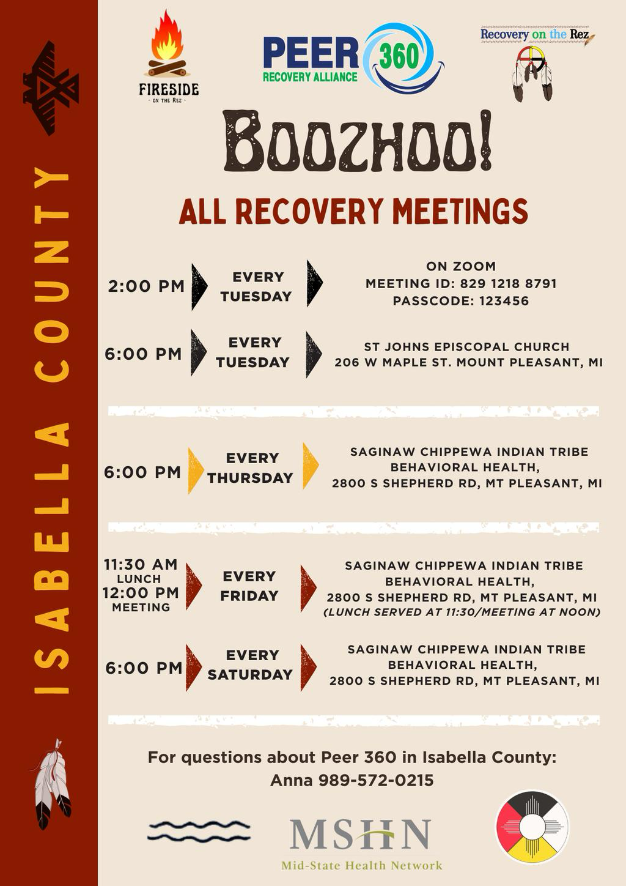
Peer 360: Recovery on the Rez — Cultural Innovation
Recovery on the Rez & Fireside on the Rez
Peer 360's culturally rooted recovery groups in Isabella County are held in a traditional lodge and led by Peer Recovery Coaches versed in Saginaw-Chippewa traditions, incorporating the 7 Grandfather Teachings and the Red Road to Wellbriety.
SCIT Pow-Wow Integration
Since 2021, Peer 360 has established a 'recovery safe space' campsite at the annual Saginaw Chippewa Indian Tribe Pow-Wow — the first of its kind — creating a trusted presence in a major cultural gathering.
LGBTQ+ Outreach
Peer 360 launched a multi-county virtual LGBTQ+ recovery group in partnership with Great Lakes Bay Pride (FY24/FY25), extending recovery supports to another historically underserved population.
Appendix 3: Peer 360 Isabella County

Slide 27

Next Steps:
Review LC Report - MSHN will send
Review Implementation Guide - MSHN will send
Seek Leadership’s Endorsement of equity-focused work
Identify agency “Champion” & Action Team
MSHN will schedule a meeting w. CEO/ED & identified champion(s) – MSHN will reach out
Together, we can explore community needs & agency needs for moving forward

Slide 28
Questions?

Slide 29
Treatment Breakout

Slide 30
Treatment Breakout Agenda
MDHHS 5515 Consent to Release Information
SUD Data Review
MDHHS- Plan of Safe Care
ASAM Criteria 4-Implementation Date
FY27 Annual Plans
Update on Workgroups/Task Team
Veteran Navigator updates

Slide 31
MDHHS 5515 Consent to Release Information
Kate Flavin
Treatment Administrator

Slide 32
MDHHS 5515 Consent to Release Information
Please ensure you are using the MDHHS-5515 Consent to Share Behavioral Health Information (Revised 9-25)
Available in Spanish and Arabic
FAQ Documents for Providers and for Consumers available on MDHHS's website
  https://www.michigan.gov/mdhhs/keep-mi-healthy/mentalhealth/behavioral/consent/michigan-behavioral-health-standard-consent-form
Please continue to direct all questions to Kim Zimmerman, Chief Compliance Officer
  Email: kim.zimmerman@midstatehealthnetwork.org

Slide 33
SUD Data Update
Joe Wager
Technology Project Manager

Slide 34
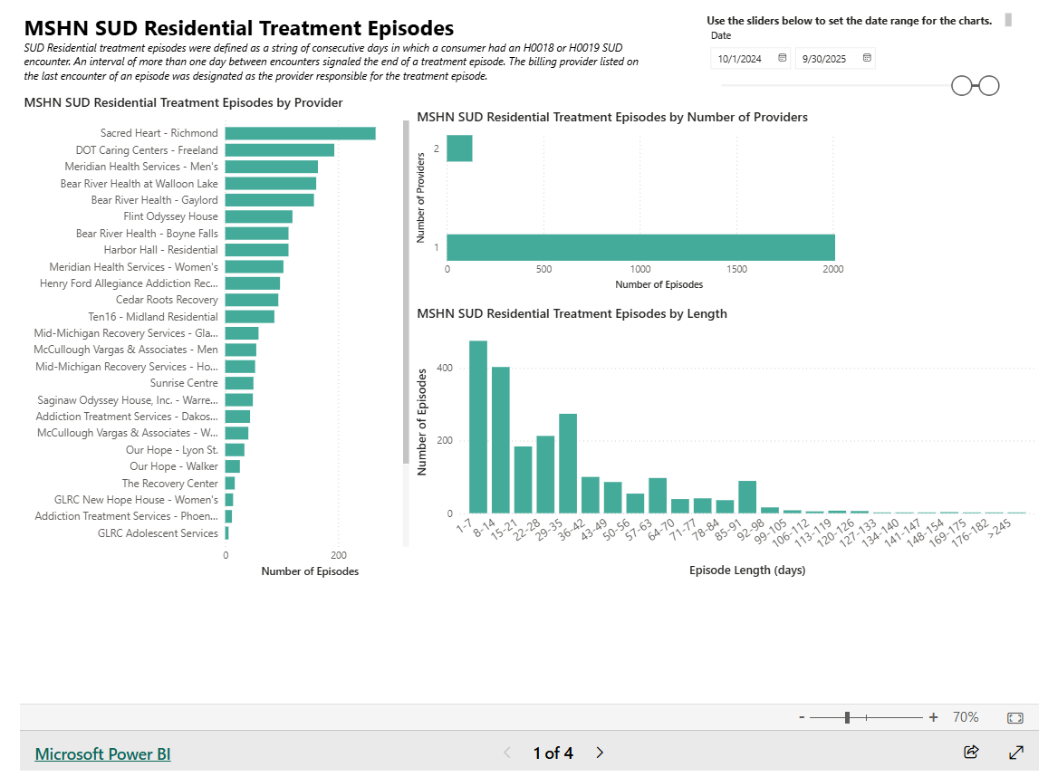
SUD Residential Readmission and Follow Up

Slide 35
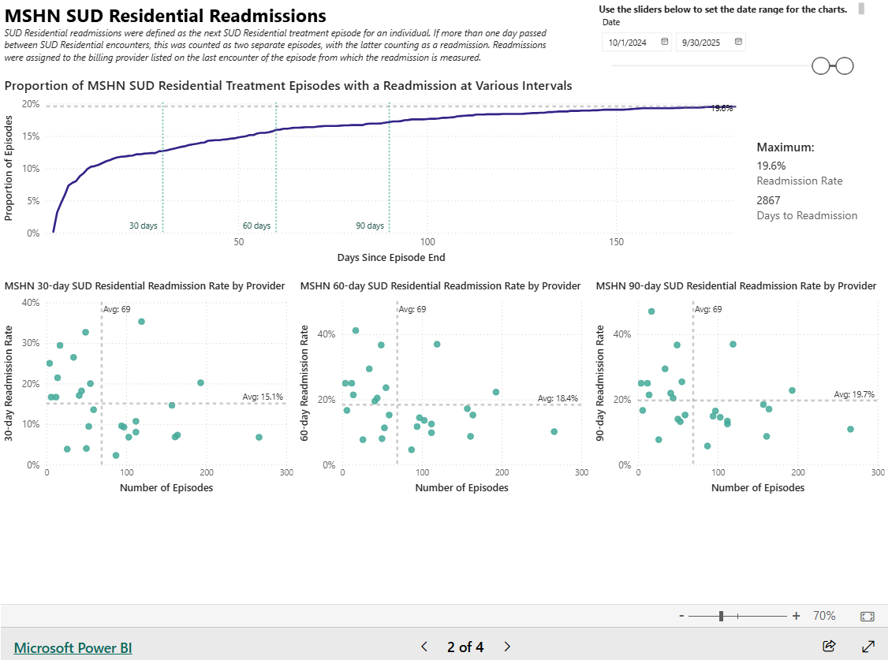
SUD Residential Readmission and Follow Up

Slide 36
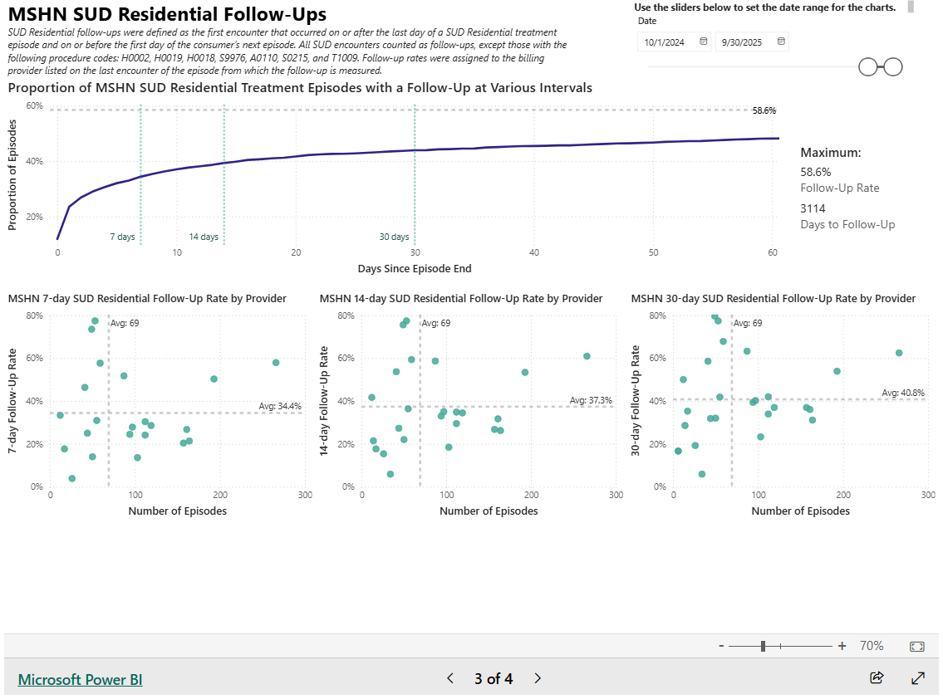
SUD Residential Readmission and Follow Up

Slide 37
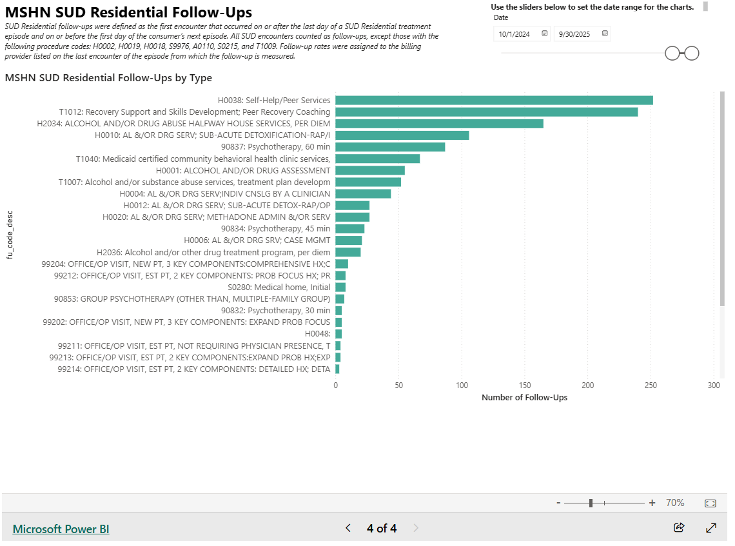
SUD Residential Readmission and Follow Up

Slide 38
Other Available Measures
SUD MMBPIS Indicator 4b
SUD Delegated Managed Care Review
SUD Withdrawal Management Readmission
AOD Initiation and Engagement
Primary Drug at SUD Admission

Slide 39
Questions?
Please contact Joseph Wager with any questions:
joseph.wager@midstatehealthnetwork.org

Slide 40
MDHHS - Plan of Safe Care
Kate Flavin
Treatment Administrator

Slide 41
MDHHS-Plan of Safe Care
What is it?
  A Plan of Safe Care (POSC) is a personalized tool to support pregnant and parenting people impacted by substance use, their infants, and any other household members. A POSC focuses on family strengths, healthy pregnancies and keeping families safely together.
  Plan of Safe Care
    MDHHS-6182, My Plan of Safe Care
    Community_Driven_Plan_of_Safe_Care.pdf
What comes next?
  Currently, MSHN is working with MDHHS and other PIHPs to gather more information regarding training and data collection. MSHN will continue to provide updates as we have them. For now, there is nothing providers need to do.

Slide 42
Questions?
Please contact Kate Flavin with any questions:
kathrine.flavin@midstatehealthnetwork.org

Slide 43
ASAM Criteria 4 Implementation Update
Trisha Thrush, PhD, LMSW
Director of SUD Services & Operations

Slide 44
ASAM Criteria 4 Implementation Update
ASAM Continuum Update
  Beta testing has been extended. Outpatient providers have been added.
  Roll out of the updated version is unknown.
MiCAL System Update for ASAM Designations
  In progress
MDHHS will maintain levels of care for:
  0.5 Early Intervention
  3.2 WM
  3.7 WM
MDHHS still plans for full implementation by 10-1-2026 for FY27

Slide 45
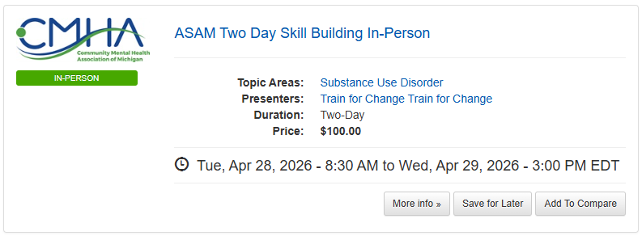
ASAM Criteria 4 Implementation Update
ASAM Criteria 4 Training
  Community Mental Health Association of Michigan
    ASAM Two Day Skill Building In-Person

Slide 46
Questions?

Slide 47
FY27 Annual Plans
Kate Flavin
Treatment Administrator

Slide 48
Process
  The agency’s lead treatment specialist will reach out and provide FY27 annual plan documents and information individualized to each agency.
  Meetings will be completed virtually using the Zoom platform.
  MSHN is requesting providers review prior to the scheduled meeting date/time.
  Please ensure agency staff who are knowledgeable about annual plan topics are in attendance for the annual plan meeting.

Slide 49
Timeframe
  March
    Provider will receive an email with link to Box with FY27 annual plan documents and request dates and times they are available to meet.
    Treatment Specialist will schedule annual plan meeting and provide a Zoom meeting invite.
  April & May
    Annual Plan meetings will take place. Plan for 60-90 minutes for this interaction.
    Annual Plans will be finalized in Box for each provider.
    All Cost Reimbursed providers should have their finance/budget person review the April 2025 Lunch & Learn on Budget Preparation.

Slide 50
Timeframe Continued
  June
    Cost Reimbursed budget requests are due by COB 6/1/2026.
    Please email budgets to Trisha Thrush at trisha.thrush@midstatehealthnetwork.org
    Please submit budget(s) early if they are prepared.
    Cost reimbursed budgets will be reviewed.
    Questions regarding the budgets will be shared with the provider.
  July
    Treatment Team makes FY27 contract recommendations.

Slide 51
Timeframe Continued
    August
      FY27 contract recommendations supported by PA2 funding go before Oversight Policy Board (OPB) for review and approval/denial.
      Items approved will move to MSHN Board of Directors (BOD) for final review of approval/denial.
      September
        FY27 contract recommendations go before MSHN Board of Directors (BOD)
        If approved, MSHN will send contracts to providers.
        If denied, MSHN treatment specialist would be in contact and follow-up.

Slide 52
Questions?

Slide 53
Update on MSHN Workgroups & Task Team
Kate Flavin
Treatment Administrator

Slide 54
Update on MSHN Workgroups &
Task Team
Due to a continued trend of limited agenda items and cancelled meetings, MSHN Treatment team has made the decision to pause the remaining workgroups and task team meetings for Outpatient/MAT, Women's Task Team and Residential/WM for the remainder of FY26.
MSHN will evaluate the need to resume meetings in FY27
If you have any questions or needs that would have been addressed in a workgroup meeting, please reach out to you lead treatment specialist.

Slide 55
Questions?

Slide 56
Veteran Navigator Updates
Tammy Foster
Veteran Navigator

Slide 57
Veteran Navigator
VA Healthcare & Treatment Access
VA Healthcare ≠ VA insurance
Not all veterans are eligible and/or enrolled in VA Healthcare
Important to know:
VA does not provide detox
VA SUD programs can often have long wait times
Medicaid provider may be the fastest path to SUD treatment
Jesse house (sober living/homeless veterans): VA Healthcare connected veterans
Notes:
AMANDA
These are arranged by strengths and weaknesses (internal-looking), threats and opportunities (external-looking).
viewed as a highly collaborative in region and with external partners, and a statewide leader in reciprocity. MSHN is known to “listen” to the needs of region and incorporate network feedback into services and operations. MSHN is a trailblazer in new state waiver initiatives, for example: HCBS, Autism, Influence, leading to systems change. MSHN has operationalized innovation when developing programs like the Mobile Care Unit.

Slide 58
Veteran Navigator
MSHN Veteran Navigator Role
Help veteran/SUD provider determine VA vs Medicaid provider for treatment
Connect to housing, food and basic needs
Liaison with Veterans Affairs (VA) programs
COMPACT Act:
Comprehensive Access to Care and Treatment: Applies to acute suicide crisis
QUESTIONS?
Scan QR code for MSHN VN page
Tammy Foster
tammy.foster@midstatehealthnetwork.org
517-483-2742
Notes:
AMANDA
These are arranged by strengths and weaknesses (internal-looking), threats and opportunities (external-looking).
viewed as a highly collaborative in region and with external partners, and a statewide leader in reciprocity. MSHN is known to “listen” to the needs of region and incorporate network feedback into services and operations. MSHN is a trailblazer in new state waiver initiatives, for example: HCBS, Autism, Influence, leading to systems change. MSHN has operationalized innovation when developing programs like the Mobile Care Unit.

Slide 59
Upcoming Quarterly SUD Provider Meetings
June 18, 2026
September 17, 2026
MSHN SUD Provider Meeting Agenda's & Recordings can be found on the MSHN website: SUD Provider Meetings - Mid-State Health Network

Slide 60
Prevention Breakout

Slide 61
Quarterly SUD Provider Meeting
Prevention Breakout
March 19, 2026
MPDS Update
FY27 Annual Plans
FY26 Additional Hours Report Reminder
Prevention Conference Update
Notes:
AMANDA
These are arranged by strengths and weaknesses (internal-looking), threats and opportunities (external-looking).
viewed as a highly collaborative in region and with external partners, and a statewide leader in reciprocity. MSHN is known to “listen” to the needs of region and incorporate network feedback into services and operations. MSHN is a trailblazer in new state waiver initiatives, for example: HCBS, Autism, Influence, leading to systems change. MSHN has operationalized innovation when developing programs like the Mobile Care Unit.

Slide 62
MPDS Update
MSHN staff available to meet with your staff over Zoom to offer assistance as needed
Data from October 1 to present should be entered by May 31
Spreadsheets will need to be completed and turned in by the 10th of each month until the reporting features are available
For new staff, reach out to your MSHN staff person before requesting MPDS access on by sending us the Activation and Deactivation form
  We need to be able to let MDHHS staff know to expect and approve your registration
Any technical issues with MPDS should be reported to the MPDS email at mdhhs-mpds@michigan.gov
Questions?
Notes:
AMANDA
These are arranged by strengths and weaknesses (internal-looking), threats and opportunities (external-looking).

Slide 63
FY27 Annual Plans
Plan templates will be sent out April 1 with a return date of June 1, 2026
The required Direct Service hours have been reduced for FY27
  500 hours per 1 FTE of Direct Service entered in MPDS
  AHR has been eliminated for FY27 and will not be required
Templates have changed to reflect your work and the corresponding MPDS field entries
Please use the template we send you and do not make additions or use a previous year template
Please do not convert these to pdf documents when you return them to us
Notes:
AMANDA
These are arranged by strengths and weaknesses (internal-looking), threats and opportunities (external-looking).

Slide 64
FTE Direct Service Hour Requirements
New number of hours required for full and partially funded FTEs.
FTE: | 1 | .75 | .5 | .25 | .1
Direct Hours: | 500 | 375 | 250 | 125 | 50

Slide 65
FY27 Annual Plans
Budgets may have necessary and appropriate increases related to programming/wages, but increases are not guaranteed at this point
Budget Preparation Video
  Video can be found here on our website
Notes:
AMANDA
These are arranged by strengths and weaknesses (internal-looking), threats and opportunities (external-looking).

Slide 66
FY26 Additional Hours Report (AHR)
First half of the year is due 4/10/26 to your MSHN Prevention Specialist
The AHR collects indirect hours
  Conferences, trainings, half of your travel time, coalition prep, etc.
  Does NOT include staff meetings or non-MSHN funded activity
  Does NOT include MPDS entry time
  Details of what can be included are on the second tab- Report Instructions
Notes:
AMANDA
These are arranged by strengths and weaknesses (internal-looking), threats and opportunities (external-looking).

Slide 67
Prevention Conference Update
Get ready for a Prevention Palooza May 6-7 in Frankenmuth!
Registration was sent out on March 3
Open to MSHN-region providers and coalition members
Notes:
AMANDA
These are arranged by strengths and weaknesses (internal-looking), threats and opportunities (external-looking).

Slide 68
Questions?
cari.patrick@midstatehealthnetwork.org
sarah.surna@midstatehealthnetwork.org
sarah.andreotti@midstatehealthnetwork.org
Notes:
AMANDA
These are arranged by strengths and weaknesses (internal-looking), threats and opportunities (external-looking).

