Slide 1

OPEN Warmline:
A Same-Day Buprenorphine Bridge Clinic
December 2025
Brittenee Simpson

Slide 2

Same-day Telehealth Buprenorphine Prescribing
About the Warmline
Funded by MDHHS through SOR Funds
Telehealth appointments with video or audio-only
Same-day buprenorphine treatment for people with opioid use disorder (OUD)
Link patients to a long-term treatment provider
Currently in pilot phase and advertising the number to recently released individuals and individuals who have a wait time with a contracted PIHP provider
No callers are turned away

Slide 3

Same-Day Telehealth Buprenorphine Prescribing
Clinic Information
Open Monday through Friday.
Appointments available from 9am- 4:30pm. The Warmline is closed during lunch, 12pm-1pm.
Website: openwarmline.org

Slide 4

Same-Day Telehealth Buprenorphine Prescribing
Who Can Access the Warmline?
Physical location in the State of Michigan with access to a phone
Interested in buprenorphine for OUD
Ability to provide e-signature on Opioid Start Talking Form
Insured or uninsured individuals
  Financial assistance provided in absence of insurance

Slide 5
Warmline Clinic Model

Slide 6


The Warmline Clinic Model
Our Team [OPEN + Packard Health]
Collaborative care team of behavioral health and medical staff:
  Prescribing providers
  Licensed behavioral health clinicians
  Nurse care manager
  Peer recovery coach

Slide 7
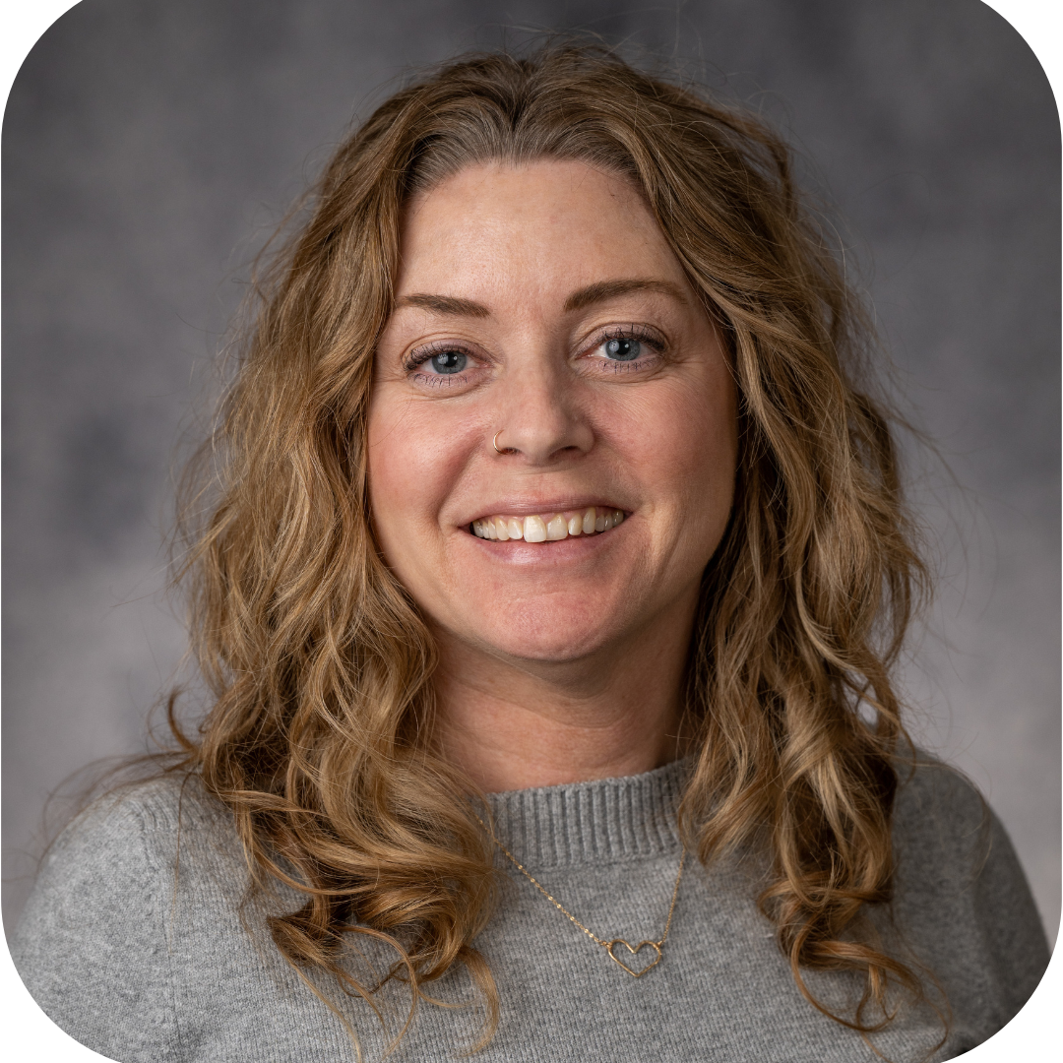
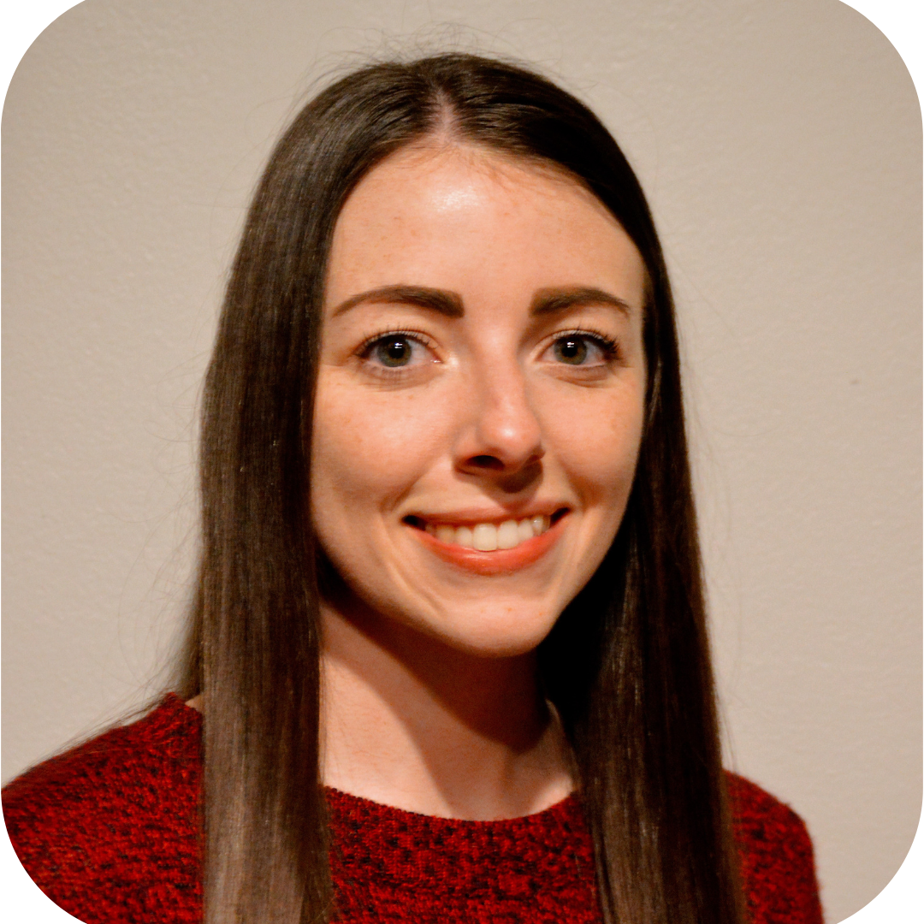
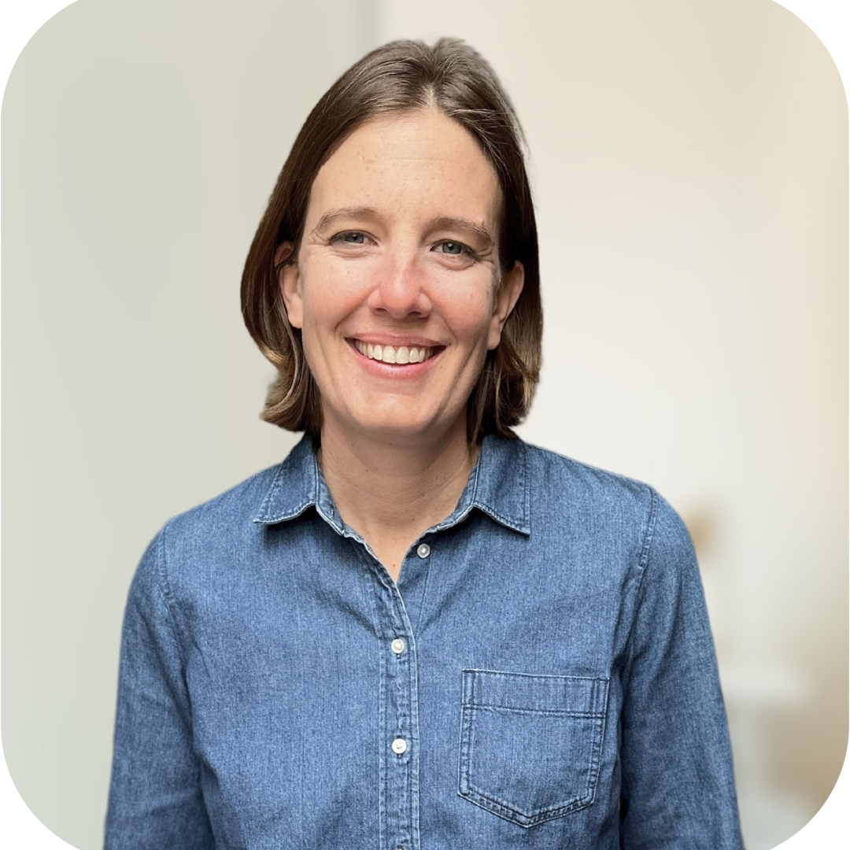


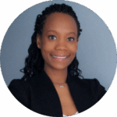
The Warmline Care Team
Melissa DeMarse, LPC, CAADC
Madison, Hille LMSW, CAADC
Allison Gorine, LMSW
Ciara Gray-Walker, RN
Thomas Jones, Peer Recovery Coach
Brittenee Simpson, Warmline Manager

Slide 8
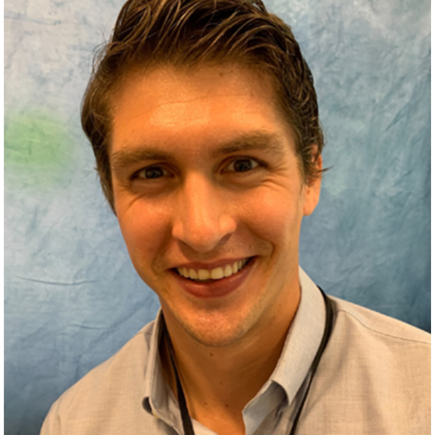
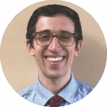
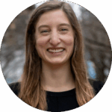

The Warmline Prescribing Providers
Brian Desmond, MD
Prescriber
Dan Oram, MD, Prescriber
Danielle Dubois, PA-C, Prescriber
Amanda Hartwell, FNP, Prescriber

Slide 9
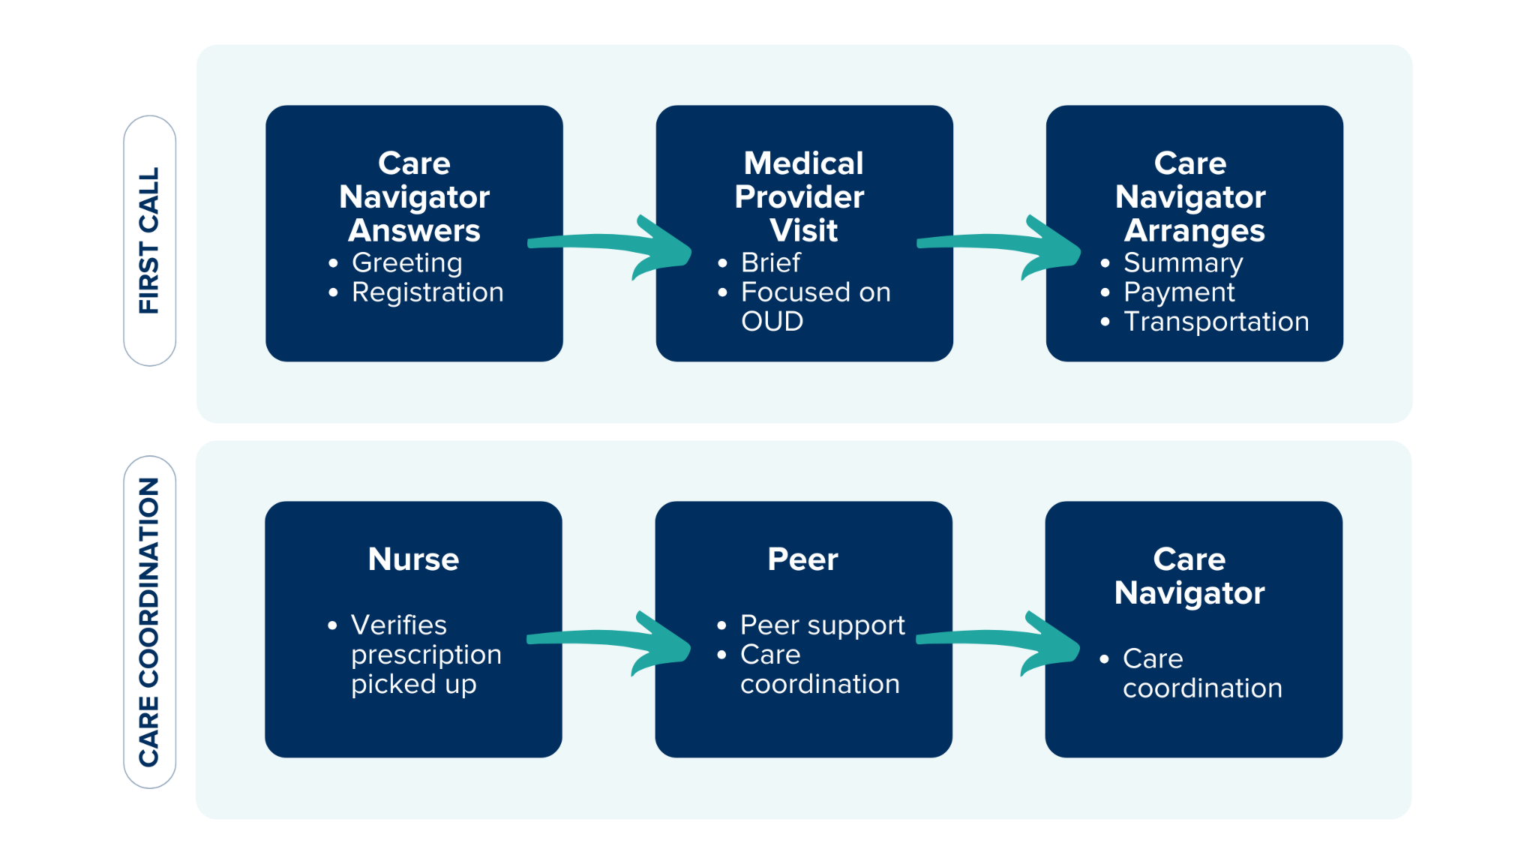
Warmline Care Model

Slide 10
OPEN Warmline Pilot

Slide 11
Pilot Timeline
September
2025
October
2025
Late 2025 /
Early 2026
Individuals with MDOC involvement (releasing, on probation or parole)
Individuals with wait times for MOUD via PIHP
24 jails participating in MDHHS-funded MOUD Jail Collaborative
Several individual providers
All remaining Michigan jails
Emergency Departments
Post-overdose response teams

Slide 12
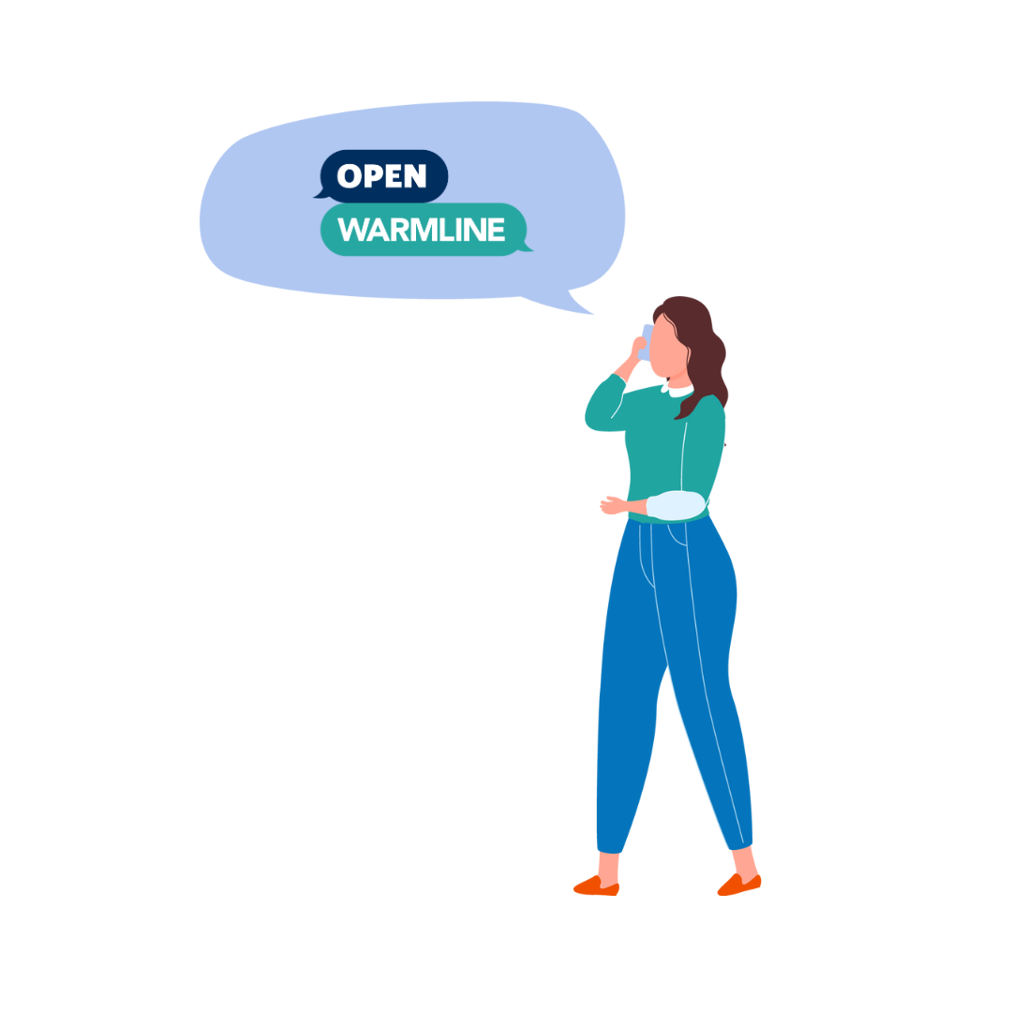
8 Weeks Into the Pilot:
Patients Served
50 patients assessed by a Warmline provider
23 patients looking for bridge prescriptions, with long-term provider already identified.
27 patients looking for bridge prescriptions and needing warm-hand offs to ongoing care.
7 patients reporting to live in MSHN PIHP Region

Slide 13


Thank You!
Openwarmline.org
Overdose Prevention Engagement Network
OPEN (Opioid Prescribing Engagement Network)

